Slide 1
VHC010-VHC011
The mini-industrial vacuums range compressed air drive

Slide 2
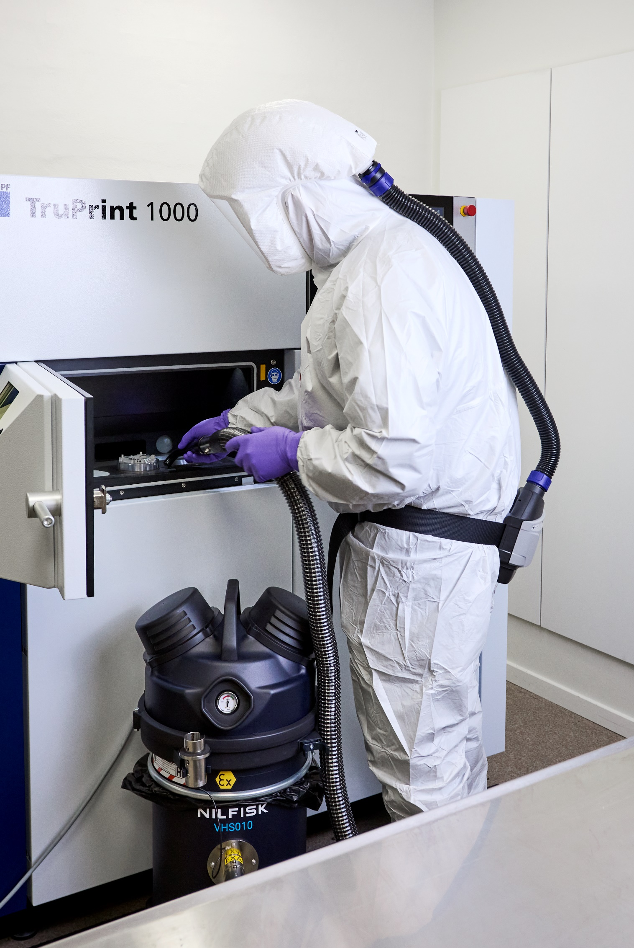
Agenda
1
Mini IVS range
and layouts
5
Marketing material
2
Jobs to be done
6
Technical specification
3
Key features
and benefits
7
Naming and hierarchy
4
Accessories
8
The corporate
responsibility

Slide 3
1
Mini IVS compressed air layouts

Slide 4
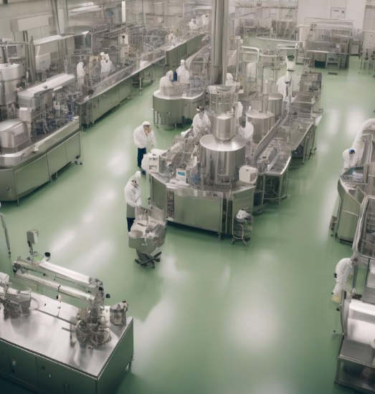
VHC010 / VHC011 Z1
Compressed air industrial vacuum cleaner
Compressed air driven industrial vacuum cleaner
An industrial vacuum powered by compressed air is a device used for cleaning and maintaining industrial environments. It operates by using a high-speed air stream, generated through an air compressor, to create powerful suction that collects dust, debris, liquids, and other materials.
Main applications
Compressed air is often preferred in environments where electricity could pose a risk or where it's necessary to handle flammable or combustible materials, as the use of compressed air eliminates the risk of electrical sparks. They are utilised in a variety of industries, including, electronic, pharmaceutical, additive manufacturing, and chemical industry, to keep workplaces clean and improve safety and operational efficiency.

Slide 5
Mini IVS
Range introduction
MEET NILFISK’S MINI INDUSTRIAL VACUUMS
Small but mighty
Maximum performance, safety, and flexibility. Minimum footprint.
Introduction
Mini-IVS is a platform of industrial vacuum cleaner of small and compact footprint. The range is designed for industrial application as alternative solution to the 400 mm platform, bigger machine VHC110 and VHC120, always compressed air driven.
Designed for dry collection of powders and fine powders or grains, combustible and or conductive and hazardous dusts.
Range key feature:
One layout with safe disposal – body 010
One layout with pull clean filter cleaning system without needs of consumable – body 011
Lightweight and robust, perfect solution for fast and frequent cleaning job also in narrow spaces or when the are obstacles on the floors or difficult places to reach
New dedicated range of industrial reduced footprint accessories, EXA

Slide 6
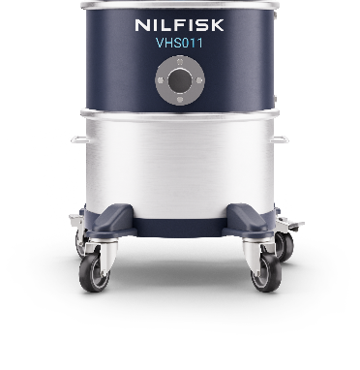
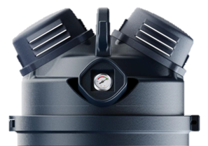
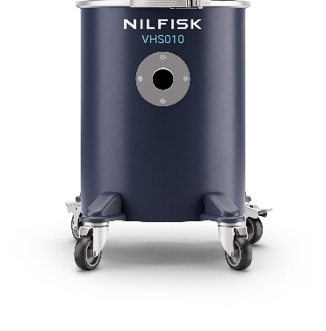
Mini IVS
Layout
Pull&Clean – body 011
Container 15 L with removable wheel-base
Optional Upstream HEPA14 filter (US included)
Suitable for combustible dust and ATEX
Suitable for hazardous dust
Body 011
VHC011 Z1 EXA
Pump enclosure
Safe disposal – body 010
Container 30 L
Configuration: bag filter + safety filter H14
Suitable for combustible dust and ATEX
Suitable for hazardous dusts
Body 010
VHC010 SBS Z1 EXA

Slide 7
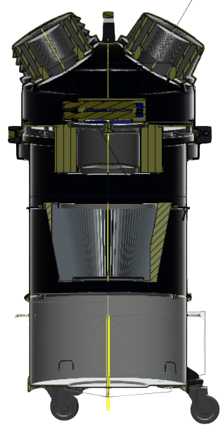
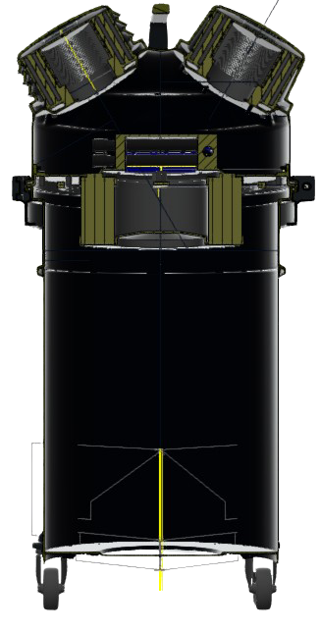
Product definition: compressed air architecture
Section view: flow schematic and architecture Z1/EXP models
E10
E10
VHC011 Z1 EXA
With conical cartridge
Class M and Pull&Clean™
*ULPA for stainless steel versions
E10
E10
VHC010 Z1 EXA
Safe disposal with:
Class M antistatic
fleece filter
H14 HEPA
H14 HEPA
VHC010 Z1 EXA DBS
Safe disposal with:
Class M antistatic
fleece filter + guillotine valve
MCLASS cartridge
MCLASS bag filter
Process air
VHC010 Z1 EXA SBS
Safe disposal with:
Safe bag system: SBS
Cleaned Process air
UP to 3 filtration stage
Always 3 filtration stage

Slide 8
2
Jobs to be done

Slide 9
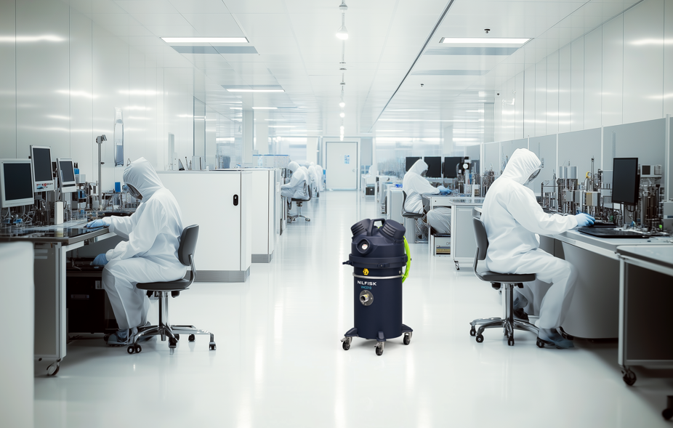
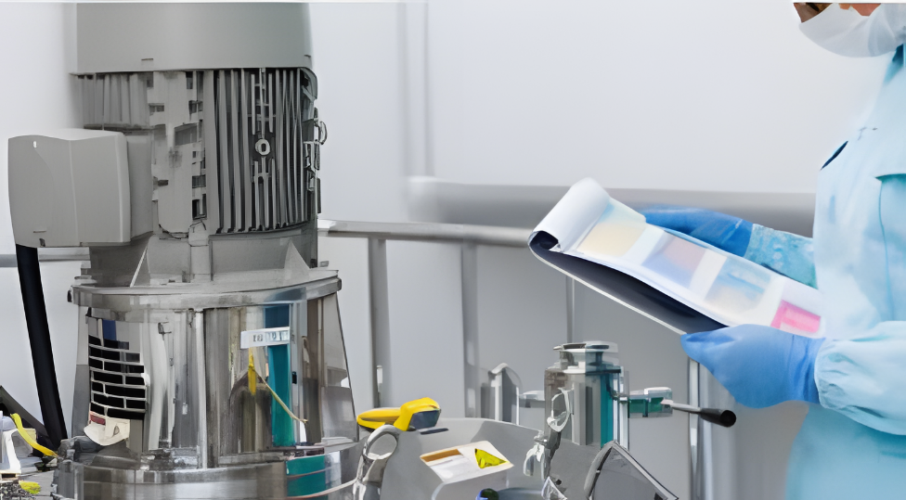
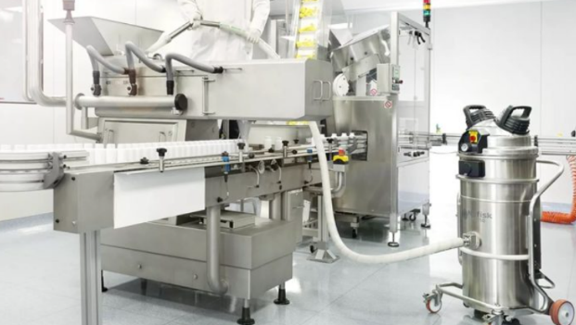
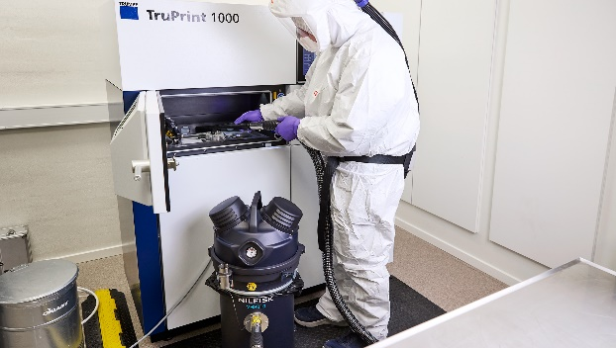
Focus segments and jobs to be done
Electronic
PCB production, components production
Typical cleaning job:
  Cleaning of work benches and working areas using existing pneumatic lines
  Cleaning of floors, and surfaces
Key features:
  No electrical parts
  Easy to connect to existing pneumatic distribution
  Avoid spark generation
Chemical Industry
Laboratories and production
Typical cleaning job:
  Collecting powders in environments with solvents, test batches…
  Cleaning of floors, desks, surfaces
Key features:
  For Z1 Atex zones and for combustible dusts
  Long life filter and no consumables
  Washable container
  Downstream ULPA filters option available
Pharma
Primary and secondary packaging
Typical cleaning job:
  Cleaning pharmaceutical process machines or process equipment
  Cleaning laboratories equipment
  in Z1 areas
Key features:
  Fully Stainless-steel body
  HEPA14 filtration
  Not contaminating working environment
  Downstream ULPA filters option available
AM industry
Production line, part of the process
Typical cleaning job:
  Collection and cleaning metal 3D printers, glove box, finished parts, emptying bins…
Key features:
  Certified for conductive combustible dust, safe with IP65 enclosure
  Safe bag system disposal
  Downstream ULPA filters option available

Slide 10
3
Key features and benefits

Slide 11
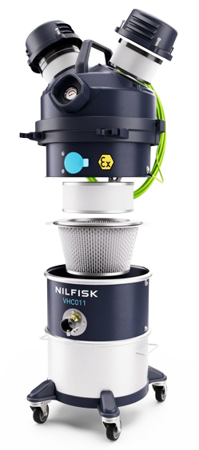
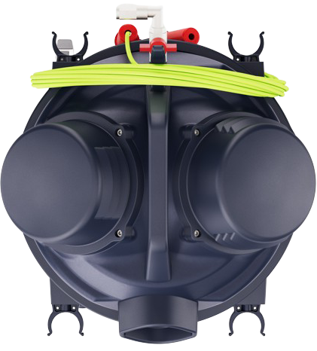
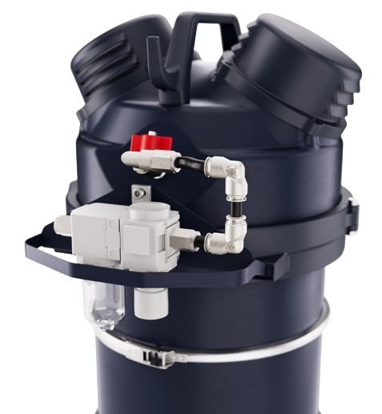
Key features and design
Handle with grounding cable holder
VHS011 Z22 EXA / C2D2
Air supply
Vacuum gauge for a constant monitoring of the performance and filtration efficiency
Free dust pump enclosure with optional downstream ULPA filter
Grounding clamp
Rounded shape for an easy cleaning of the overall surface
PullClean cleaning filter system, easy and efficient operation
Quiet – only 70 dB(A) level noise
High efficiency filters: M-Class (as standard);
PTFE or HEPA 14 upstream filter 99,995%
0.1-0.2 microns (as option) all filters are antistatic
Accessories holder
Easy and fast service: everything quickly accessible
Safe and mistake proof connection for certified ATEX accessories Ø40 EXA
Fully grounded and bonded, avoids electrostatic sparks, electrical hazard
Air manual valve
15 L removable container AISI304, easily washable thanks to removable wheel-base
Parking brake, stable also on slightly sloped
Protection bracket
High manoeuvrable thanks to
the 4 ball bearing pivoting wheels
Optional pressure regulator
Antistatic wheels

Slide 12
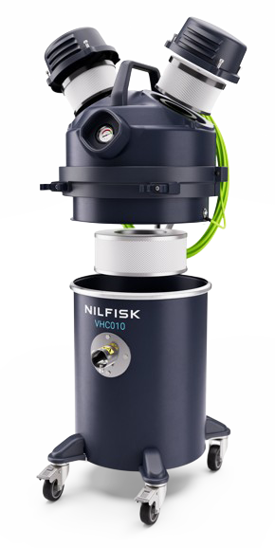
Key features and design
Handle with grounding cable holder
VHC010 Z1 / CID1
Air supply
Vacuum gauge for a constant monitoring of the performance and filtration efficiency
Free dust pump enclosure with optional downstream ULPA filter
Grounding clamp
HEPA 14 safety filter efficiency 99,995% 0.1-0.2 microns
Rounded shape for an easy cleaning of the overall surface
30 L externally painted AISI 304 container
Quiet – only 70 dB(A) level noise
Accessories holder
Safe and mistake proof connection for certified ATEX EXA accessories Ø40
Convenient and safe disposal system
Air manual valve
Fully grounded and bonded, avoids electrostatic sparks, electrical hazard
Parking brake, stable also on slightly sloped
Antistatic wheels
Protection bracket
High manoeuvrable, container
with 4 ball bearing pivoting wheels
Optional pressure regulator kit

Slide 13
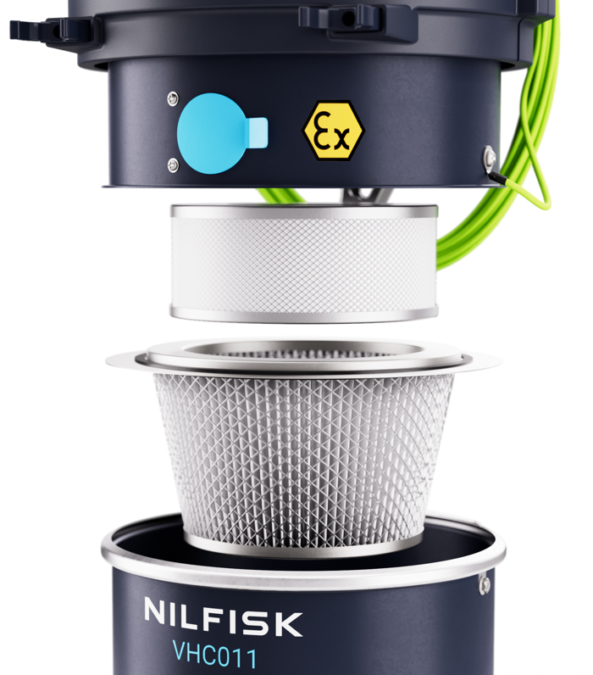
PullClean
VHC011 Z1 EXA
Efficient filter cleaning
Description
Pull clean filter cleaning system is a manual system with which operator can easily clean the filter and keep high the efficiency of the vacuum cleaner
How it works
The cleaning of the filter is done with the inlet of the machine closed
Three rapid opening and closing of the blue flap create a counter impulsive flow into the filter that is in this way cleaned
Rapidly repeat the cleaning process for three times for the perfect cleaning of the filter
Value and benefit
Reduced maintenance
Stable performance make faster the cleaning job
Safe method of clean the filter without stop the suction

Slide 14
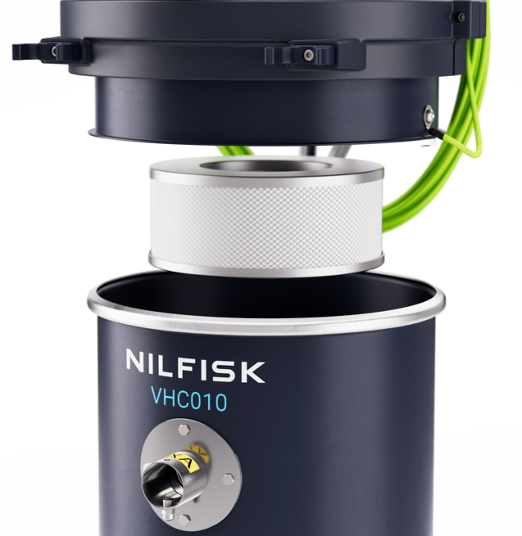
Safe bag system
VHC010 Z1 EXA SBS
No dust exposure
Description
SBS models are quipped with the safe bag system; this disposal system
allow to dispose the collected material without being in contact with the material itself
How it works
It is built with a CLASS M fleece filter and a special bag inlet with safety guillotine valve, externally protected by a conductive and resistant plastic bag
The bag filter safely collect the material, external plastic bag protects operator from the contact with the filtering bag during the disposal procedure
The guillotine valve, when manually closed, avoid any leakage of dust from the inlet of the safe bag system
Value and benefit
Perfect protection accordingly different types of hazardous dusts
Secondary protection with HEPA14 certified filter
Safe, easy and quick disposal system

Slide 15
4
Accessories and optionals

Slide 16
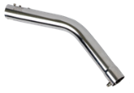
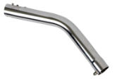
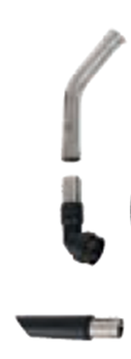

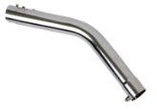

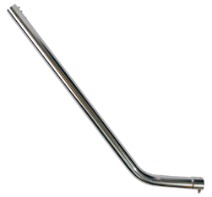
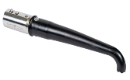


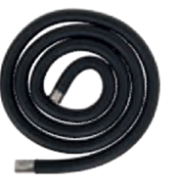
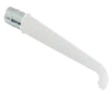

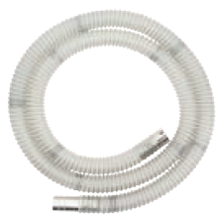
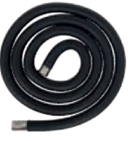


Mini IVS VHC010 Z1 & VHC011 Z1
EXA connection with PIN
EXA Ø40 mm accessories (also for IECEX and CID1)
EXA antistatic hose 3 m
EXA bent connection
EXA conductive cone
EXA antistatic hose 3 m polyurethan FDA
EXA bent connection AISI 304
EXA antistatic cone silicon transparent
EXA flat lance AISI 304 300 mm NEW
EXA silicon nozzle with D40-32 reduction
EXA antistatic hose 3 m,
EXA bent connection AISI 304
EXA AISI 304 antistatic cone
EXA AISI 304 flat lance 300 mm NEW
EXA AISI 304 antistatic round brush
EXA small handgrip (for bent connection) NEW
EXA AISI 304 mobile floor nozzle
300 mm NEW
EXA antistatic hose 3 m FDA,
EXA bent connection AISI 304
EXA conductive cone black
EXA flat lance AISI 304 300 mm NEW
EXA conductive nozzle Ø40-32
Basic Ø40 mm EXA (available also in combo version: CB)
4072400773
Machineries FDA Ø40 mm EXA
(complete) Ø40 mm
4072400822
General cleaning Ø40 mm
EXA
4072400824
Machineries conductive
Ø40 mm EXA (complete)
Ø40 mm
4072400823
2
2
4
2
7
5
5
2
4
4
5
6
3
1
1
3
1
3
1
3

Slide 17
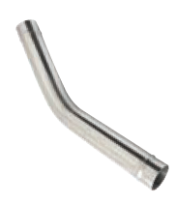

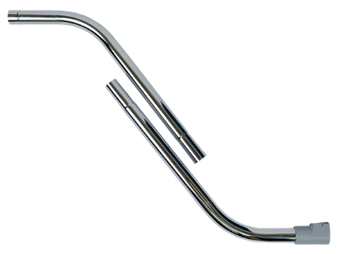



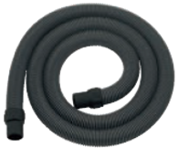

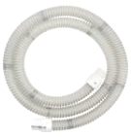



Mini IVS VHC010 & VHC011 combustible dust
ACD sleeve connection
ACD Ø40 mm accessories kits
Flex conductive hose 3 m + sleeves
AISI304 bent connection
Conductive cone
Basic ANTIST. Kit ACD Ø40
4072400825
Flex conductive hose 3 m + sleeves
AISI304 bent connection
Conductive cone
AISI 304 flat lance 300 mm NEW
Antistatic floor nozzle 300 mm NEW
AISI 304 small handgrip 2 parts NEW
Round antistatic brush
General kit ACD Ø40
4072400774
Antistatic FDA transparent hose 3 m + sleeves,
AISI 304 bent connection
Silicone Antistatic FDA Cone
Flat lance AISI 300 mm NEW
Reducer Ø40/Ø32 SS
Flexible nozzle autoclavable Ø32
Machineries FDA ACD kit Ø40
4072400826
2
5
2
6
5
6
3
3
2
1
1
3
1
4
7
4

Slide 18
Accessory holder
Parking position
Description
Four convenient and robust clips, two each side, useful to easily transport up to 4 end tools
How it works
When IVAC is parked, the accessories holder can easily keep the new small handgrip and floor nozzle
Disconnect hose from IVAC’s inlet and handgrip for an easiest positioning
Disconnect bulky accessories, as handgrip and floor nozzle, before moving the machines
Value and benefit
Accessories always nearby
Parking with minimum space occupation
Electric version represented

Slide 19
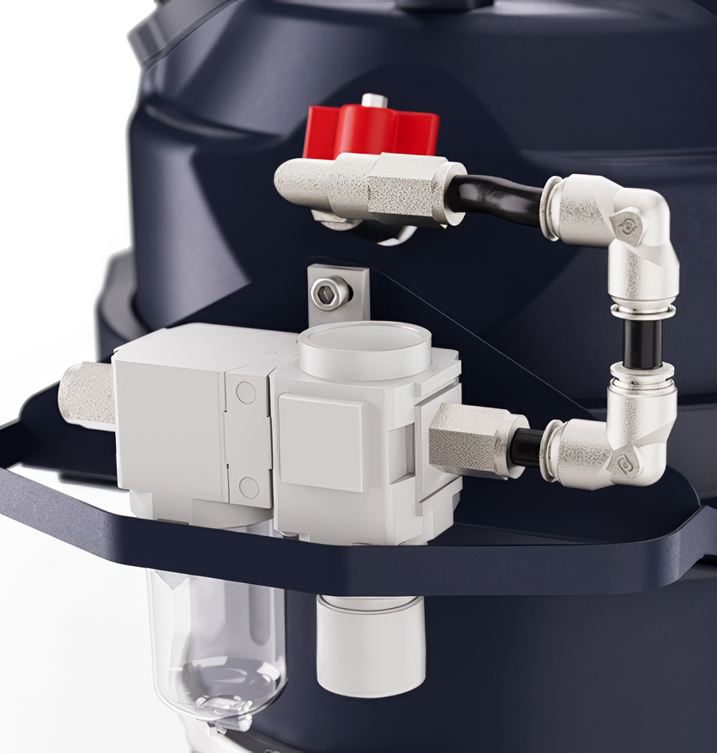
Product definition
New pressure regulator kit
Pressure regulator kit
Description
Optional pressure regulator kit can be easily installed using the screws of the accessory holder
How it works
Set the proper supply pressure reducing to the desired value (5-6 bar)
It grants always the maximum performance by taking under control the pressure loss of the supply line
It is suggested when IVAC is connected far from the main pneumatic
supply line
Value and benefit
It is small, compact and easy to install
It is ergonomic and well protected
It assures always the best performance

Slide 20
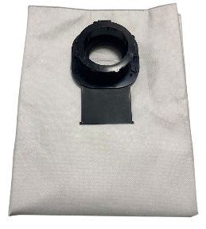
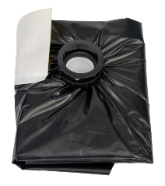

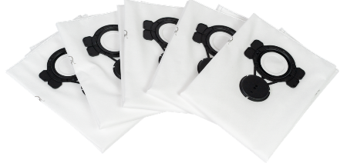
VHC010 Z1 EXA filters
Spare filter and bags filters for VHC010...
HEPA H14
4081701910
All versions of
VHS010
Standard
107419592
VHC010 Z1
5PC
Dust Bag System
4089101208
VHC010 Z1 DBS
5PC
Safe Bag System
4089101209
VHC010 Z1 SBS
5PC
HEPA14 spare filter: 4081701910 (only filter)
5 PC fleece filter: 107419592 (standard models)
5 PC fleece filter + guillotine valve 4089101208 (standard models only)
5 PC safe bag system: 4089101209 (SBS models only)
* Refer to user manual and spare part list for maintenance and spare kits

Slide 21
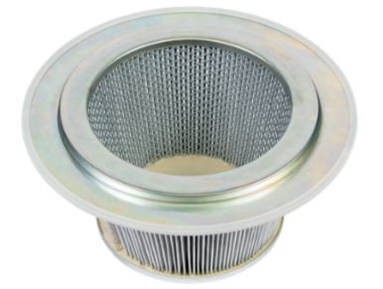
VHC011 Z1 EXA filters
VHS011 LC Z22 EXA / C2D2 and VHS011 LC ACD
HEPA H14
4081701910
Included in
VHC011 AU
versions
Standard
4081701855*
VHC011
HEPA14 spare filter: 4081701910
Primary Filter Cat. M: 4081701855
Primary Filter Cat. M PTFE: 4081701856
* Refer to user manual and spare part list for maintenance and spare kits

Slide 22
5
Marketing material

Slide 23
VHC010/011 – Dealer Package
You can find the Dealer Package on the
Dealer Portal
Brochure
Factsheet
Instructions for Use
Location Images
Main Data File
Sales Presentation
Spare Parts
Renders
Dealer package

Slide 24
6
Technical specification

Slide 25
Technical data EU-UK
Mini IVS compressed
Technical data | Unit | VHC010 Z1 EXA | VHC010 Z1 EXA SBS | VHC010 Z1 EXA 2X SBS | VHC011 Z1 EXA | VHC011 Z1 EXA AU | VHC011 Z1 EXA 3X
PN |  | 4061300042 | 4061300043 | 4061300044 | 4061300045 | 4061300046 | 4061300047
Air consumption | NL/min | 630 | 630 | 630 | 630 | 630 | 630
Feeding pressure | Bar | 6 | 6 | 6 | 6 | 6 | 6
Max airflow | L/min – m³/h | 2033 - 122 | 2033 - 122 | 2033 - 122 | 2033 - 122 | 2033 - 122 | 2033 - 122
Airflow with 3-meter hose | L/min – m³/h | 110 | 110 | 110 | 110 | 110 | 110
Vacuum max | kPa – mbar | 34 - 340 | 34 - 340 | 34 - 340 | 34 - 340 | 34 - 340 | 34 - 340
Ø Air supply hose external-internal | Mm | 12-10 | 12-10 | 12-10 | 12-10 | 12-10 | 12-10
Sound pressure level | dB(A) | 70 | 70 | 70 | 70 | 70 | 70
Container capacity | L | 30 | 30 | 30 | 15 | 15 | 15
Main filter type |  | Fleece M class | SBS | SBS | Cartridge M CLASS | Cartridge M CLASS | Cartridge M CLASS
Main filter area | cm² | – | – | – | 9000 | 9000 | 9000
Upstream HEPA filter H14 area | cm² | 12000 | 12000 | 12000 | – | 12000 | –
Inlet | mm | EXA 40 | EXA 40 | EXA 40 | EXA 40 | EXA 40 | EXA 40
Length x Width x Height | cm | 41x43x83 | 41x43x83 | 41x43x83 | 41x43x83 | 41x43x83 | 41x43x83
Weight | kg | 17 | 17 | 17 | 19 | 19 | 19

Slide 26
Technical data US
Mini IVS compressed
Technical data | Unit | VHC010 EXP SBS | VHC010 EXP 2X SBS | VHC011 EXP AU | VHC011 EXP AU 3X
PN |  | 4061300048 | 4061300049 | 4061300050 | 4061300051
Air consumption | NL/min | 630 | 630 | 630 | 630
Feeding pressure | Bar | 6 | 6 | 6 | 6
Max airflow | L/min – m³/h | 2033 - 122 | 2033 - 122 | 2033 - 122 | 2033 – 122
Airflow with 3-meter hose | L/min – m³/h | 110 | 110 | 110 | 110
Vacuum max | kPa – mbar | 34 - 340 | 34 - 340 | 34 - 340 | 34 – 340
Ø Air supply hose external-internal | Mm | 12-10 | 12-10 | 12-10 | 12-10
Sound pressure level | dB(A) | 70 | 70 | 70 | 70
Container capacity | L | 30 | 30 | 15 | 15
Main filter type |  | SBS | SBS | Cartridge M CLASS | Cartridge M CLASS
Main filter area | cm² | – | – | 9000. | 9000
Upstream HEPA filter H14 area | cm² | 12000 | 12000 | 12000 | 12000
Inlet | mm | EXA 40 | EXA 40 | EXA 40 | EXA 40
Length x Width x Height | cm | 41x43x83 | 41x43x83 | 41x43x83 | 41x43x83
Weight | kg | 17 | 17 | 19 | 19

Slide 27
7
Naming and product hierarchy

Slide 28
Naming and product hierarchy
L3 = Compressed air
L4 = VHC01 ATEX
L5 = VHC010 ATEX
L6: • VHC010 Z1 EXA
• VHC010 SBS Z1 EXA
L5 = VHC011 ATEX
L6: • VHC011 Z1 EXA
• VHC011 Z1 EXA AU
L5 = VHC010 EXP
L6: • VHC010 EXP
• VHC010 SBS EXP
L5 = VHC011 EXP
L6: • VHC011 EXP
• VHC011 EXP AU
VHC010 SBS Z1 EXA
C:
compressed air driven
0: Safe disposal
1: Pneumatic pump
Acronyms
0: 320 mm platform
VHC011 Z1 EXA
*L4 = VHC01
L5 = VHC010
L6: • VHC010 CD
• VHC010 CD SBS
L5 = VHC011
L6: • VHC011 CD
• VHC011 CD AU
C:
compressed air driven
1: Pull&Clean version
1: Pneumatic pump
Acronyms
0: 320 mm platform
* Non HazLoc/Atex model upon request

Slide 29
PNs and versions available at launch date
Model type | PN
4061300042 | VHC010 Z1 EXA | EU
4061300043 | VHC010 Z1 EXA SBS
4061300044 | VHC010 Z1 EXA 2X SBS
4061300045 | VHC011 Z1 EXA
4061300046 | VHC011 Z1 EXA AU
4061300047 | VHC011 Z1 EXA 3X
4061300048 | VHC010 EXP SBS | US
4061300049 | VHC010 EXP 2X SBS
4061300050 | VHC011 EXP AU
4061300051 | VHC011 EXP AU 3X

Slide 30
8
The corporate responsibility

Slide 31



The corporate responsibility
No emissions during production
Recyclable metal and parts
All the parts (except for the filters) are made of recyclable materials

