Slide 1
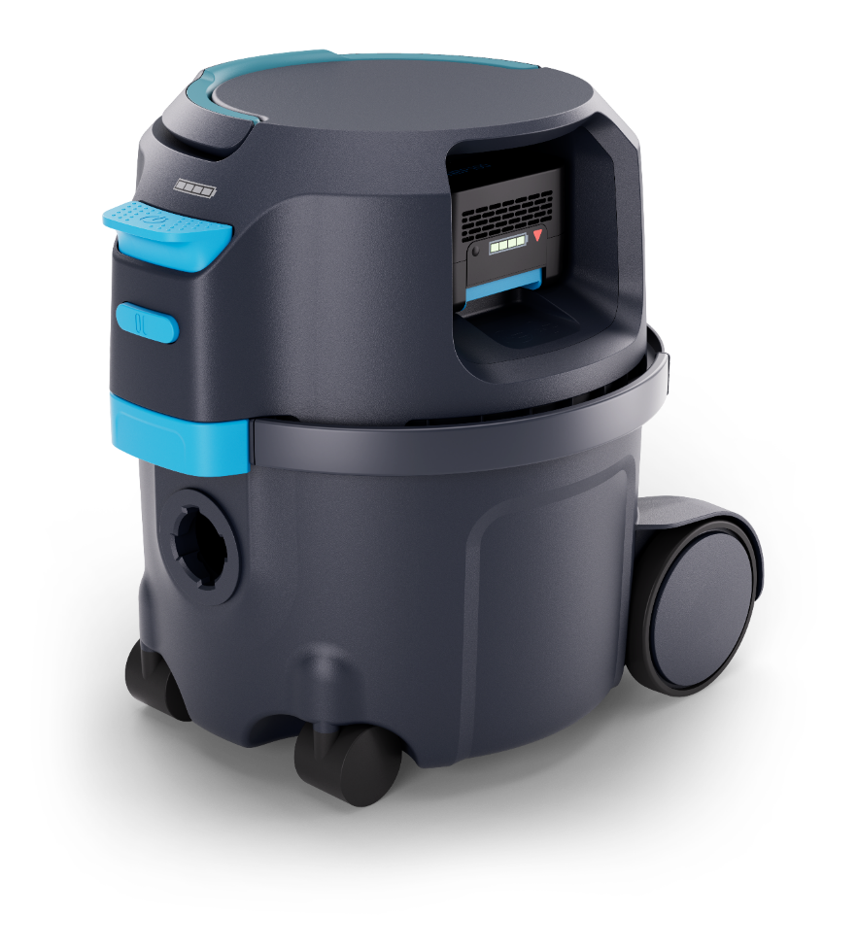
Nilfisk VP500 Commercial dry vacuum EXTERNAL sales presentation

Slide 2
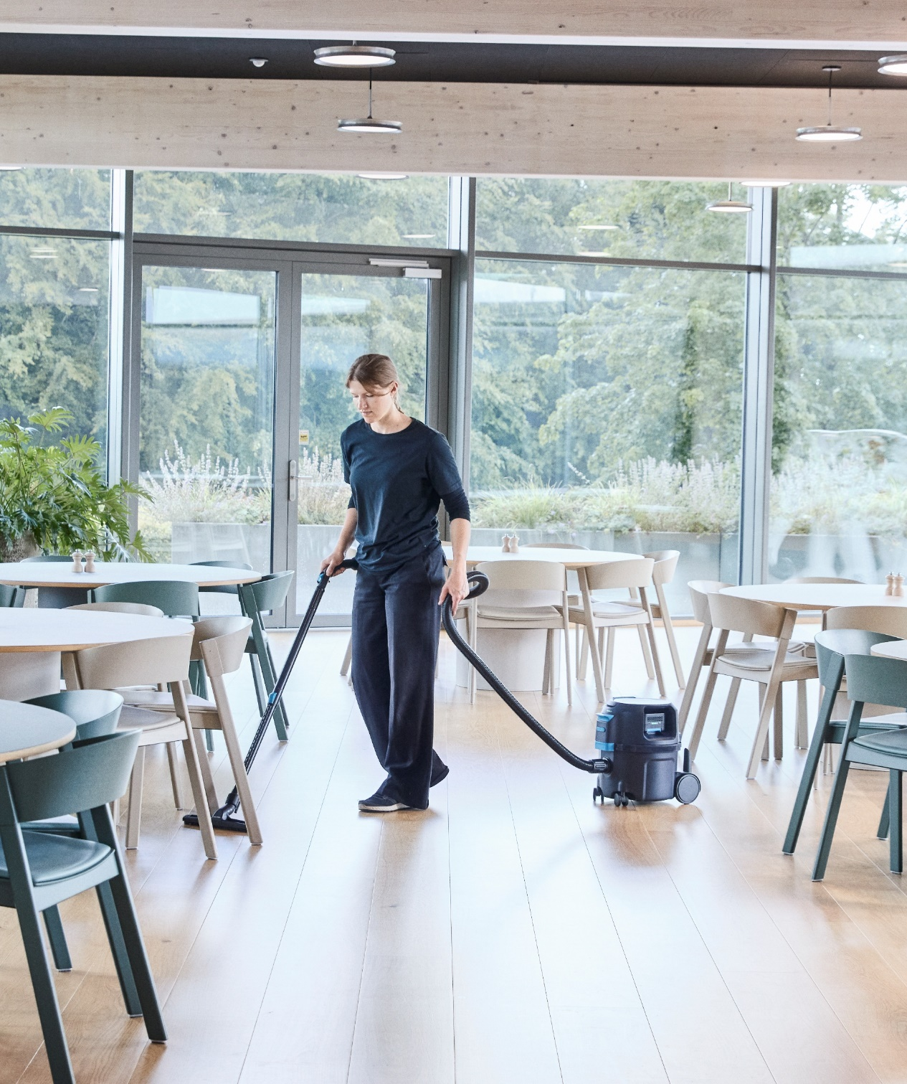
Agenda
1
Background
2
New battery vacuum
3
Key selling points
4
Other

Slide 3
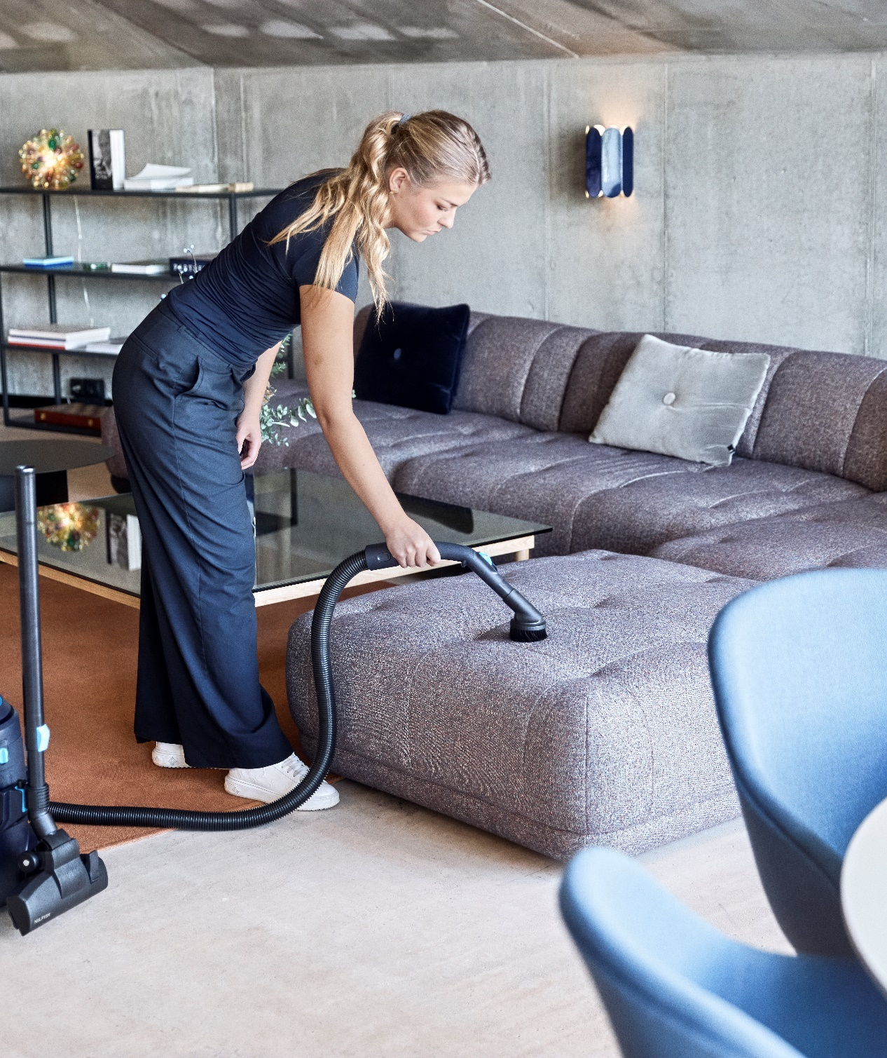
Agenda
1
Background
2
New battery vacuum
3
Key selling points
4
Other

Slide 4
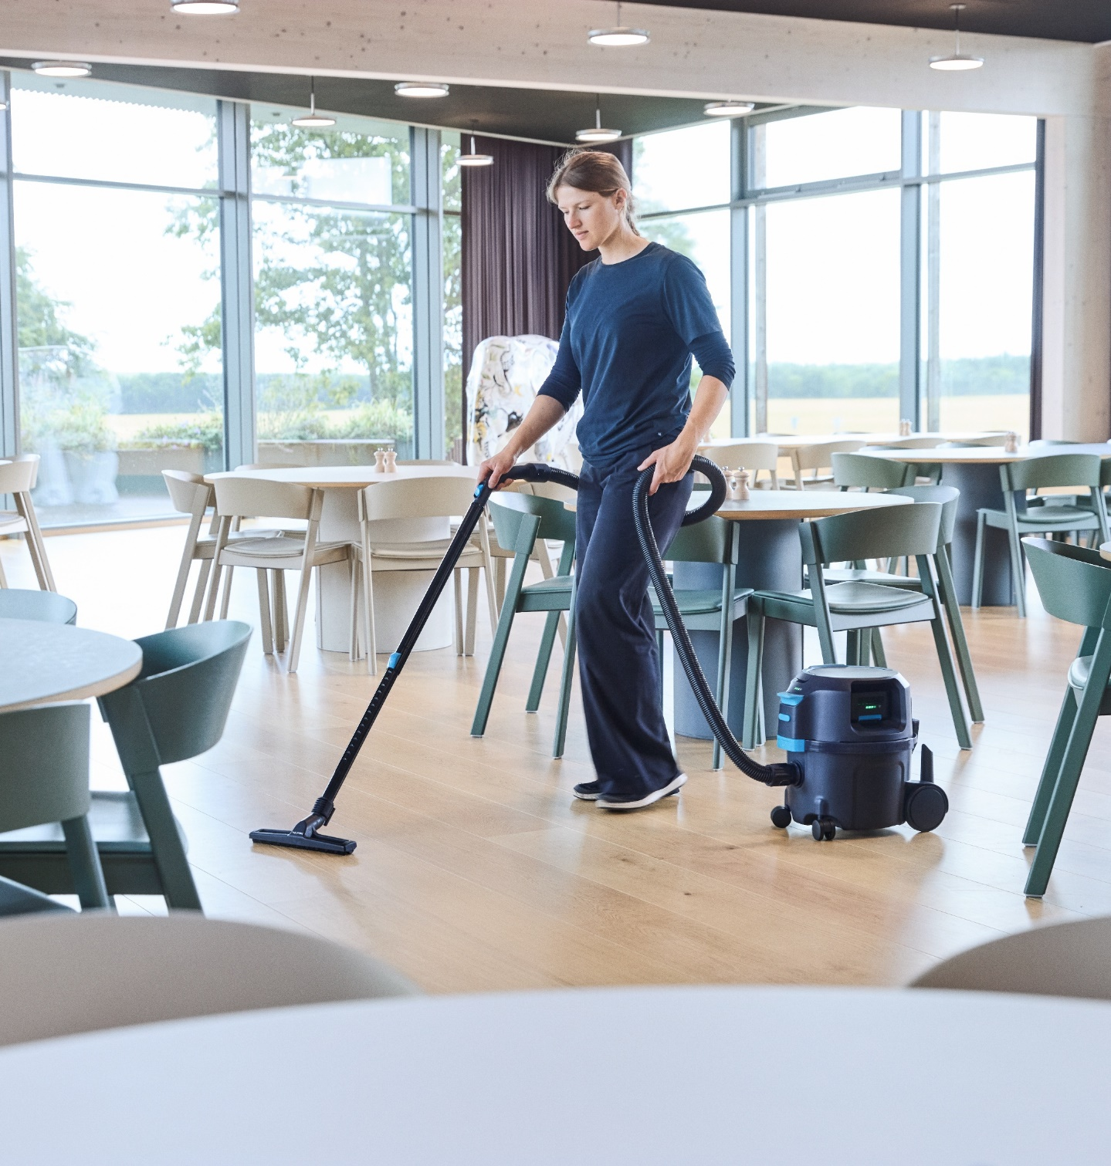
1 | Background
VP500
As a part of the second wave of the Compact Dry Vacuum portfolio renewal, an extension of the VP300 series and visual identity, hereby introducing the new Nilfisk VP500.
A cordless Commercial dry vacuum targeted to be a significant player within the battery-driven compact class. The previous unit of Nilfisk lacked on several parameters; cost, performance, size, weight – Here you’ll get game changing power combined with a base that provides a real competitive edge.
VP500
Freedom taken to another level – despite the battery and large practical filling capacity vs. size; it’s extremely compact and lightweight.
Among the most silent cordless vacuums in its class – yet the most efficient
Intuitive use with highlighted UI – live and quick battery level inspection (front of machine)
Fast charge enabled and hot-swap ready battery for continuous use
With this cordless phenomenon, it complements the Commercial vacuum range of Nilfisk compact dry vacuums remarkably well.

Slide 5

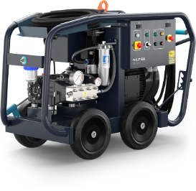
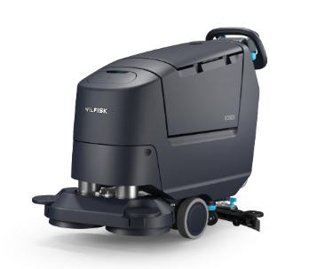
1 | Background – Brand & Design
NextGen professional colour strategy
Primary product body colour
This is the main product colour to be used on all major parts.
New professional (PBLS)
Product colours & ratios
Ergonomic / feature colour
A colour to highlight ergonomic areas (e.g. grip) and product specific features and USPs.
User touchpoint operational colour
Switches, buttons, caps, grips. Any part in this colour is meant for interaction when operating the machine effectively.
Safety / service colour
All parts in this colour indicate safety elements (e.g. charging cables, reverse buttons) and service points.
The new professional CMF palette has been extensively researched, developed and tested – it supports intuitive usability.

Slide 6
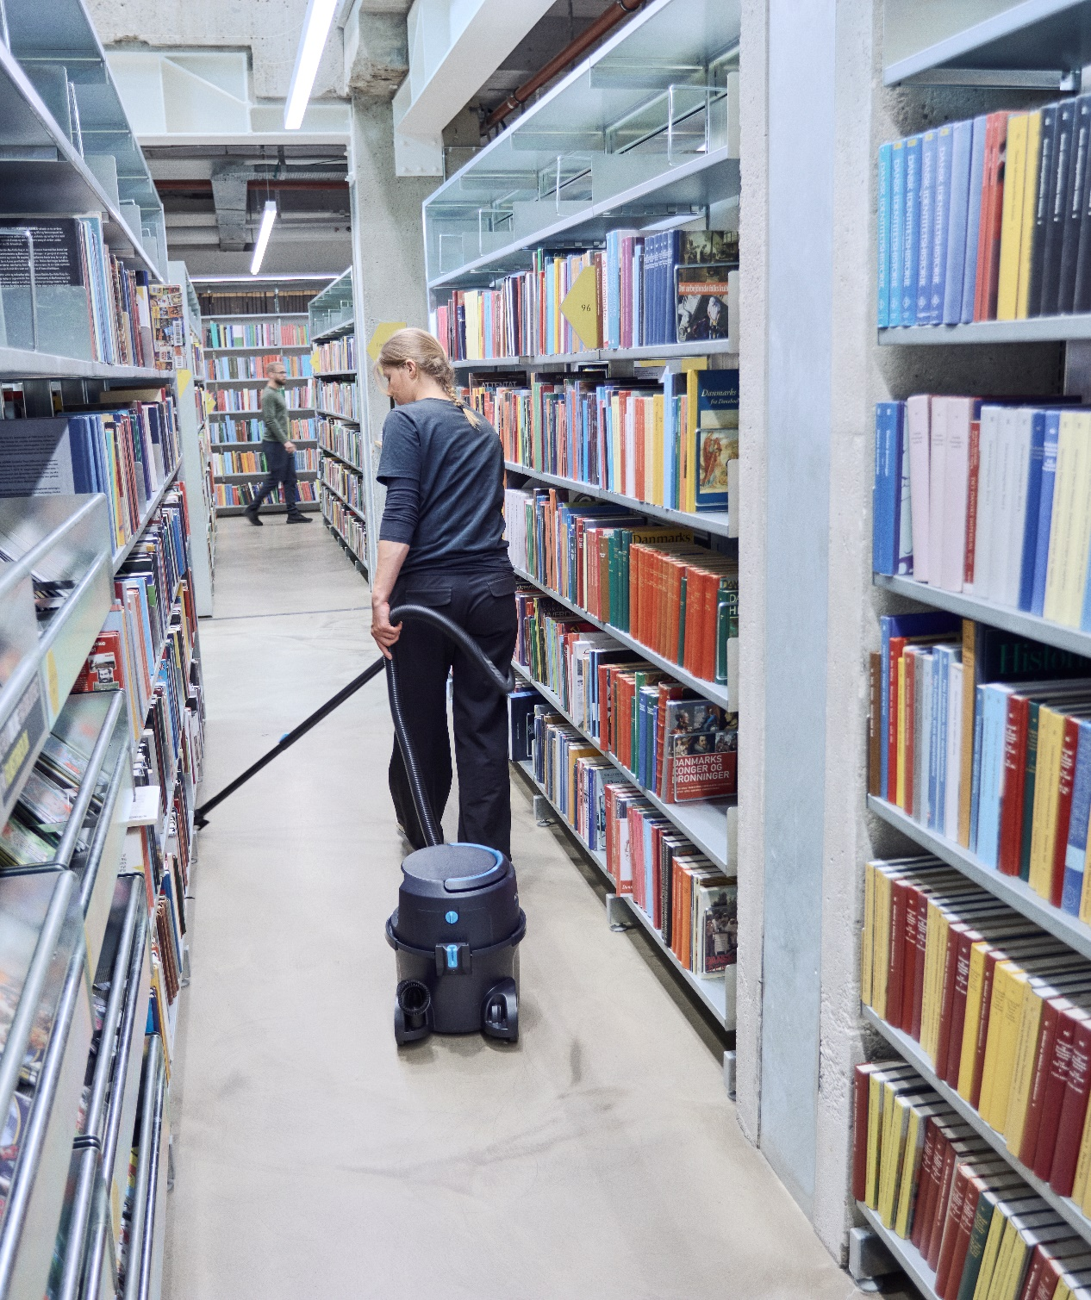
Agenda
1
Background & VP
2
New battery vacuum
3
Key selling points
4
Other

Slide 7

2 | New battery vacuum
VP500 highlights
Improved serviceability
Filter; easy access and NO tools
Performance/Efficiency/Durability
Improved cleaning performance despite of reducing energy consumption
Suction +50% on some parameters despite of reducing energy by -20%
→ whole structure, highly efficient brushless motor, sealings, accessories etc.
Among best sound levels in class
Reduced 4dB (official test standards)
Increased durability and possible daily use
Decent size prefilter and one of best net-filling capacities in-between cordless prof VACs
Enhanced UX/Convenience
Reduced weight – extraordinarily (3kg’s less incl. battery and machine vs VP600 B)
Compact footprint
Fast hot swap of battery – and highlighted touch points across
Ergonomic shaped touch points (Handle, bent-end, latch)
Durable large power switch
Icon and illustration guidance (battery areas, main filter door, prefilter etc)
Easy hose repair/replacement
Modernized design
Part of VP300 ‘series’
Improved packaging content (selling points)
Service/maintenance kits
Light (5x paper bags, 1x HEPA, 1x Motor filter)
Plus (20x paper bags, 1x HEPA, 1x Motor filter)
395 mm / 15.55 in
340 mm / 13.38 in
398 mm /
15.66 in

Slide 8
2 | New battery vacuum
Technical specs of VP500 range
 | Country variant |  |  |  | EU/UK
 | Item number |  |  |  | 107422302 | 107422316 | 107422320
 | Description | Note |  |  | VP500 R H BP EU/UK | VP500 R H BP+ EU/UK | VP500 R H 2BP EU/UK
Technical data
Voltage / Frequency | V/Hz |  |  |  | 36/50-60 | 36/50-60 | 36/50-60
Protection class / IP protection |  |  |  |  | II / IP20 | II / IP20 | II / IP20
Rated power | W |  |  |  | 500 | 500 | 500
Airflow (Max) | l/s |  |  |  | 40 | 40 | 40
Airflow (end of tube) | l/s |  |  |  | 29 | 29 | 29
Vacuum (at nozzle) | kPa |  |  |  | 21 | 21 | 21
Suction power (end of tube) | W |  |  |  | 190 | 190 | 190
Sound level 2m | dB(A) | Sound at working/operation position; 2m distance |  |  | 52 | 52 | 52
Sound pressure level @1m (IEC 60335-2-69) | dB(A) |  |  |  | 57 | 57 | 57
Run time up to NBP60 / NBP100 (Eco mode) | min |  |  |  | 55 / 90 | 55 / 90 | 55 / 90
Capacity | L |  |  |  | 10 | 10 | 10
Main filter type |  |  |  |  | HEPA 13 | HEPA 13 | HEPA 13
Main filter area | cm² |  |  |  | 2400 | 2400 | 2400
Weight (machine) | Kg | machine only |  |  | 5 | 5 | 5
Dimensions (LxWxH) | mm |  |  |  | 398x340x395 | 398x340x395 | 398x340x395
Features
Detachable cord
Cordless |  |  |  |  | I | I | I
HEPA filtration |  |  |  |  | I | I | I
Recycled material |  |  |  |  | I | I | I
Durable rewind system
Silent mode |  | (Dual speed) |  |  | I | I | I
Fast charge
Tube parking |  |  |  |  | I | I | I
Tool storage |  |  |  |  | I | I | I
Ergonomic handle |  |  |  |  | I | I | I
Ergo bent-end |  |  |  |  | I | I | I
Ergo+ bent-end |  | 2k/soft overmold
Dust bags |  |  |  |  | 1-P | 1-P | 1-P

Slide 9
2 | New battery vacuum
Configuration of VP500 range | How are the machines equipped
 | Country variant |  |  |  | EU/UK
 | Item number |  |  |  | 107422302 | 107422316 | 107422320
 | Description | Note |  |  | VP500 R H BP EU/UK | VP500 R H BP+ EU/UK | VP500 R H 2BP EU/UK
Accessories
Tubes
Extension tube steel D32 – Black | 140 8246 040
Extension tube aluminium – Black | 107421471
Telescopic tube aluminium – Black/Blue | 107421463 |  |  |  | I | I | I
Extension tube steel 450mm (short) | 140 8246 050
Hose & bent-end
Hose W connectors D32 | 107421449
Hose CPL W bent-end D32 | 107421450 |  |  |  | I | I | I
Hose CPL W bent-end PREM D32 | 107421451
Bent-end | 107421446
Bent-end PREM | 107421445
Floor nozzles
Multi surface nozzle | 140 6700 540 |  |  |  | I | I | I
Combi nozzle RD295P W.CLIP | 107417790
Combi nozzle RD295 | 140 8492 520
Combi nozzle RD277 | 107411677 |  |  |  | I | I | I
Combi nozzle JP | 107405141
Filters & bags
HEPA 13 filter | 147 1250 600 |  |  |  | I | I | I
HEPA 14 filter | 107421443
Standard filter | 107421444
Sack prefilter | 147 1432 500 |  |  |  | I | I | I
Motor filter | 147 0670 000 |  |  |  | I | I | I
Fleece dust bag 10-P | 82367820
Paper dust bag 5-P | 82367810
Paper dust bag 10-P | 140 8618 000
Reusable dust bag 1-P (cloth) | 22251800
Maintenance kit VP300/400/500/700 – Light | 107421454
Maintenance kit VP300/400/500/700 – Plus | 107421455
Other accessories
Round brush | 140 8244 500 |  |  |  | I | I | I
Crevice nozzle | 147 0146 500
Premium HF nozzle 350mm | 107413080
Premium HF nozzle 495mm | 107413081
Radiator crevice | 81530400
Battery & charger
NBP60 36V Li – 6Ah compact battery | 106479020 |  |  |  | I |  | I (x2)
NBP100 36V Li – 10Ah compact battery | 106479021 |  |  |  |  | I
NBC215 36V fast charger – W/O cord | 106476050 |  |  |  | I | I | I
Charger cord EU | 107424752 | 1m length |  |  | I | I | I
Charger cord UK | 107424753 | 1m length |  |  | I | I | I
Charger cord AU | 107424754 | 1m length
Charger cord CN | 107424755 | 1m length
Charger cord JP | 107424756 | 1m length
Charger cord US | 107424757 | 1m length

Slide 10
2 | New battery vacuum
Naming details in system
New Commercial Vacuum range
Compact Dry Vacuum
VP300 ‘Series’ Launch
VP300 (manual cord) Feb 2025
VP400 (handle cord rewind) Feb 2025
VP500 (battery)* Dec 2025
VP700 (manual cord) Dec 2025
Naming details* If not part of name
R Recycled material** Normal material
HEPA / H HEPA filtration (H13 or H14) Foam/Standard filter
Basic Fixed cord Detachable cord
X Xtra cord length (e.g. 15m) 10m cord
E Ext. aluminium tubes Ext steel tubes
T Telescopic alu tube Ext steel tubes
C Combi nozzle Multi surface nozzle
P Premium 2K bent-end Basic bent-end
S2 2-Speed function*
BP 6Ah battery+charger included
BP+ 10Ah battery+charger included
** Accessories and speed function not part of battery machine models marketing name (key focus on battery configuration), but dual speed visible on type plate name; All VP500s are standard 2-speed ** All VP500’s are recycled with same % as VP300 (38%)

Slide 11
Agenda
1
Background & VP
2
New battery vacuum
3
Key selling points
4
Other

Slide 12

3 | VP500 features
Old vs New (VP500 @upgrade = dark grey coloured area)
Feature | VP600 B | VP500 (New)
Machine bumper | • | •
Robust foot-operatable power switch | • | •
Tube parking position | • | •
HEPA filter | • | •
Accessories storage | • | •
Compact and Lightweight (smaller footprint and much lighter) |  | •
New light and compact battery series |  | •
Prefilter (durability and ensures performance longer (suction-filtration) |  | •
Tool-Free HEPA filter access/change |  | •
Live LED interface on machine (battery capacity) |  | •
Ergonomic handle + Ergo latch |  | •
Highlighted touchpoints |  | •
Commercial/professional appearance |  | •
Share multiple parts with VP300/400 |  | •
VP600 Battery
VP500

Slide 13
3 | VP500 features
Key selling points
Compact and light design
Lightweight Professional cordless vacuum – Among the lightest in class; agile and reducing strain
High performance – almost corded VAC level Powerful cordless cleaning; among the best in class
Low quality sound level
Best sound level of cordless compact VACs along with neat soft-start and ramp of speed modes – almost meditating
Battery – Battery Management System (BMS)
Protective bat. system controlling voltages, temperatures etc
Highlighted-coloured touch points
Intuitive UI ensures a seamless operation
LIVE battery level indicators
4 LEDs gives an immediate status just by looking back)
Certified HEPA filter
Quick, tool-free checks and replacements,
ensuring optimal air quality while saving time
Same interfaces across VACs
Bags, filters, accessories shared with VP300 series
Fast charging enabled and hot-swap for continuous uninterrupted use Fully charge down to only 60 min*
Cordless freedom and a small footprint
Keep cleaning with no limits – Enabling mobility and efficiency at new heights; ideal in confined spaces
* Approx 90% battery capacity

Slide 14
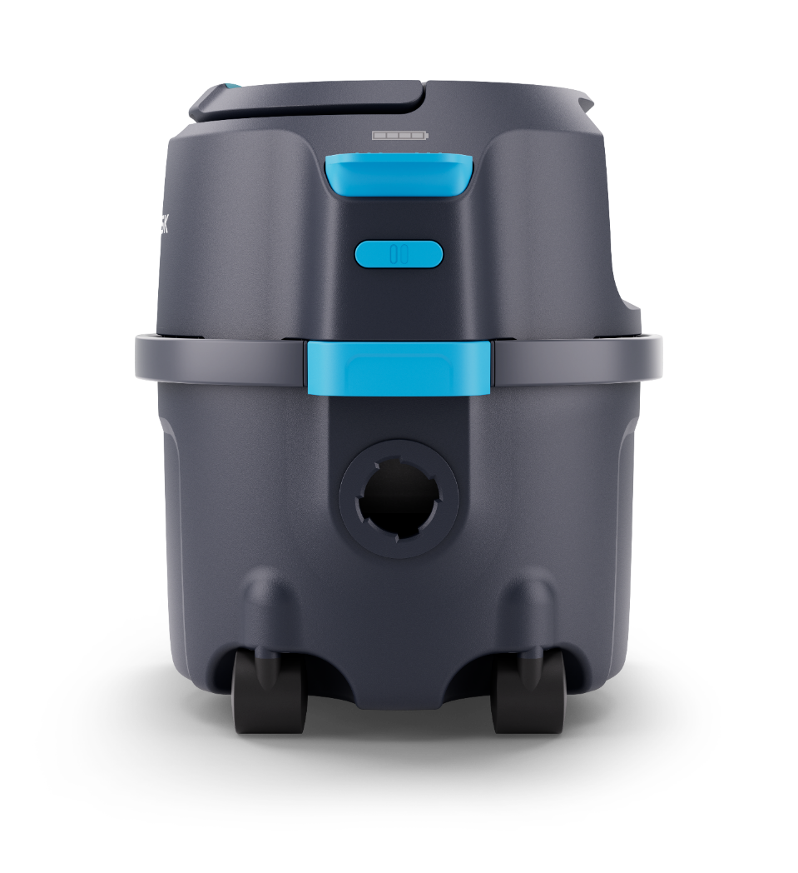
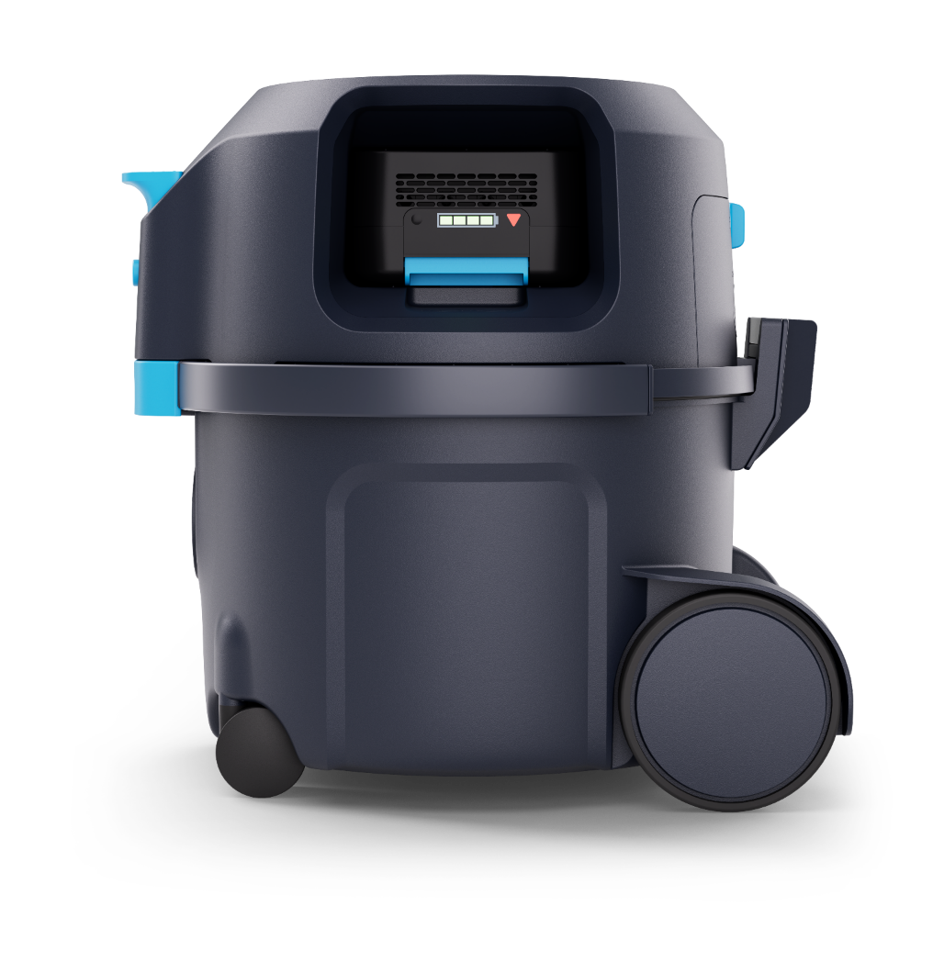
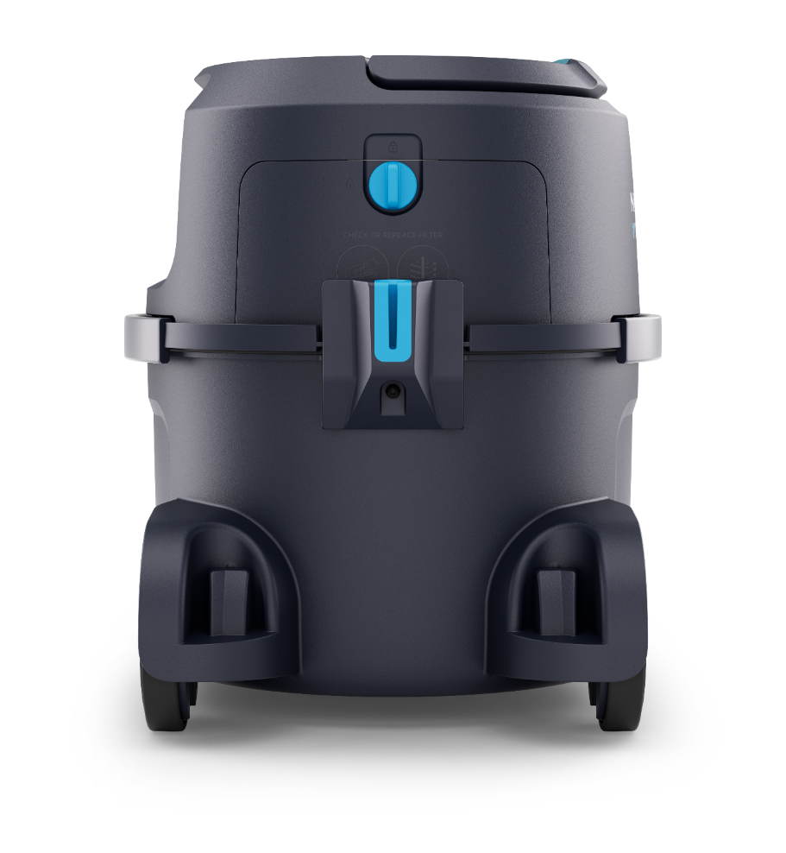
3 | VP500 features
Selected design details and features | Several identical to VP300 and VP400

Slide 15
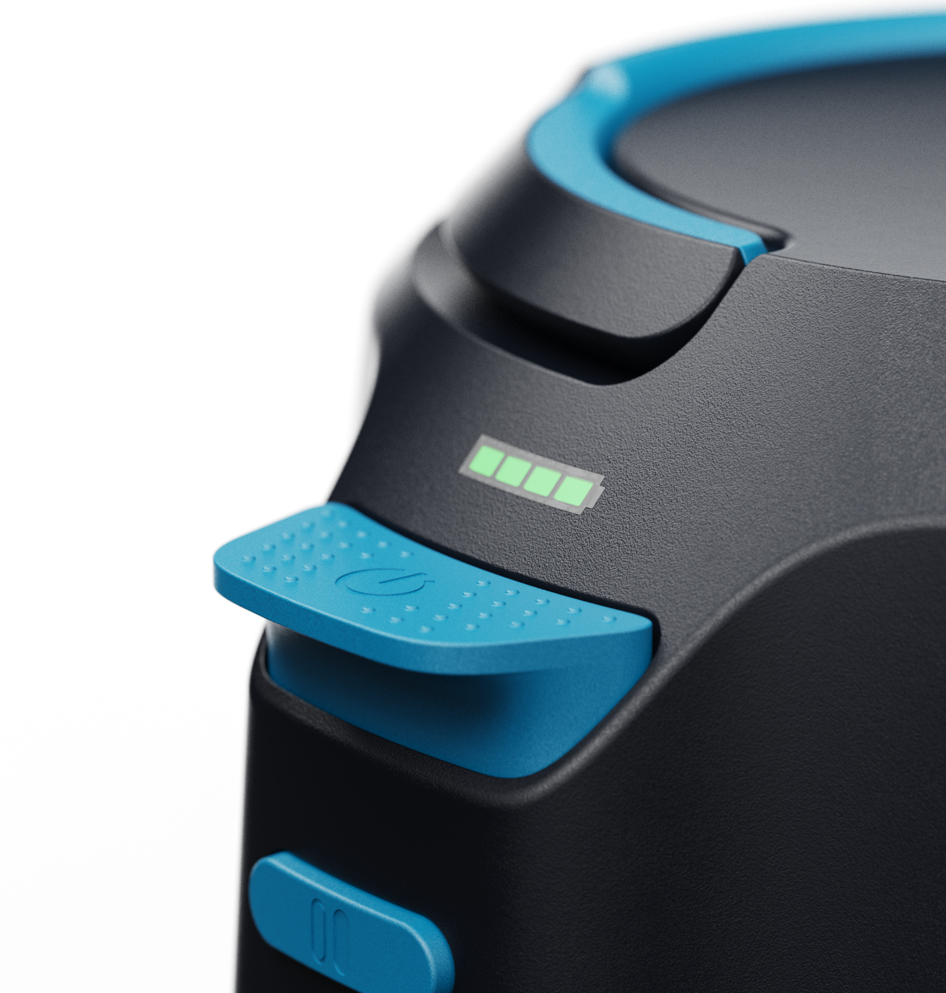
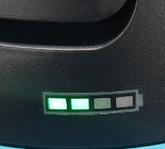
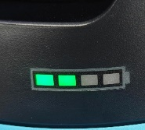
3 | VP500 features
Design details | Enhanced UI and ease of use
Large durable power switch
Quick UI
Possible to operate by foot
Reduced operator strain/injuries
‘Live’ LED battery capacity level in front of machine
Fast check by operator → saves time
On the fly adjustment of cleaning plan/stint if low and need to go in direction of charger
Standard dual speed possibility
Adjust to the specific customer needs…:
Quality ramp at speed mode change (and startup – starts in last setting)
Low speed
Extend run time
(Light green LED’s)
High speed
Enhance cleaning power
(Dark green LED’s)

Slide 16
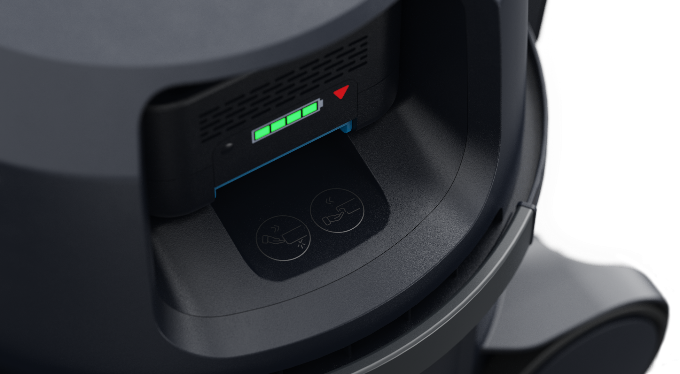
3 | VP500 features
Battery installation area | In-moulded guidance and colour highlighted battery UI ensures easy use
Battery installation area
Instruction icons

Slide 17
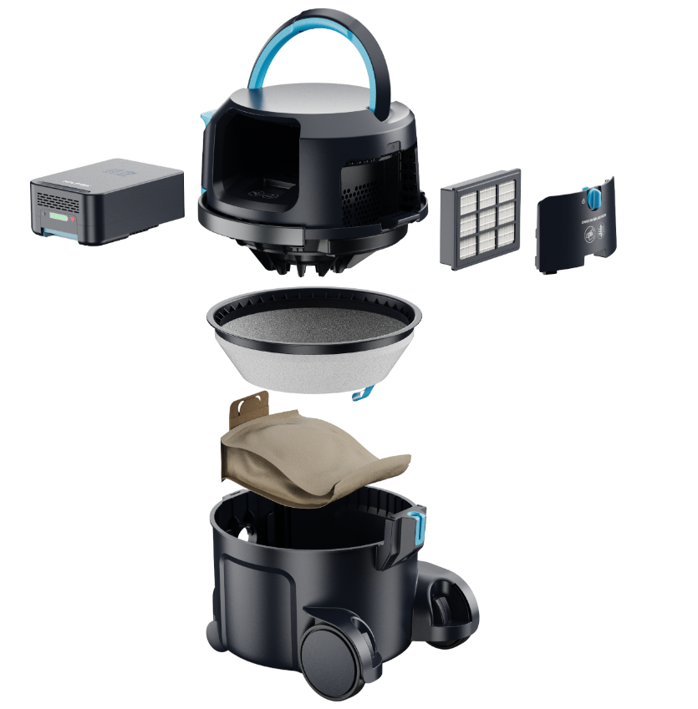
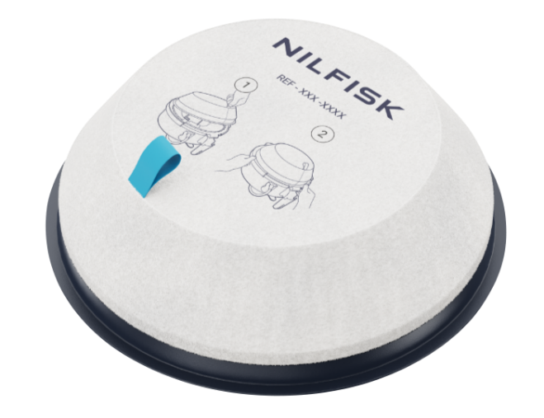
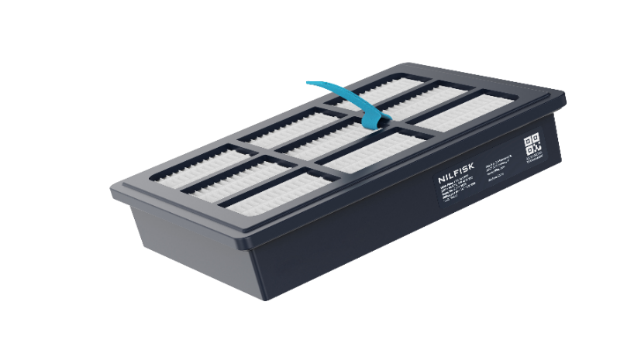
3 | VP500 features – Filtration
Bag, prefilter and HEPA | Enhanced serviceability and usability
Prefilter (sack)
Quick and easy inspection/change
Highlighted-colour touch point UI
PN and illustrations/guidance
Convenient Improved tolerance/usability
Protects machine
Same across VP300, VP400 and VP500
HEPA filter
Grip point and colour-highlighted → optimising usability and time
NO tools to access/change
Ensuring good and healthy air quality
Catching small health risk particles
HEPA 13 or HEPA 14*;
Used for whole Nilfisk Commercial VAC compact dry vacuum range: VP300, VP400, VP500 and VP7000
* Majority of range are HEPA configured models

Slide 18
Agenda
1
Background & VP
2
New battery vacuum
3
Key selling points
4
Other

Slide 19
4 | New battery platform
NBP series | Scalable battery power in a compact format
Combat 1
NBP series
NBP60
NBP100
COMPANY CONFIDENTIAL

Slide 20
4 | New battery platform
Tech specs of NBP series vs predecessor
Specifications | Combat 1 | NBP60 | NBP100
Power | 36V Li | 36V Li | 36V Li
Battery capacity | 7,8 Ah (280Wh) | 6,0 Ah (216Wh) | 10,0 Ah (360Wh)
Weight (kg) | 2,7 | 1,8 | 1,9
Dimensions LxWxH (mm) | 240x160x70 | 183x130x73 | 183x130x73
Charger | Fast charger | Fast charger NBC215 | Fast charger NBC215
73 mm / 2.87 in
Lighter weight
More compact and scalable design
Increased UX and UI → grip on top and coloured release button
Enhanced positioning → scalability; difference performance/price levels
Notification/warning LED on battery (triangle)
183 mm / 7.20 in
130 mm /
5.11 in
NBP60 visuals – same physical footprint(size) and interface as NBP100 – More details in specific NBP presentation

Slide 21
4 | New battery platform
Tech specs of the new charger; NBC215
Specifications | NBC215 36V fast charger
Battery platform | 36V NBP series
Charging current | Max. 5A
Power supply (V/hz) | 100-240 / 50-60
Charging time (approx. min) NBP60 – 80% / 90% / 100% | 55 / 65 / 80
Charging time (approx. min) NBP100 – 80% / 90% / 100% | 90 / 100 / 130
Weight (kg) | 1,2
Dimensions LxWxH (mm) | 211x189x81
81 mm / 3.18 in
211 mm / 8.30 in
189 mm /
7.44 in

Slide 22
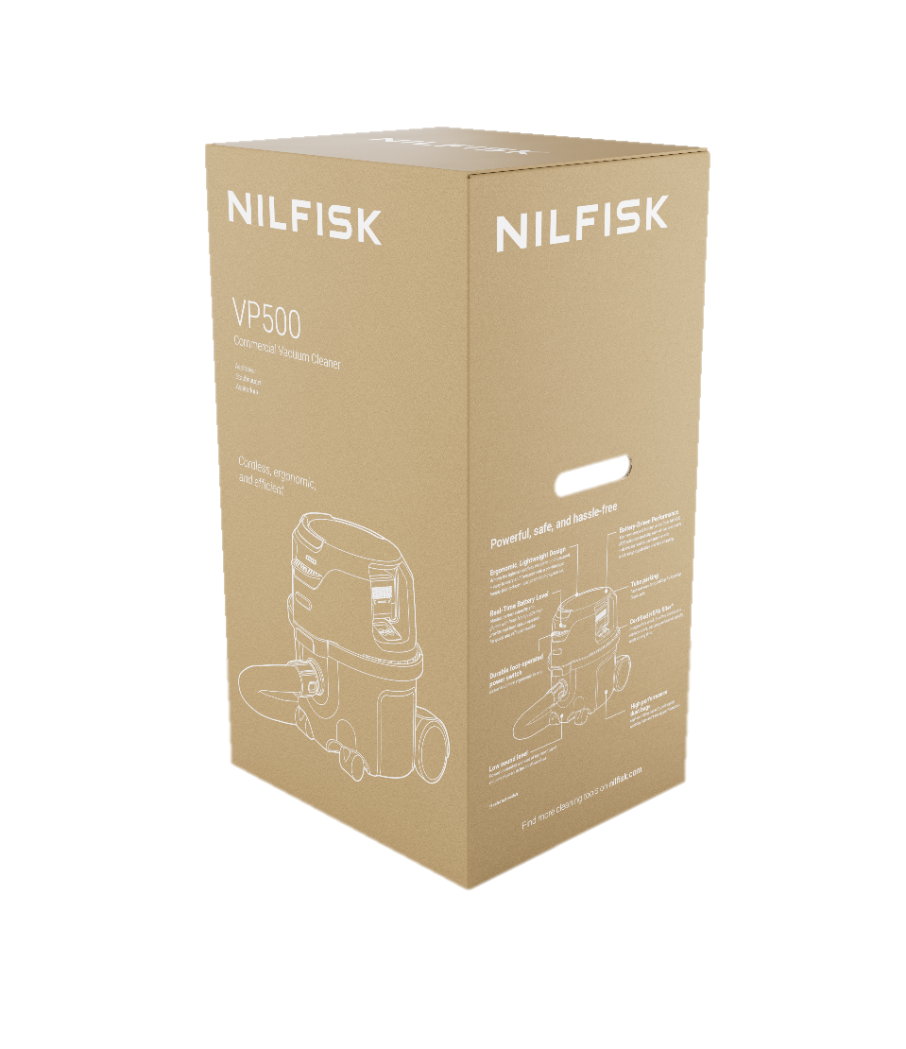
4 | Packaging
New improved machine box artwork | Better presence at showrooms/dealers and quick view of KSP’s
COMPANY CONFIDENTIAL

Slide 23
4 | Marketing Dealer Package
4 x Social media posts –
Web banners
Roll up banner showing VP400 and VP500
Battery one-pager
Product signs
Product renderings
Location pictures
Sales and promo video
Brochure
Fact sheet
External presentation
Recommended part list [R&D]
User manual [R&D]
Main data file [GPM]
Service manual [Service mng]
Dealer package

Slide 24
Nilfisk to dealers
Dealer package

