Slide 1
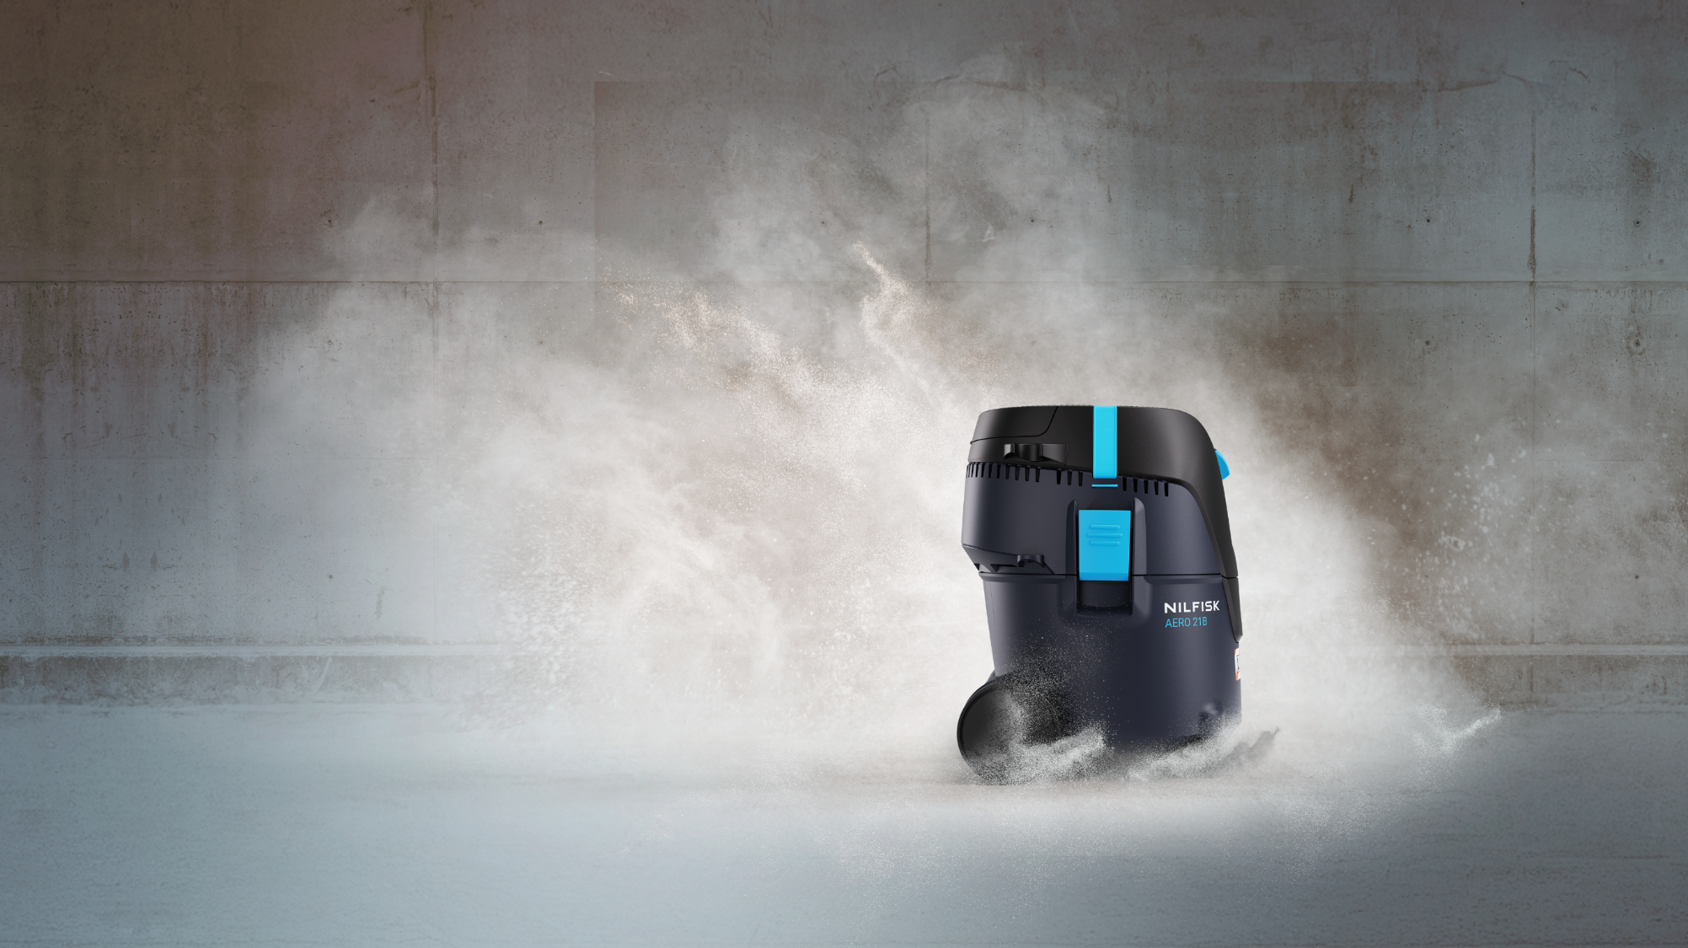
Introducing our new AERO battery range Nilfisk AERO battery

Slide 2
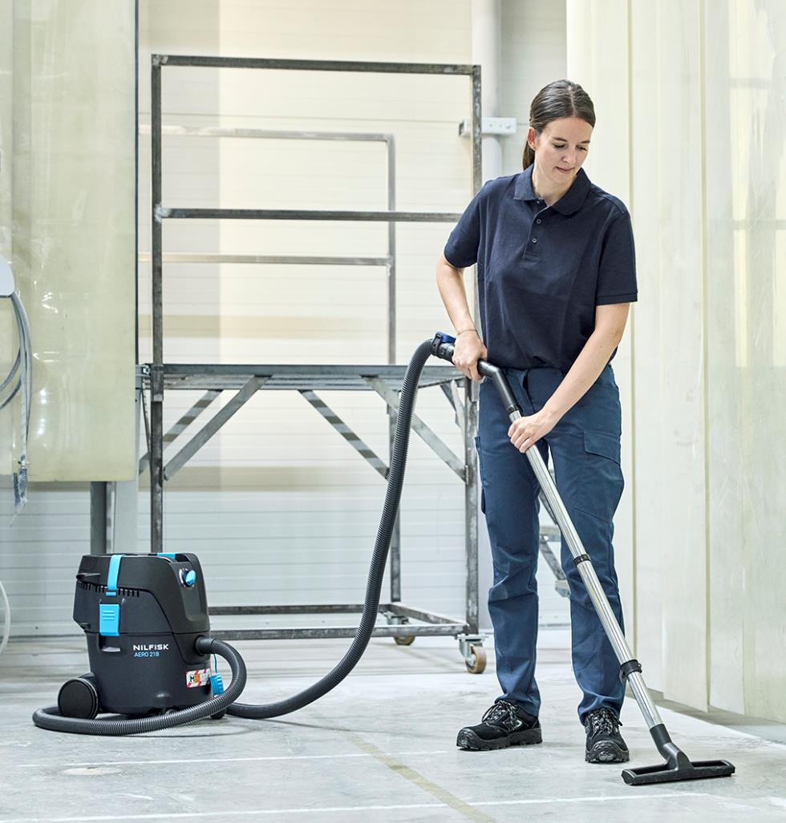
Agenda
1
Background & VP
2
Target segment
3
New battery vacuum
4
Key selling points
5
Other

Slide 3
Agenda
1
Background & VP
2
Target segment
3
New battery vacuum
4
Key selling points
5
Other

Slide 4
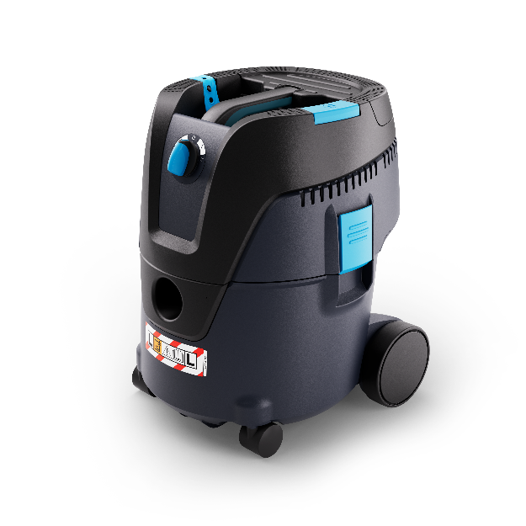
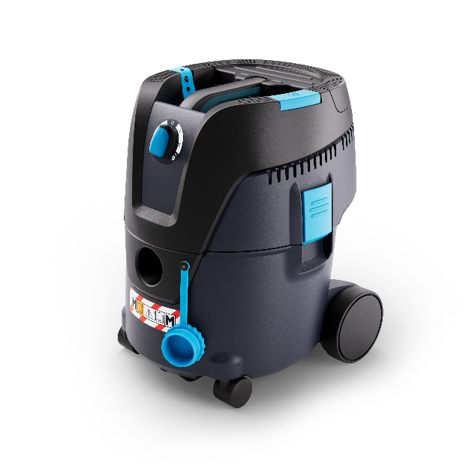
1 | Background – AERO battery
First fully comprehensive LightIvac
The AERO battery now completes the Nilfisk LightIVac portfolio with cordless, battery-powered versions. In addition to different country versions, the AERO battery is available as a SafetyVac in the L-class and M-class versions.
Compared with many cordless vacuums currently seen on the market, the AERO battery is a genuine LightIVac – designed for rough working environments combined with wet & dry use.
The new battery developed by Nilfisk (NBP60 and NBP100) is unique and plays a major role here. This battery has been developed exclusively for the requirements of cleaning equipment and not for the power tools of most of our competitors.
AERO battery
The new formula for freedom – cordless high-performance. Battery-driven vacuuming with superior suction power that ensures maximum efficiency for any cleaning task, wet and dry
High performance in terms of Airflow and runtime
Fast charge enabled & hot-swap ready battery for continous use
The AERO battery sets a new standard when it comes to battery-powered LightIVacs.

Slide 5
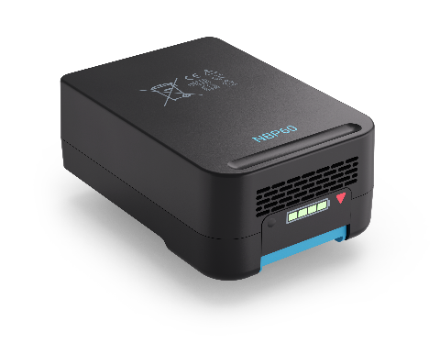

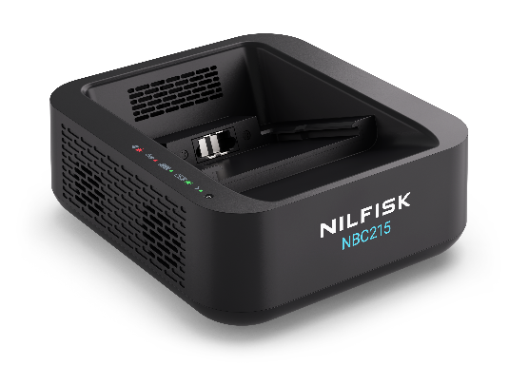
1 | Background NBP – NBC215
High-performance battery generation
Nilfisk decided to develop its own high-performance battery designed exclusively for the cleaning industry and their specific requirements. This decision led to the creation of a generation of batteries that impress with their performance, sustainability and reliability. This distinguishes the NBP from most universal batteries available on the market, which are used in a wide variety of electrical appliances.
The AERO battery comes with the 6Ah version of the NBP as standard – a 10Ah version is available as an option.
The NBP could be charged with an also self in-haus developed charger. This NBC215 is an active and intelligent charger, communicates during charging process with the BMS (battery management system) of the battery and can therefore react in an event of overheating or other unusuality's during the charging process – either by increasing the cooling power or by switching off the charging process in case needed.

Slide 6
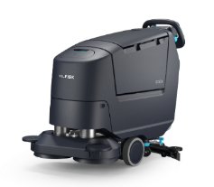
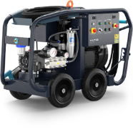
1 | Background – brand & design
NextGen professional colour strategy
Product colours & ratios
Primary product body colour
This is the main product colour to be used on all major parts.
Ergonomic / feature colour
A colour to highlight ergonomic areas (e.g. grip) and product specific features and USPs.
User touchpoint operational colour
Switches, buttons, caps, grips. Any part this colour is needed to be interacted with to operate the machine effectively.
New professional (PBLS)
Safety / service colour
Parts this colour indicate safety elements (e.g. charging cables, reverse buttons) and service point.
The new professional CMF palette has been extensively researched, developed and tested – supports intuitive usability.

Slide 7
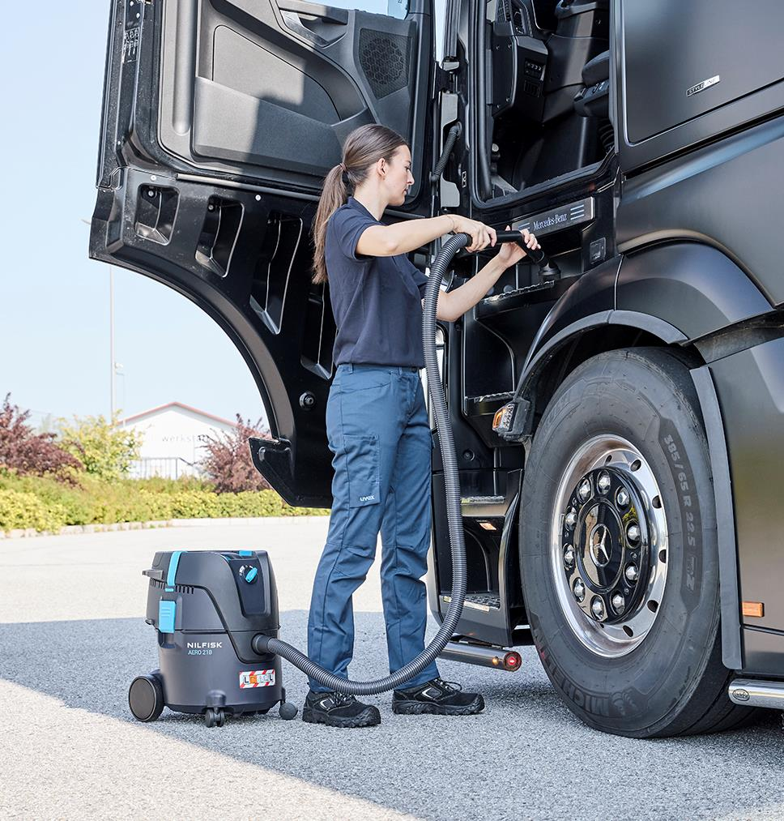
Agenda
1
Background & VP
2
Target segment
3
New battery vacuum
4
Key selling points
5
Other

Slide 8














2 | Customer segments
Primarily B&C | Vacuuming of dry dust/debris | Soft-hard floors | Often larger areas/long stints
Domestic & household
Private homes
Vehicle cleaning
Retail
Dining areas
Shop areas and aisles
Warehousing & logistics
Loading docks and shipping area
Pick & place area
Bundling & packaging area
Food & beverage
Production machines & conveyors production area
Packaging area
Tanks, silos and pipes
DIY
Garage / workshop
Renovations
Healthcare
Hallways
Residential rooms
Patient & treatment rooms
Laboratories & cleanrooms
Manufacturing
Clean (electronics) manufacturing
Electronic component manufacturing
Electronics assembly area
Auto manufacturing
Assembly line
Assembly area
Saw mill / furniture manufacturing
Production machinery
Production area
Cement factory / construction materials production
Production machinery
Production area
Pharmaceuticals
Production equipment
Production area
Final product warehouse
Ofﬁces & public adm.
Receptions / lobbies
Meeting / conference rooms
Desks & workstations
Automotive
Showrooms
Vehicle cleaning
Shop areas
Iron & metal
Foundries / mechanical components / metal parts production
General cleaning
Production equipment: cleaning
Additive manufacturing / aluminum & titanium parts / laser cutting / grinding
Production equipment
Painting / coating
General cleaning
Defence & law enforcement
Cutt-off areas
Field supplies
Aircraft cleaning
Building & construction
Tools & Equipment
Dust extraction, containment & disposal
General cleaning / scaffolding jobs
Hospitality
Lobby & public areas
Hallways
Banquets & conference rooms
Residential rooms

Slide 9
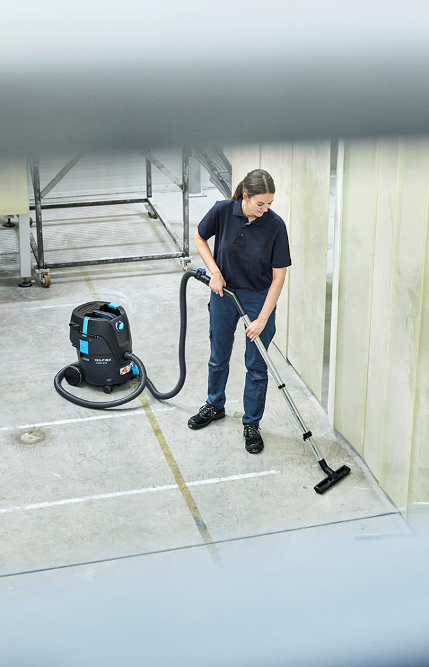
2 | Target segment and key applications
Identified drivers & highlighted needs
Segments
B&C
Light industry
Automotive
Defence
General cleaning
Key applications
Versatile cleaning across industries Built on the trusted AERO platform, ideal for industrial, automotive, and construction cleaning tasks.
Mobile and cordless operation Equipped with the powerful NBP60 battery for high-performance use in areas without power access.
Smart and remote-controlled operation AutoSense remote control enables efficient, user-friendly operation in complex or hazardous environments.
Safe handling of hazardous dust Certified for L, M-class dust, supporting applications in environments with strict health and safety regulations.
Efficient filter cleaning for continuous use Push&Clean™ technology ensures uninterrupted performance in dust-intensive tasks.
Quiet and powerful suction for sensitive environments High-efficiency turbine with low noise levels is ideal for use in noise-sensitive areas like hospitals, schools, or offices.

Slide 10
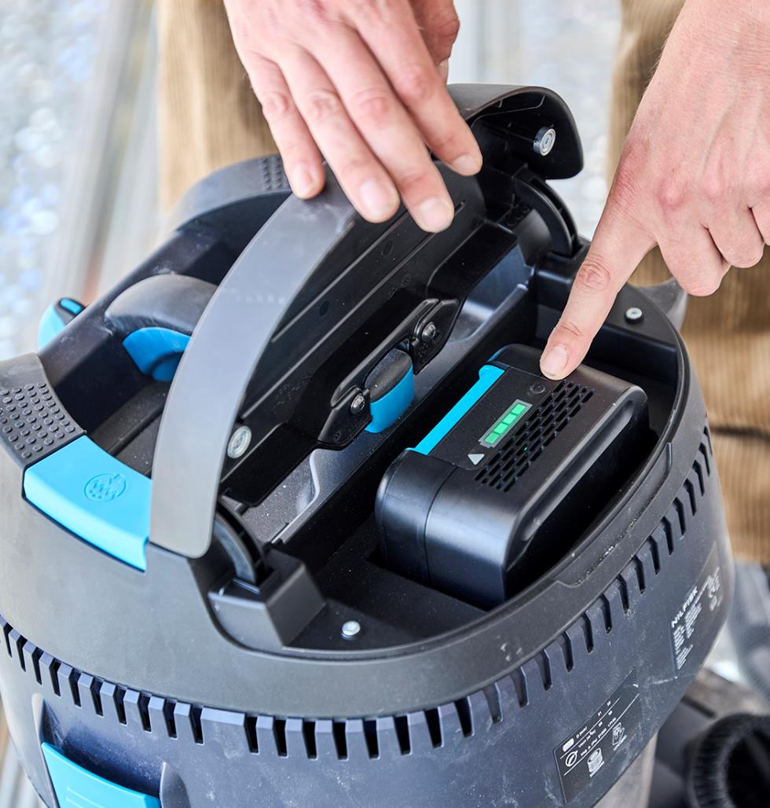
Agenda
1
Background & VP
2
Target segment
3
New battery vacuum
4
Key selling points
5
Other

Slide 11

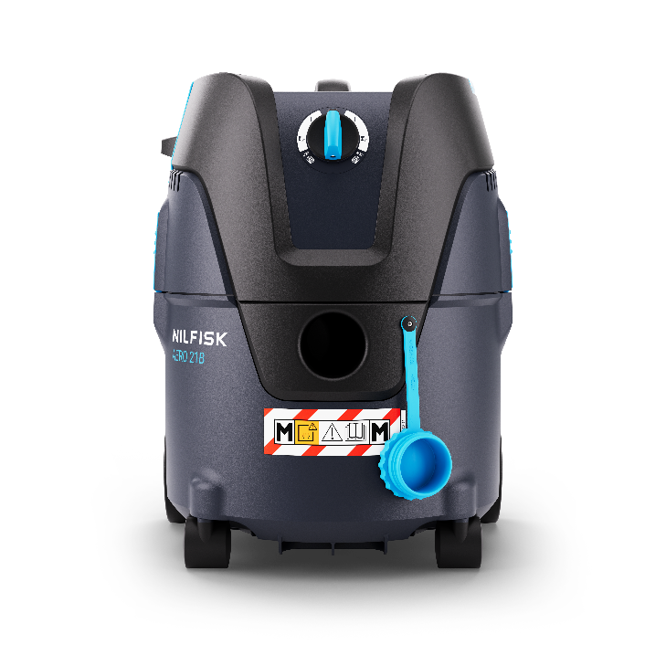
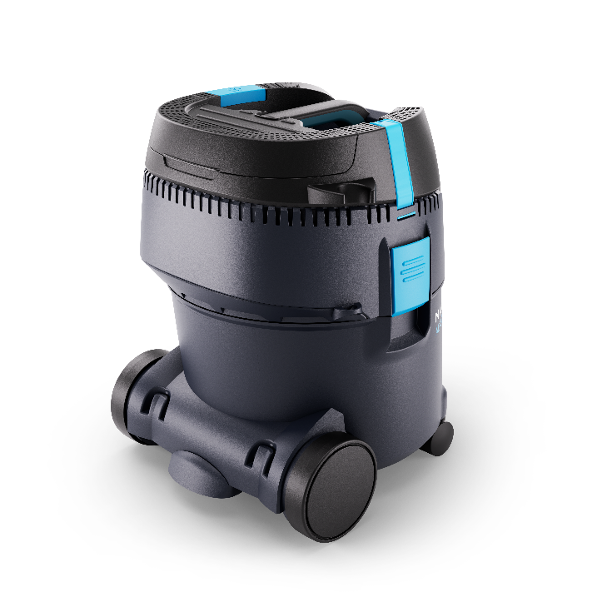
3 | New AERO battery
First fully battery driven LightIVac

Slide 12
3 | AERO battery highlights
Unique LightIVac – main USPs
Uninterrupted high-performance cleaning
No plug, just play: Cordless design ensures seamless operation
Superior suction power for maximum efficiency in both wet and dry conditions
Push&Clean™ filter system maintains peak performance with minimal downtime
Lightweight, user-friendly, and smart
Only 8.3 kg for effortless handling and low-effort operation
Low noise emissions for daytime cleaning without disturbance
Bluetooth remote-control option (M Class, with AutoSense for enhanced safety and efficiency)
Unmatched durability and endurance
Best-in-class battery: 500+ charge cycles with industry-leading runtime
Robust turbine withstands heavy use with minimal maintenance
Proven reliability through rigorous field and lab testing
A safer and cleaner work environment
Certified for the highest safety standards against hazardous dust
Efficient PET filter and air-flow design reduce airborne particles
Cordless operation eliminates trip hazards and improves mobility
530 mm
375 mm
392 mm

Slide 13
3 | New battery vacuum
Technical specs of AERO battery range
 |  |  | EU/UK
Technical | Description | Note | AERO 21B-0L PC BP36V EU Version | AERO 21B-W0M PCBP 36V EU Version | AERO 21B-W0M PC BP36V UK Version
 |  |  | 107419700 | 107419701 | 107420743
Voltage/Frequency | V/Hz |  | 36 | 36 | 36
Protection class / IP protection |  |  | III / IPX4 | III / IPX4 | III / IPX4
Rated power | W |  | 500 | 500 | 500
Airflow (Max, measured on turbine) | l/s |  | 61 | 61 | 61
Airflow (Max, measured on turbine) | l/min |  | 3660 | 3660 | 3660
Airflow (Max, measured on turbine) | m³/h |  | 219 | 219 | 219
Airflow (Max, measured on turbine) | CFM |  | 129 | 129 | 129
Vacuum (Max) | kPa |  | 15,5 | 15,5 | 15,5
Vacuum (Max) | hPa |  | 155 | 155 | 155
Vacuum (Max) | in h₂0 |  | 62 | 62 | 62
Suction power | W |  | 160 | 160 | 160
Sound pressure level @m at rated power (LpA) | dB(A) |  | 68 | 68 | 68
Working sound level @3m at rated power(working pressure) | dB(A) |  | 60 | 60 | 60
Run time up to NBP60 / NBP100 (Eco mode) | min |  | 25 (6Ah) 40 (10Ah) 65(10Ah Eco-Mode) | 25 (6Ah) 40 (10Ah) | 25 (6Ah) 40 (10Ah)
Capacity | L |  | 20 | 20 | 20
Container |  |  | plastic | plastic | plastic
Max allowed working temperature | °C |  | 40 | 40 | 40
Weight (machine) | kg | Machine only | 7 | 7,1 | 7,1
Dimensions (LxWxH) | mm |  | 397 x 378 x 485 | 407 x 378 x 485 | 407 x 378 x 485
Filter system
Dust class |  |  | L | M | M
Filter cleaning system |  |  | PushClean | PushClean | PushClean
Filter cartridge D185x140 PET M-Class |  |  | • | • | •
Filter surface |  |  | 3000m² | 3000m² | 3000m²

Slide 14
3 | New battery vacuum
Technical specs of AERO battery range
 |  |  | EU/UK
Features | Description | Note | AERO 21B-0L PC BP36V EU Version | AERO 21B-W0M PCBP 36V EU Version | AERO 21B-W0M PC BP36V UK Version
 |  |  | 107419700 | 107419701 | 107420743
Bluetooth remote |  |  |  | • | •
AutoSense |  |  |  | • | •
Auto start stop for power tools |  |  |  | • | •
PushClean |  |  | • | • | •
Floater as liquide level trigger |  |  | • | • | •
Hose inlet plug |  |  |  | • | •
Container lifting handle |  |  | • | • | •
Rubber strap for cable storage |  |  | • | • | •
Tube parking 2-point |  |  | • | • | •
Cordless |  |  | • | • | •
Silent mode – boost mode |  | (Dual speed) | •
Tube parking |  |  | • | • | •
Wheelie bar |  |  | • | • | •
Dust bags |  |  | 1-P | 1-P | 1-P

Slide 15
3 | New battery vacuum
Technical specs of AERO battery range
 |  |  | EU/UK
Accesories |  |  | AERO 21B-0L PC BP36V EU Version | AERO 21B-W0M PCBP 36V EU Version | AERO 21B-W0M PC BP36V UK Version
 |  |  | 107419700 | 107419701 | 107420743
Extention tubes
Extrn. tube steel D35x505mm | 302000770 |  | • | • | •
Tube holder kit Ø35 (hook incl. screw) | 107407190 |  | • | • | •
Suction hoses
Suction hose high end D32x3500 CPL gray | 302002364 |  |  | • | •
Suction hose D32x1800 CPL | 302002363 |  | •
Floor nozzles
Floor nozzle D36 W/D | 107402331 |  | • | • | •
Other accessories
Universal nozzle D36x115 | 14295 |  | •
Suction brush D36 black | 302002509 |  | • | • | •
Tool adapter with rubber nozzle | 107410036 |  |  | • | •
Battery & charger
NBP60 36V Li – 6Ah compact battery | 106479020 |  | • | • | •
NBP100 36V Li – 10Ah compact battery | 106479021
NBC215 36V fast charger – w/o cord | 106476050 |  | • | • | •
Charger cord EU | 107424752 | 1m length | • | •
Charger cord UK | 107424753 | 1m length |  |  | •
Charger cord AU | 107424754 | 1m length
Charger cord CN | 107424755 | 1m length
Charger cord JP | 107424756 | 1m length
Charger cord US | 107424757 | 1m length

Slide 16
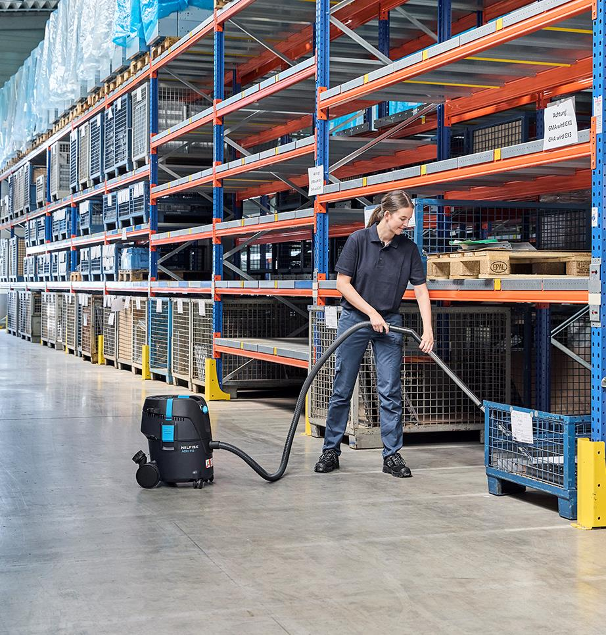
Agenda
1
Background & VP
2
Target segment
3
New battery vacuum
4
Key selling points
5
Other

Slide 17
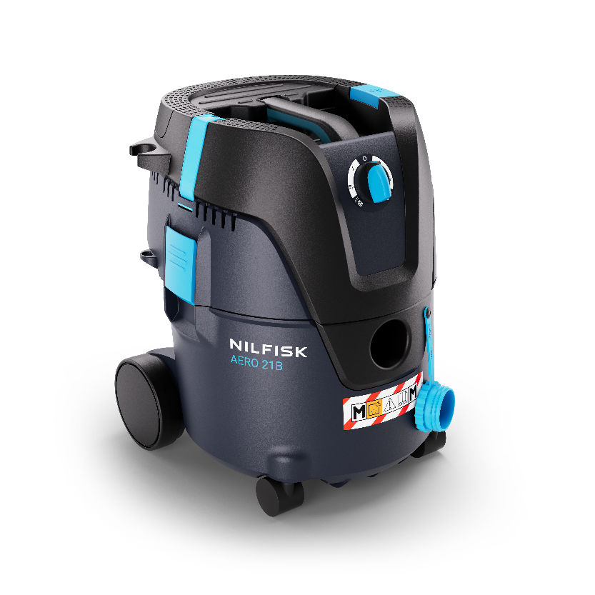
4 | AERO battery features
Key selling points
New Nilfisk developed NBP battery High performance and efficiency with Nilfisk own developed battery – up to 500 charging cycles feasible
Protected battery compartment Battery protected from dust and other influences – easy battery replacement
Profen, high efficient turbine
With 3600 l/min airflow best in class performance
Battery – battery management system (BMS)
Protective bat. system controlling voltages, temperatures etc.
Washable PET filter element
High quality filtration, longlife, durable and suitble for wet/dry use
Highlighted-colored touch points
Intuitive UI ensures a seemless operation
Very quiet, pleasant operating noise
Enables cleaning in noise-sensitive areas and daytime cleaning
MultiFit inlet
Wide range of suction hosese and accessories from the Nilfisk accessory program can be used on the AERO battery
Fast charging enabled & hot-swap for continuous uninterrupted use Fully charge down to only 60 min*
Lightwight cordless freedom & a small footprint
Keep cleaning without limits – rapid, mobile use when high suction power is urgently required
* Aprx 90% battery capacity

Slide 18

4 | AERO battery features
AERO 21B-0L PC BP36V
Entry level battery driven basic cleaning of hazardous dust
Easy to use thanks to clear UI
Exceptionally long runtime:
With NBP60 25min
With NBP100 40min
With NBP100 65min (Eco-Mode)
Entry safety vac L-Class
Developed and certified for the pick of hazardous dusts, according the dust class L
Wet and dry
Equipped with a floater – for reliable pick-up of many kinds of liquids

Slide 19

4 | AERO battery features
AERO 21B-W0M PC BP36V
Developed and designed for tough cleaning tasks involving hazardous dusts
Designed for 2 different hose diameters
Full M-class safety vac
Designed to collect hazardous dusts in dust class M. It is capable of collecting dusts such as concrete, wood or paint dust generated during craft and construction work. These dusts are safely separated in the filter bag and can thus be easily disposed of
Wet and dry
Equipped with a floater – for reliable pick-up of many kinds of liquids

Slide 20

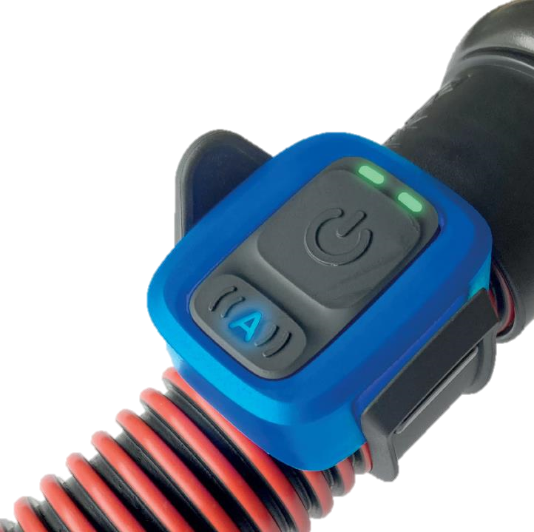
4 | AERO battery features
AutoSense
Remote control
Easy and convenient remote operation of the vacuum cleaner
Enables automatic On/Off that works with cordless tools, thanks to the intelligent AutoSense feature
Based on Bluetooth communication, reliable and easy paring
Flexible design makes it easy to fixate on hose, hand tube or power tool
Being robust and durable to deal with the environment and rough handling on construction sites
LED indicators provides visual warnings when airflow is insufficient, and attention is needed
AutoSense mode that automatically detects activations of power tools
Available on M-Class AERO battery versions

Slide 21
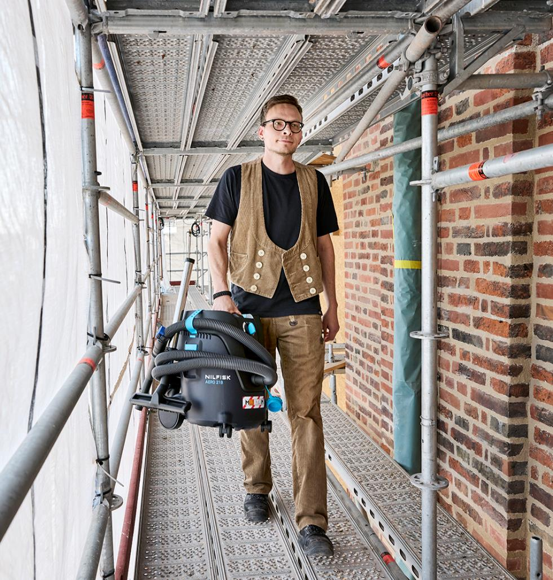
Agenda
1
Background & VP
2
Target segment
3
New battery vacuum
4
Key selling points
5
Other

Slide 22


5 | New battery platform
NBP series | Scalable battery power in a compact format
Combat 1
NBP series
NBP60
NBP100
COMPANY CONFIDENTIAL

Slide 23

5 | New battery platform
Tech specs of NBP series vs predecessor
Specifications | Combat 1 | NBP60 | NBP100
Power | 36V Li | 36V Li | 36V Li
Battery capacity | 7,8Ah (280Wh) | 6,0Ah (216Wh) | 10,0Ah (360Wh)
Weight (kg) | 2,7 | 1,8 | 1,9
Dimensions LxWxH (mm) | 240x160x70 | 183x130x73 | 183x130x73
Charger | Fast charger | Fast charger NBC215 | Fast charger NBC215
73 mm / 2.87 in
Lighter weight
More compact and scalable design
Increased UX and UI → grip on top and coloured release button
Enhanced positioning → scalability; difference performance/price levels
Notification/warning LED on battery (triangle)
183 mm / 7.20 in
130 mm / 5.11 in
NBP60 visuals – same physical footprint(size) and interface as NBP100 – More details in specific NBP presentation

Slide 24

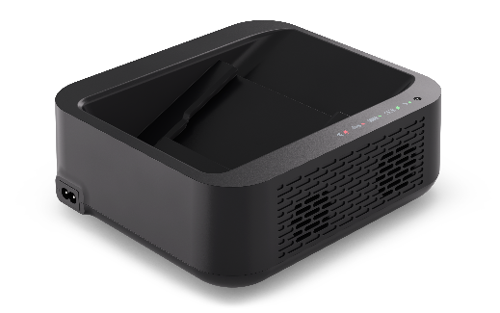
5 | New battery platform
Tech specs of the new charger – NBC215
Specifications | NBC215 36V fast charger
Battery platform | 36V NBP series
Charging current | Max. 5A
Power supply (V/hz) | 100-240 / 50-60
Charging time (approx. min) NBP60 – 80% / 90% / 100% | 55 / 65 / 80
Charging time (approx. min) NBP100 – 80% / 90% / 100% | 90 / 100 / 130
Weight (kg) | 1,2
Dimensions LxWxH (mm) | 211x189x81
81 mm / 3.18 in
211 mm / 8.30 in
189 mm / 7.44 in

