Slide 1
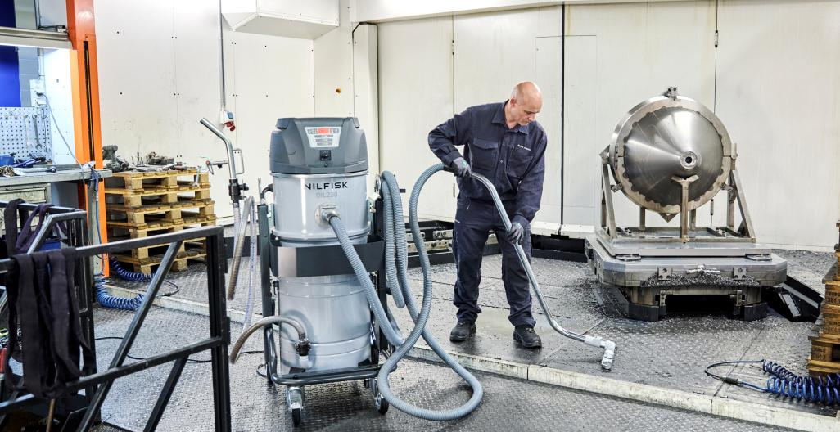
Industrial vacuum for oil and metal chips
OIL230
Notes:
Picture to be changed

Slide 2
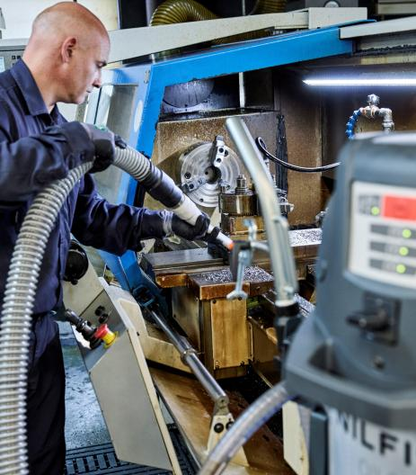




Primary application & use
OIL230
Nilfisk is introducing an industrial vacuum for oil and metal chips – OIL230:
70 l container
Liquids recovery
100 l/min
Vacuum + discharge
30 l chip basket
Solid separation
Automatic shut-off
Electronic liquid sensor
Main customer segments:
Primary: Metalworking industry, CNC machine users, tool shops, mechanical workshops.
Secondary: Maintenance service providers or contractors.
Main jobs to be done/applications:
Recover coolant, swarf, and chips from CNC sumps and chambers to cut disposal costs and keep machines efficient.
Replace cutting oil quickly through fast discharge and refill, reducing downtime.
Separate solid from liquid and enable coolant reuse, lowering waste and operating costs.
Clean surrounding areas around CNC machines, ensuring a safe and tidy workspace.

Slide 3
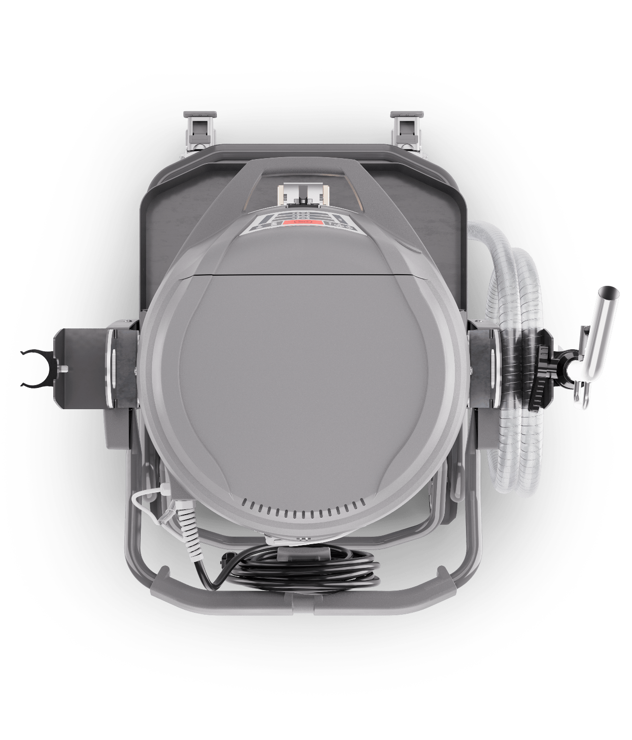
Typical pain points in metalworking
… and how we solve them
Pain point | OIL230 solution
Downtime / Low productivity | Powerful suction, fast simultaneous discharge, and hassle-free usability improve efficiency and significantly reduce downtime.
Operators won’t use the machine properly or enough | Streamlined design for repetitive tasks: easier, faster, and less tiring to use, improving operator adoption and workflow.
High labour cost | Easy to use by a single operator without performance loss, lowering labor costs.
Risk of worker injury & health issues (oil mist, slippery floors) | Oleophobic filter reduces oil mist and improves air quality. Enhanced safety design (drip-proof, hose management) keeps floors cleaner and workspaces safer reducing tripping hazards.
Maximize production while maintaining quality | Delivers more performance compared to manual cleaning. Less time spent cleaning, better results, and consistent quality output.
High disposal costs for mixed chips and liquids | Integrated chip basket and liquid separation reduce waste volume and disposal costs.
Handling large volumes of material | High suction, separation, and discharge performance manage virtually unlimited volumes thanks to simultaneous vacuum and discharge.
Budget constraints & need for robust machine | Excellent cost/performance ratio. Robust chassis, container, and filter chamber with protective coating ensure durability and long life.
Limited space in workshops | Compact footprint with high performance — fits demanding jobs without taking extra floor space.
Frequent need to move machine between workshops | Compact and easy to load onto a van, ensuring simple transport between work areas.

Slide 4
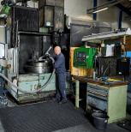
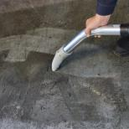
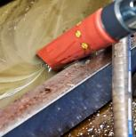
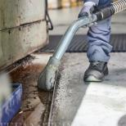










Typical application map
Cleaning oil and chip buildup in CNC machines and workshops
Machine and parts
Even with internal chips conveyors, CNC machines need detailed cleaning. Using vacuum instead of compressed air ensures a safer and more effective process.
Workshop floor
Keeping the floor around the workstation clean is essential for a safe and tidy environment.
Machine sump
The sump stores cutting fluid, but dirt and sludge quickly accumulate. Fluids must be removed, cleaned, and replaced to keep the system efficient.
Spill containment tray
CNC machines often have trays to collect leaks. Oil and sludge buildup can be difficult to remove without a powerful vacuum.

Slide 5
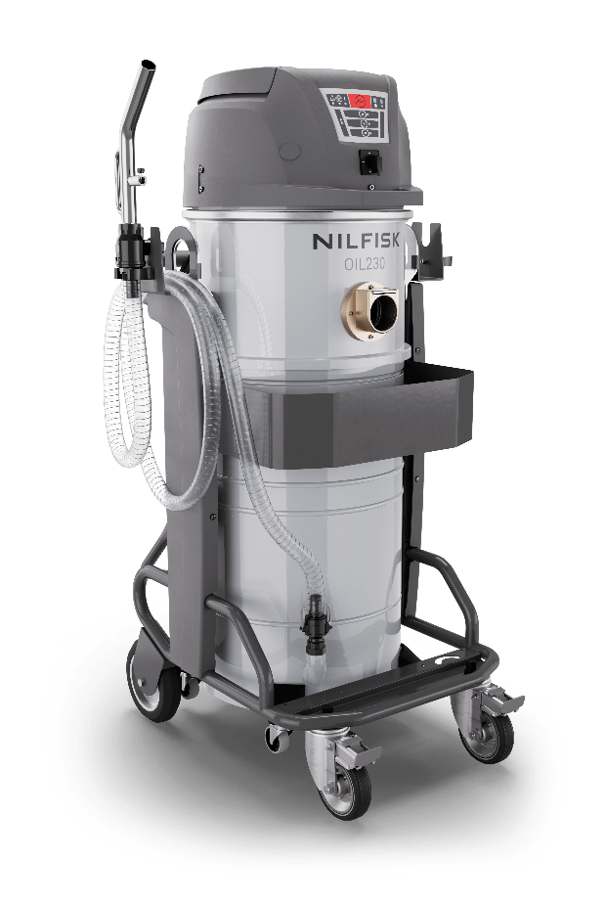
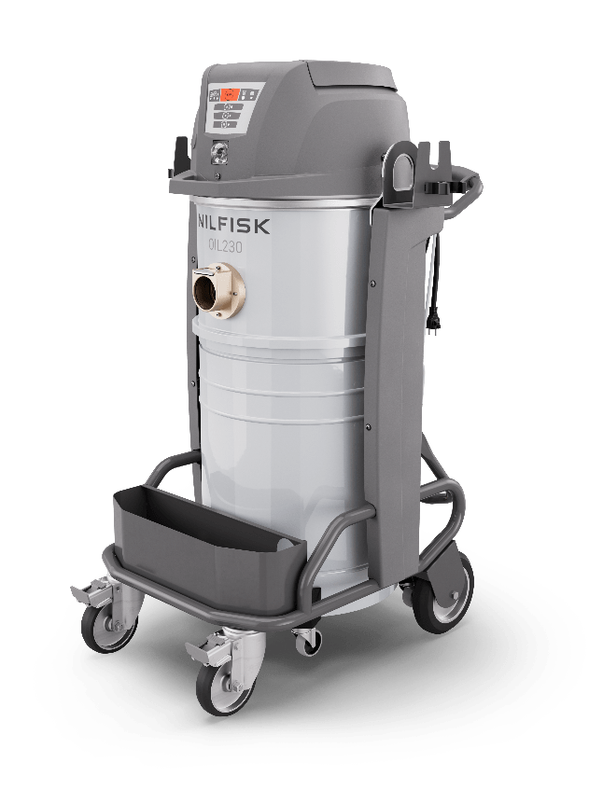
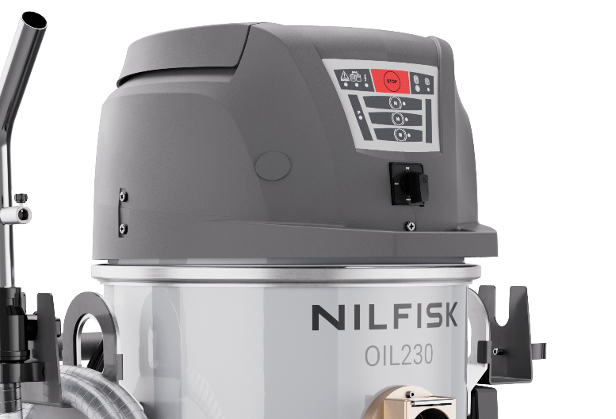
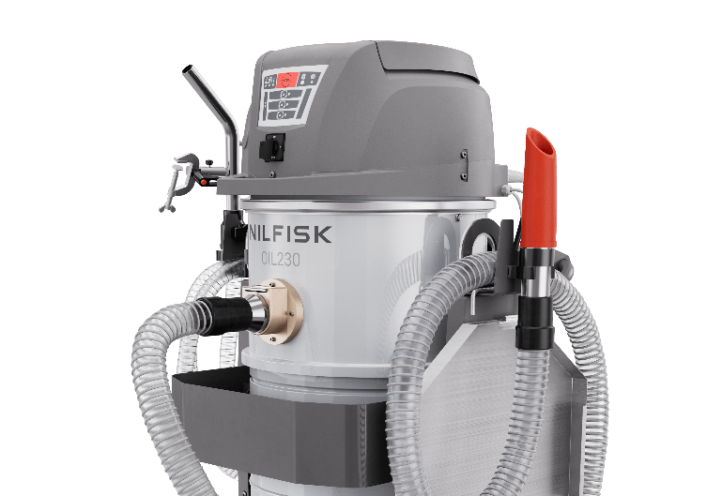
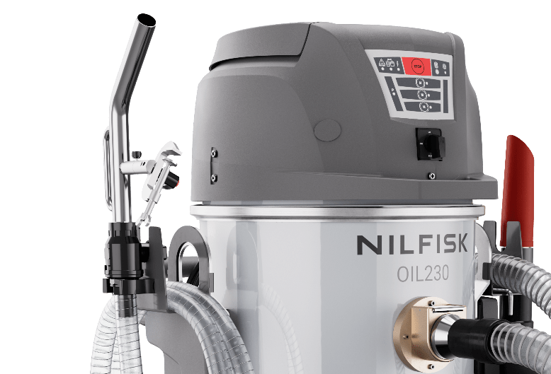
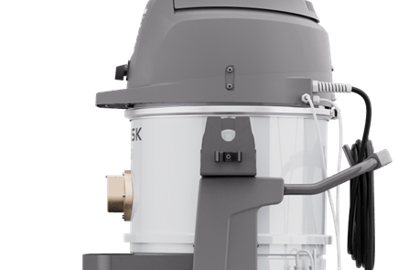
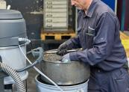
Why OIL230 stands out
Designed for performance and ease of use
Main features:
Clear, training-free interface: one switch for all modes
Drip-proof design: no leaks, no mess
Clamp-secured discharge gun: true one-man operation
Integrated hose holders and lifting hooks: easy to move and store
Ergonomic chip basket at belt height: safer handling
1
User interface
2
Drip proof
3
Gun clamp
4
Hose holders
5
Chip basket

Slide 6
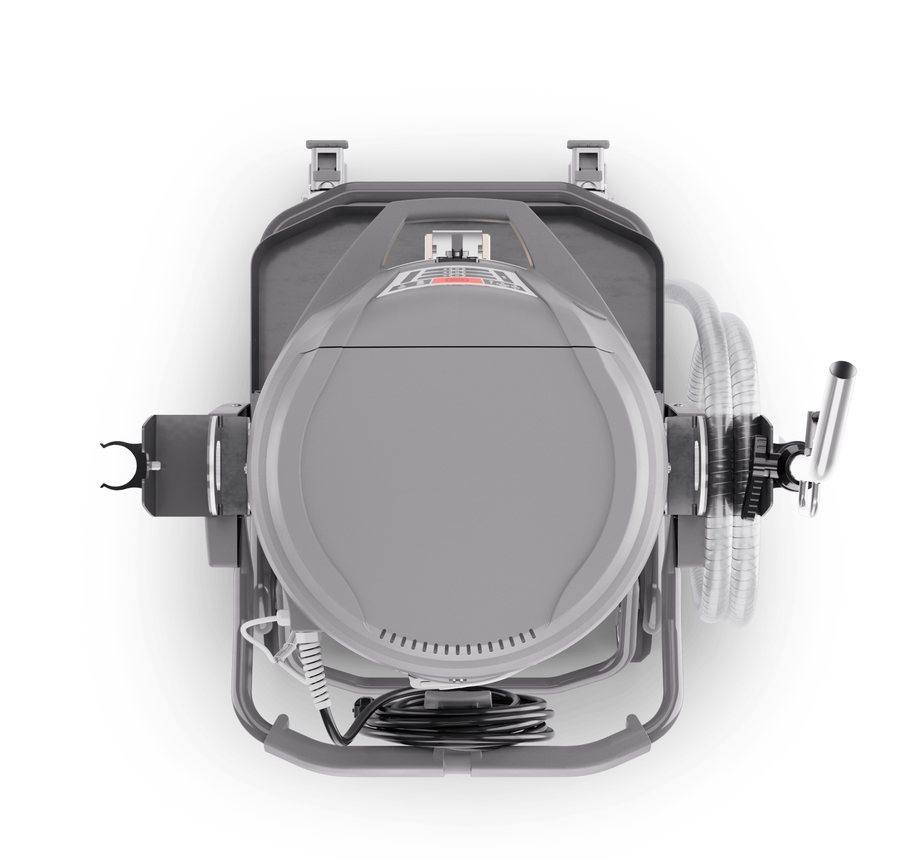
OIL230
Uncompromised performance
High-performance 3-motor platform: delivers powerful suction, ensuring reliable performance even with wet sludge, heavy chips, and demanding applications.
Built for endurance, it keeps productivity high without sacrificing efficiency.

Slide 7
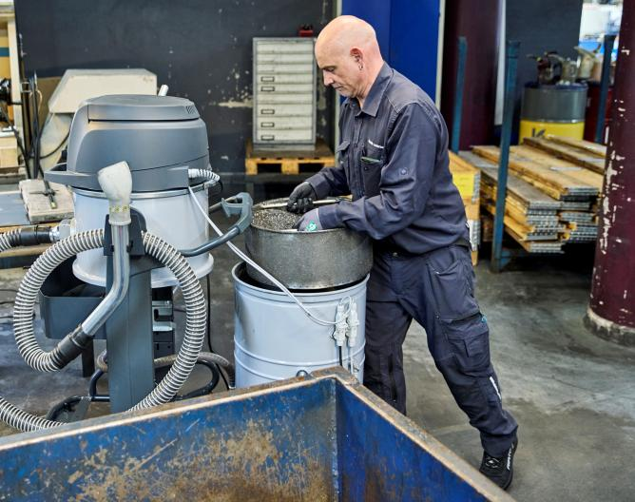
OIL230
Automatic chip & fluid separation
Automatic separation of chips and fluid for efficient recycling and reuse
Chip basket positioned at belt height to reduce operator strain
Easy access to the chip basket without disconnecting cables or discharge hose

Slide 8
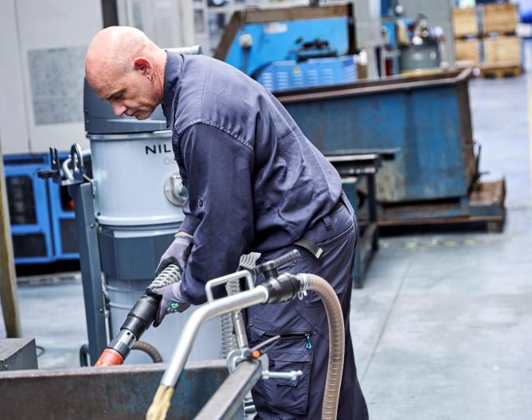
OIL230
Continuous operation, total control
Custom discharge gun: true one-man operation. Operator vacuums while the gun stays secured on the container, with adjustable orientation and flow control.
Virtually unlimited capacity: simultaneous suction and discharge with no downtime between filling and emptying.
Automatic electronic shut-off: prevents overfilling, liquid spills, and motor damage.

Slide 9
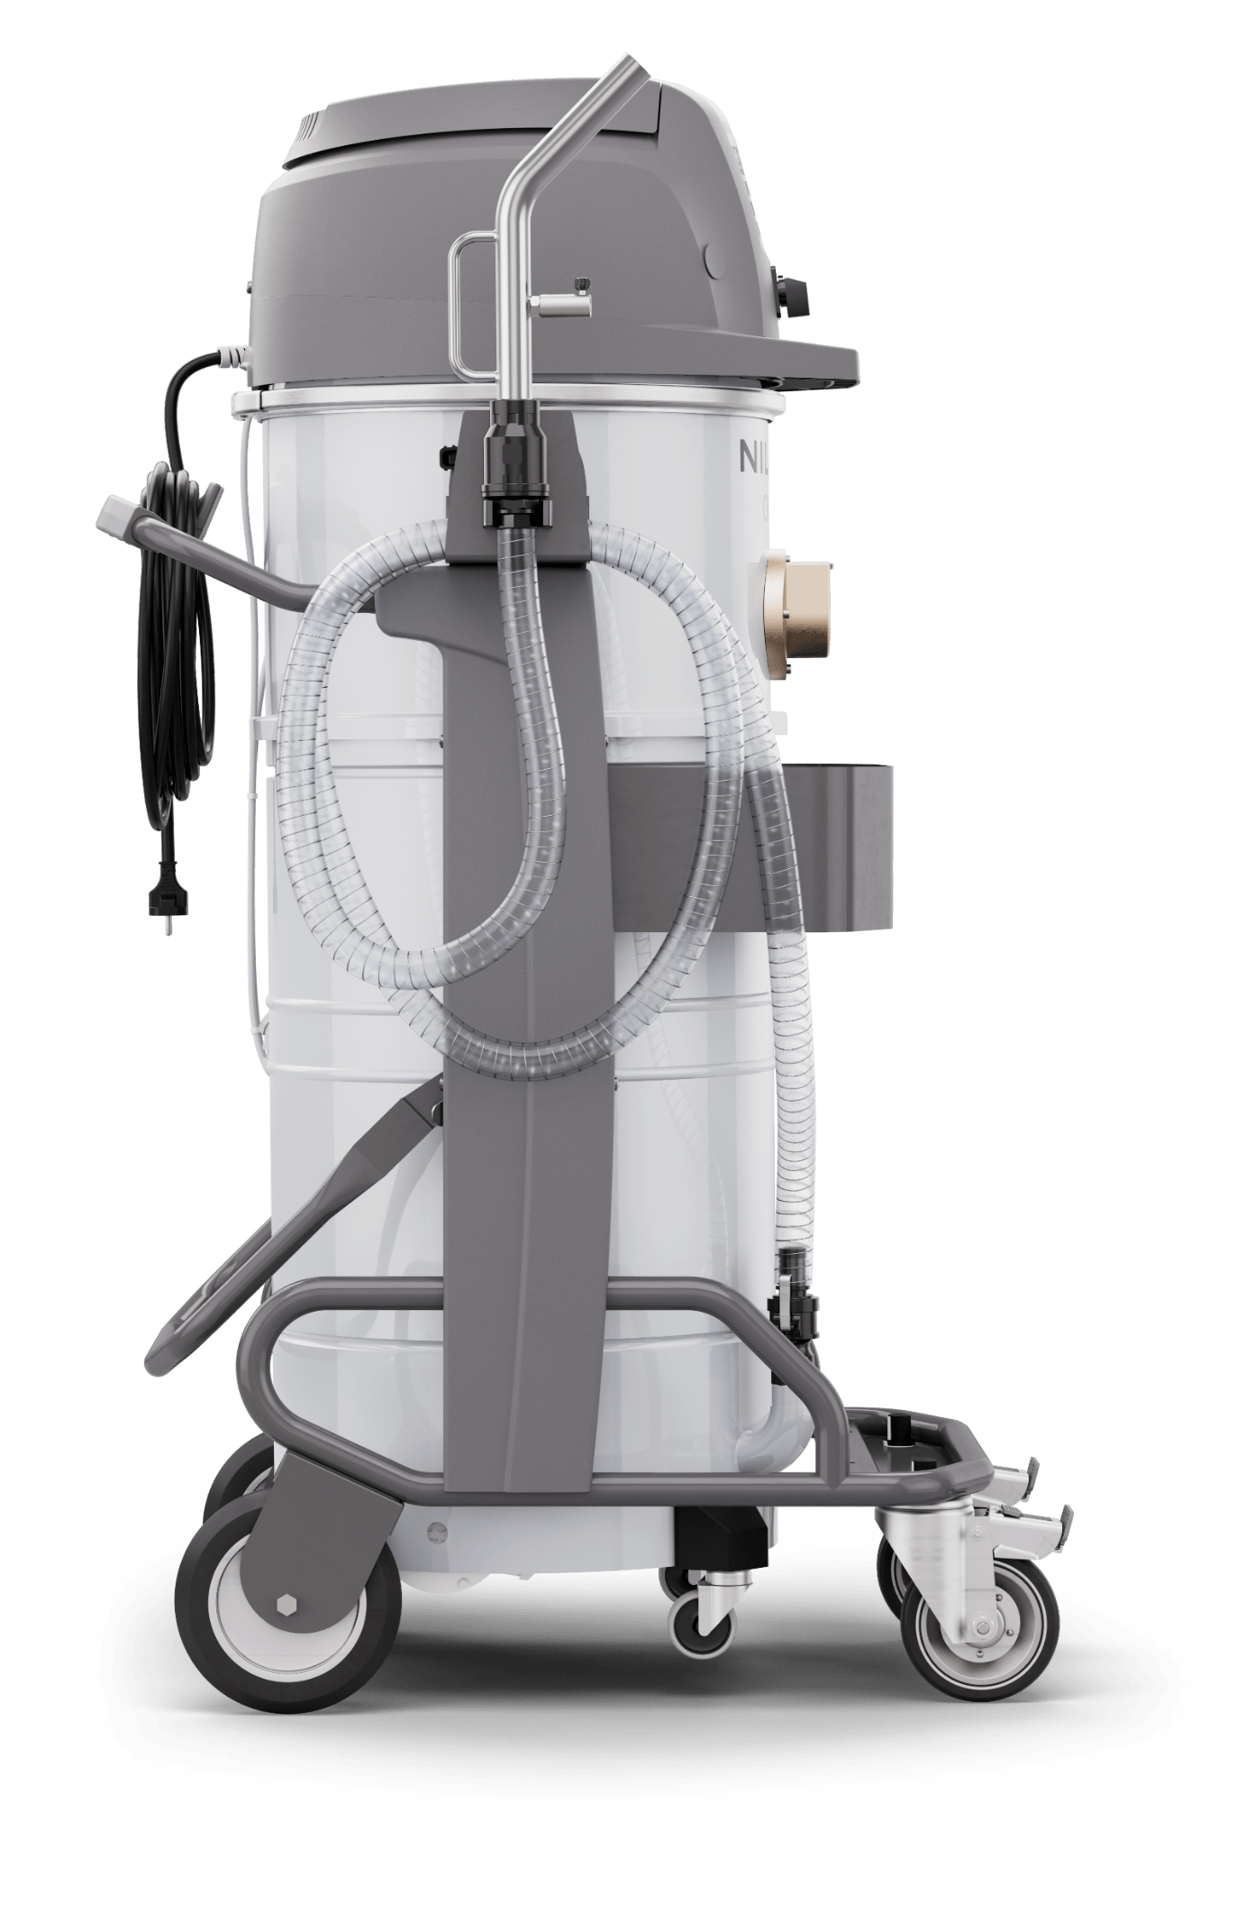
OIL230
Pump under the container
External self-priming pump
Stays clean and reliable – no contact with contaminated liquid.
Maximises container capacity – more liquid, less downtime.
Low center of gravity for rock-solid stability.
Easy service access – pump is always within reach.
High-speed discharge
Self-priming design for instant operation.
Up to 1,000 litres emptied in just 10 minutes.

Slide 10
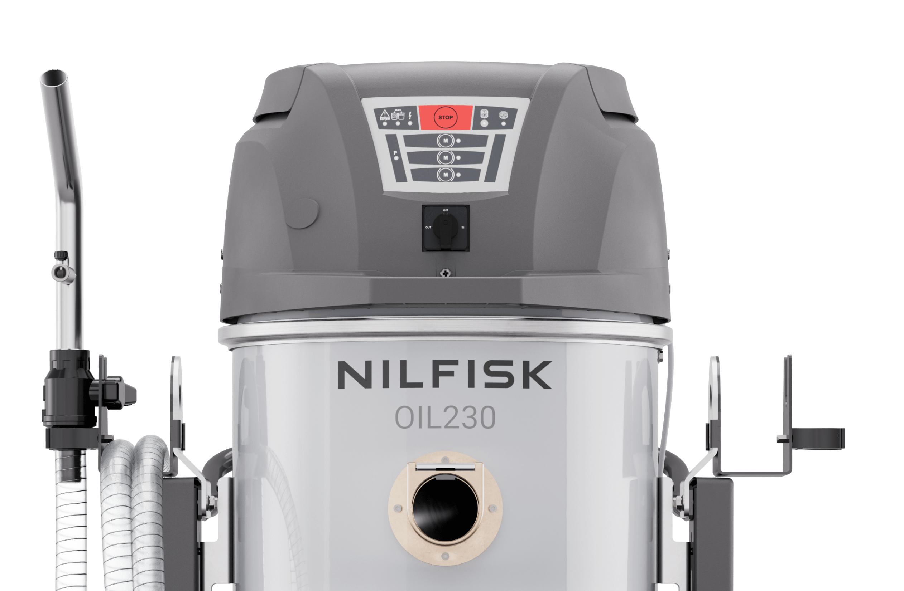
OIL230 UI
Smart, simple, and intuitive
One main switch to control all the three operating modes
LED indicators give instant feedback on machine status and liquid levels.
Pump status light clearly shows when discharge is active.
Motor selection: run on one, two, or three motors depending on the job.

Slide 11
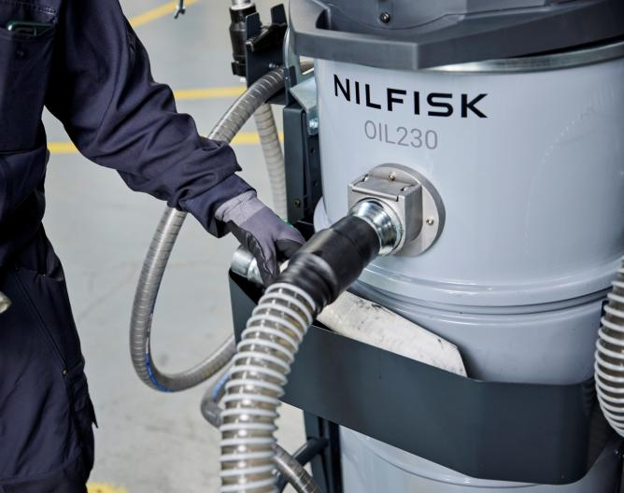
OIL230
Everything in its place!
Special hose holders keep hoses neatly arranged on-board and always ready for use.
On-board basket keeps accessories organised and always within reach.

Slide 12
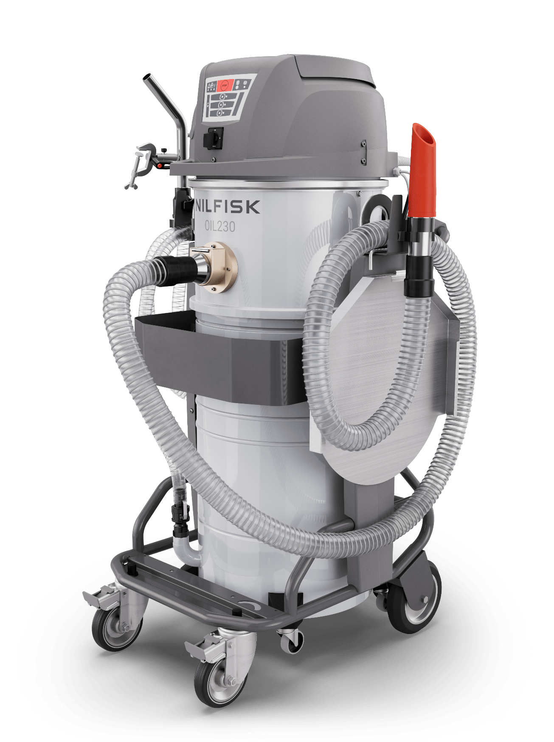
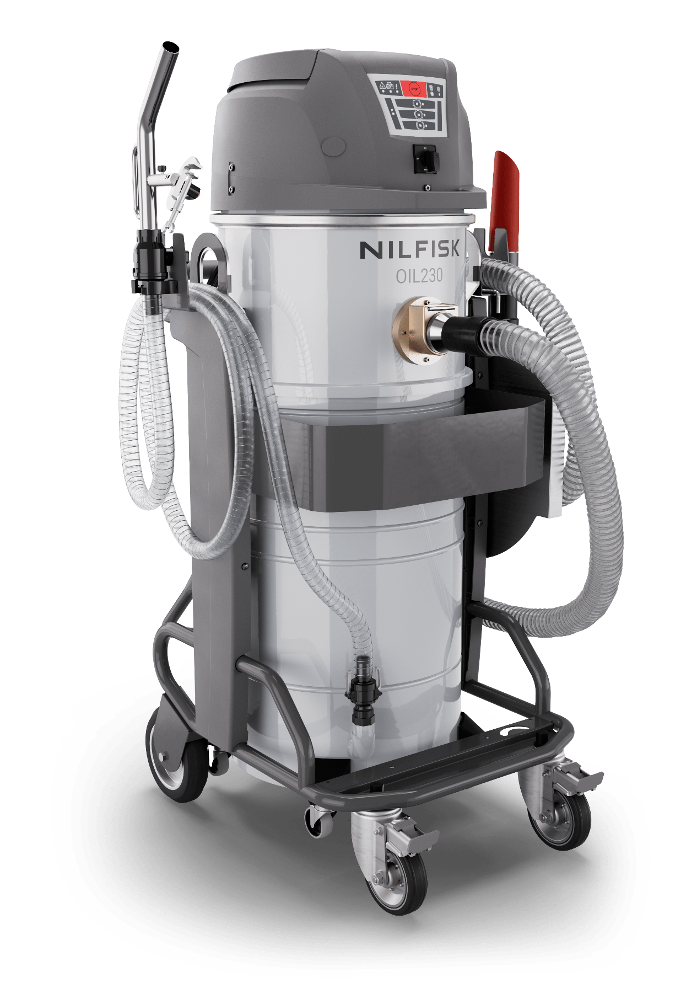
OIL230
Secure and organised onboard
Nothing comes loose or unrolls during transport.
Hoses secured with ends facing upward to avoid dripping.
Accessories stored in the on-board basket, always in order.
Integrated drip tray neatly placed on the hose holder.
Power cable firmly wrapped around the handle.
Accessories and accessory basket not included in the base version. Details on included items
and recommended accessories are provided in the dedicated section of this presentation.

Slide 13
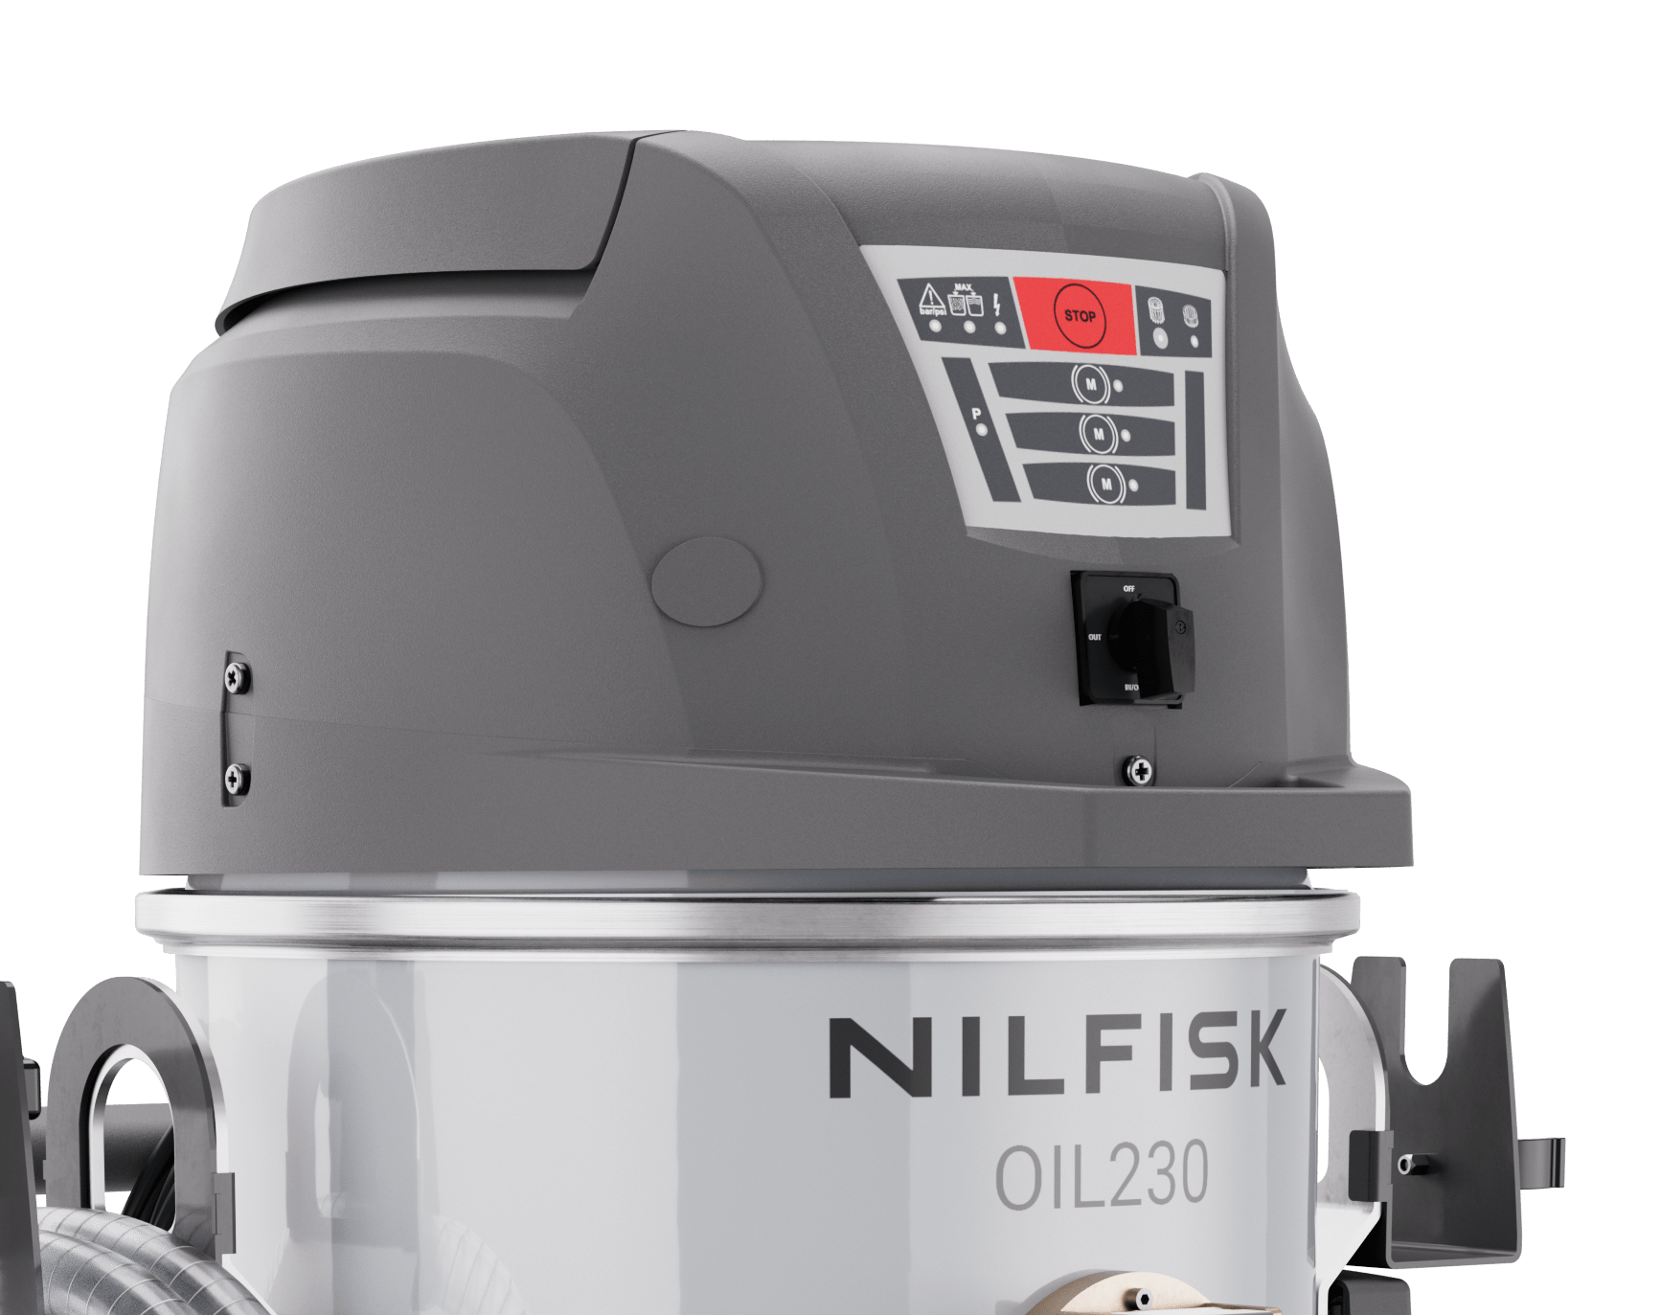
OIL230
No oil mist, no compromise
The oleophobic filter captures and blocks oil mist before it is released into the air. This prevents harmful emissions, reduces contamination of the workshop, and ensures a cleaner, healthier, and safer environment for operators.

Slide 14
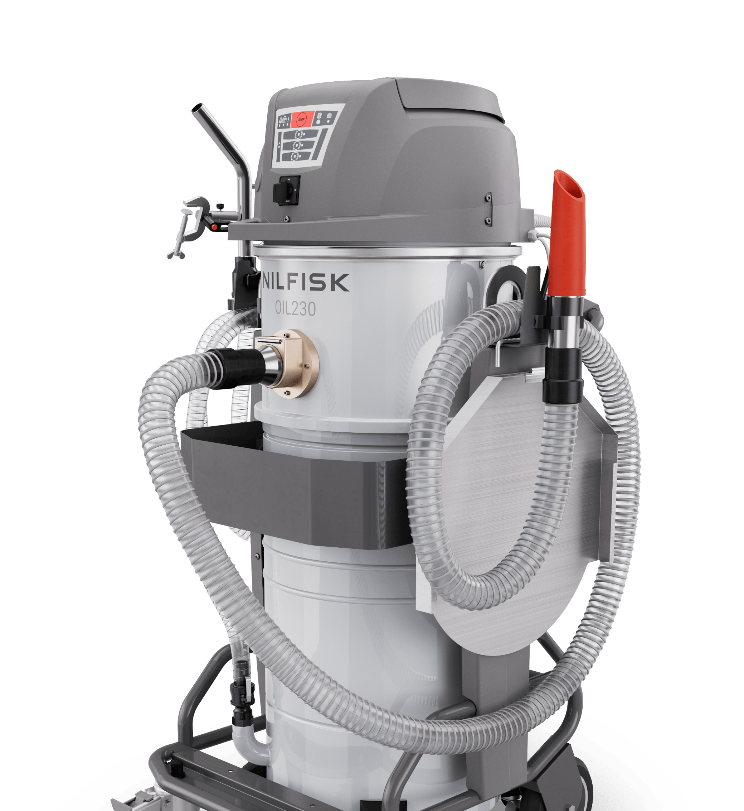
OIL230
Sealed against dripping
1
The OIL230 is designed to prevent leaks
and drips at every point:
Upward-facing hose holders to avoid liquid escape.
Double O-ring inlet ensuring tight sealing.
Accessory basket with spill containment for safe storage.
Integrated drip tray keeping the machine and floor clean.
1
2
2
3
3
4
4

Slide 15
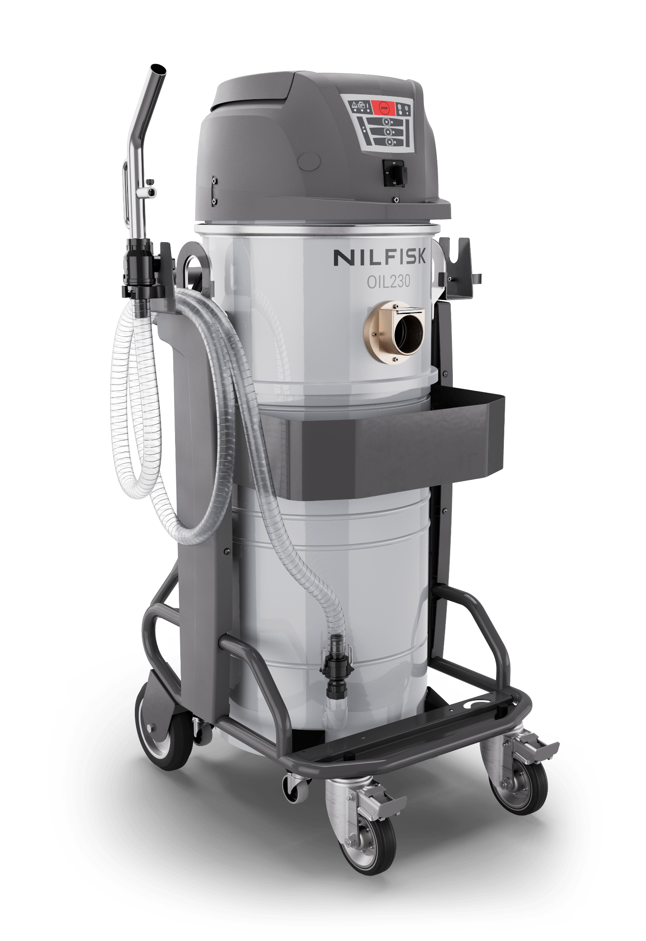
OIL230
Stronger. Safer. Built to last
The OIL230’s filter chamber and container are protected by a special plastic coating that shields them from the toughest conditions. Sharp, abrasive chips no longer compromise the surface, ensuring higher resistance and safer operation.
This protective layer significantly extends durability over time, reducing wear and maintenance needs. The result: a more robust machine that delivers consistent performance and reliability, day after day.

Slide 16
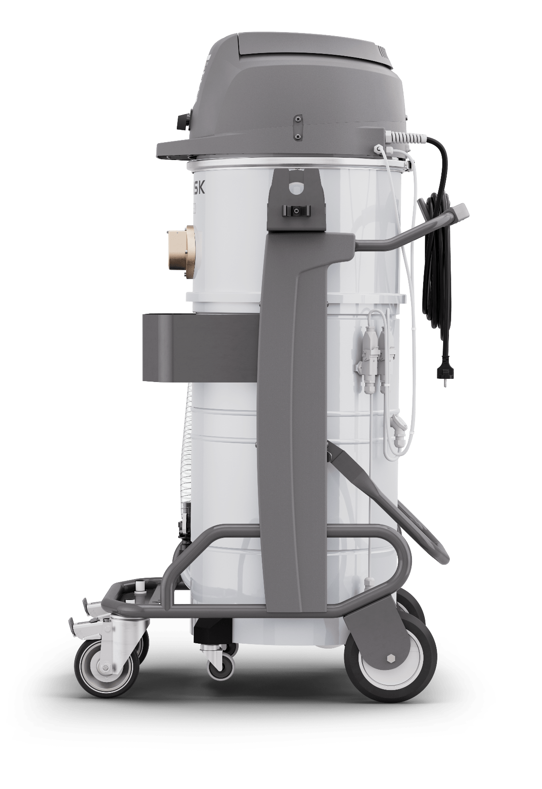
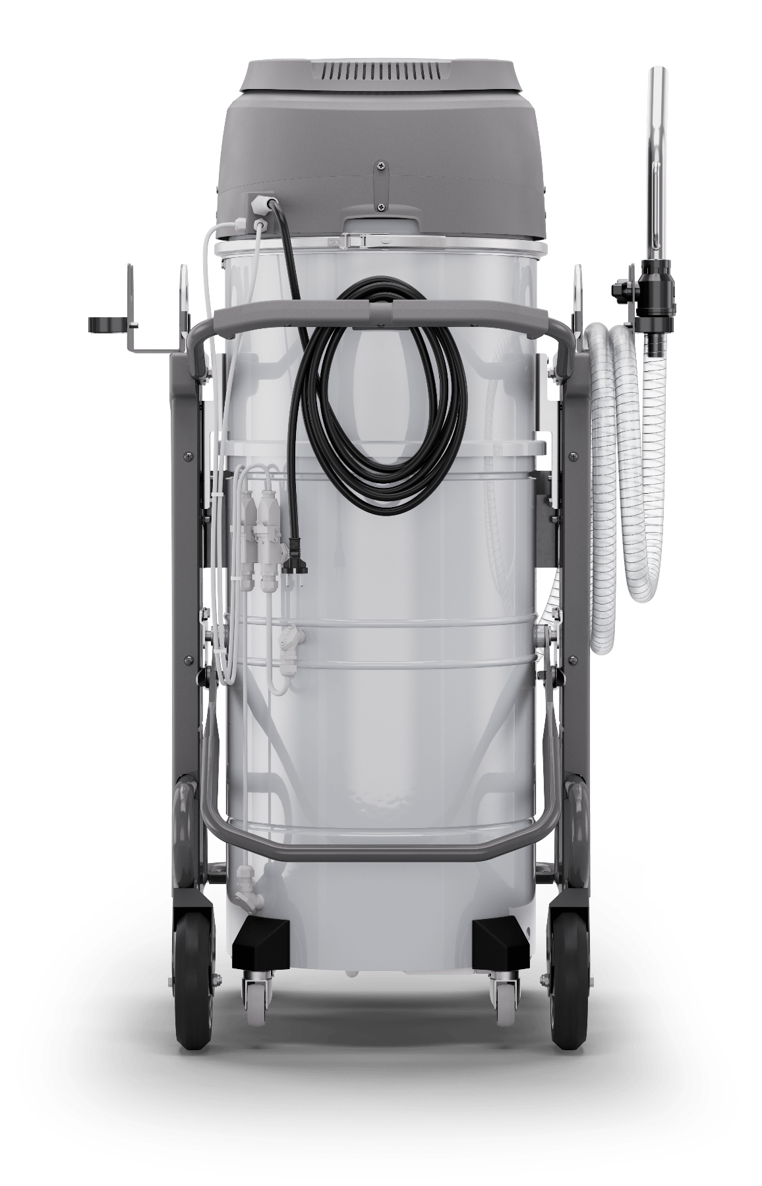
OIL230
Safe and stable lifting
The integrated lifting hooks make it easy to move the machine across the factory or lift it into large CNC centers, where bringing in the unit is easier than extending hoses.
The hooks are built into the hose-holder frame, ensuring a perfectly balanced and stable lift every time.
1
2
2
1

Slide 17
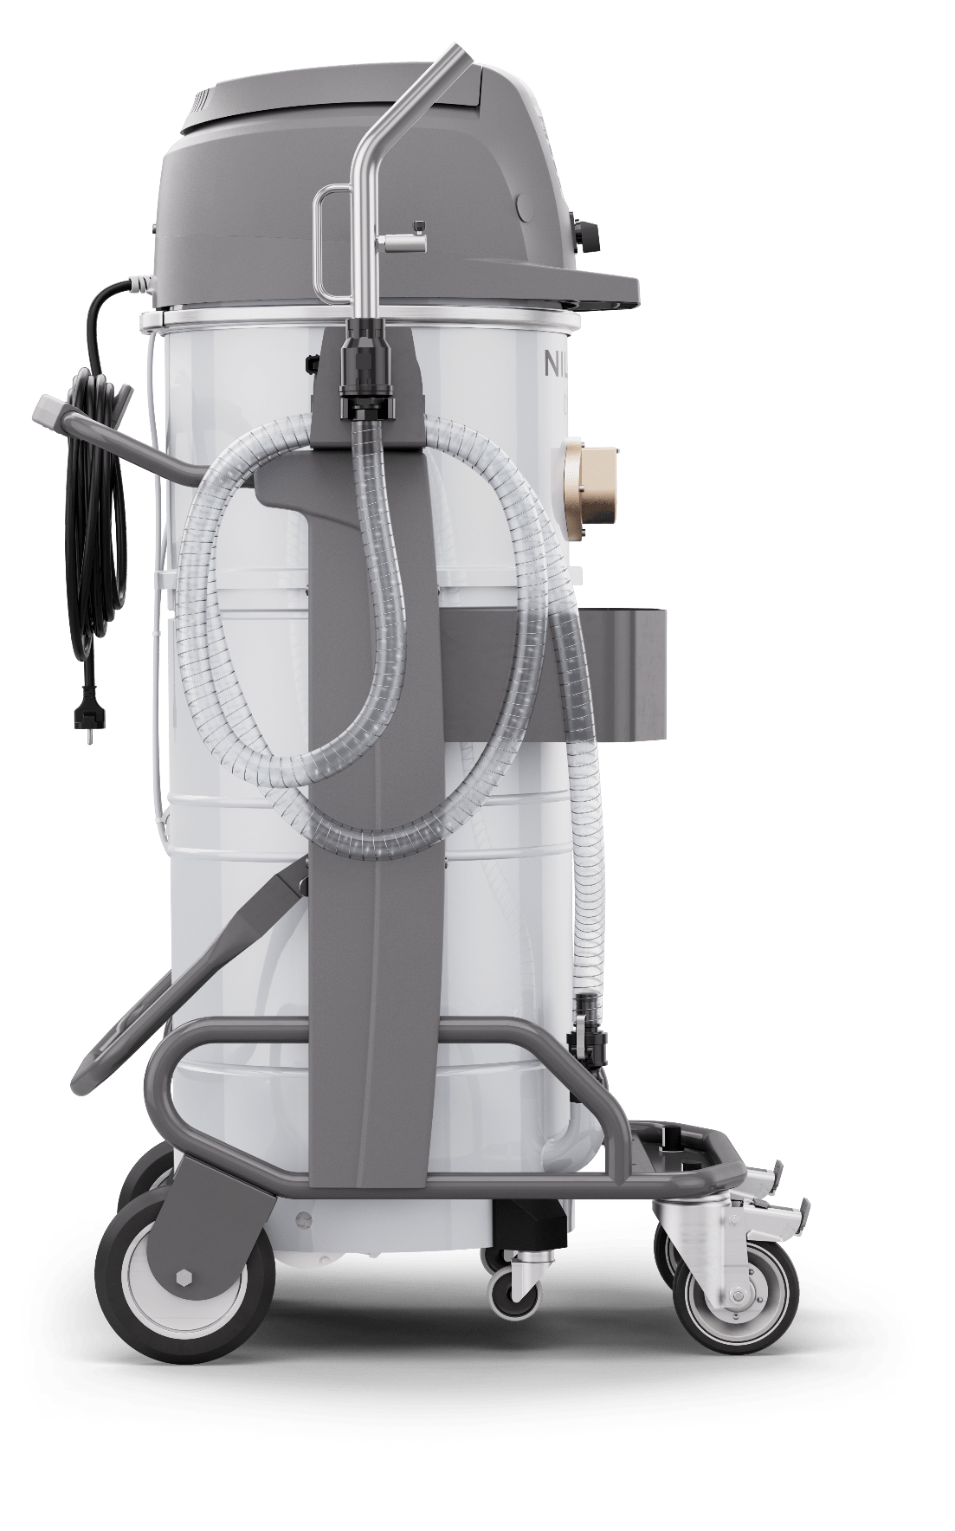
OIL230
Compact and easy to move
For cleaning contractors, the 1.4 m height makes it easy to load into standard vans and move between sites without special vehicles.
In metalworking plants, operators benefit from smooth manoeuvrability, making daily transport quick and effortless.
Its compact footprint fits easily into tight spaces, whether in use or simply parked, without blocking the workspace.
1.4 m

Slide 18
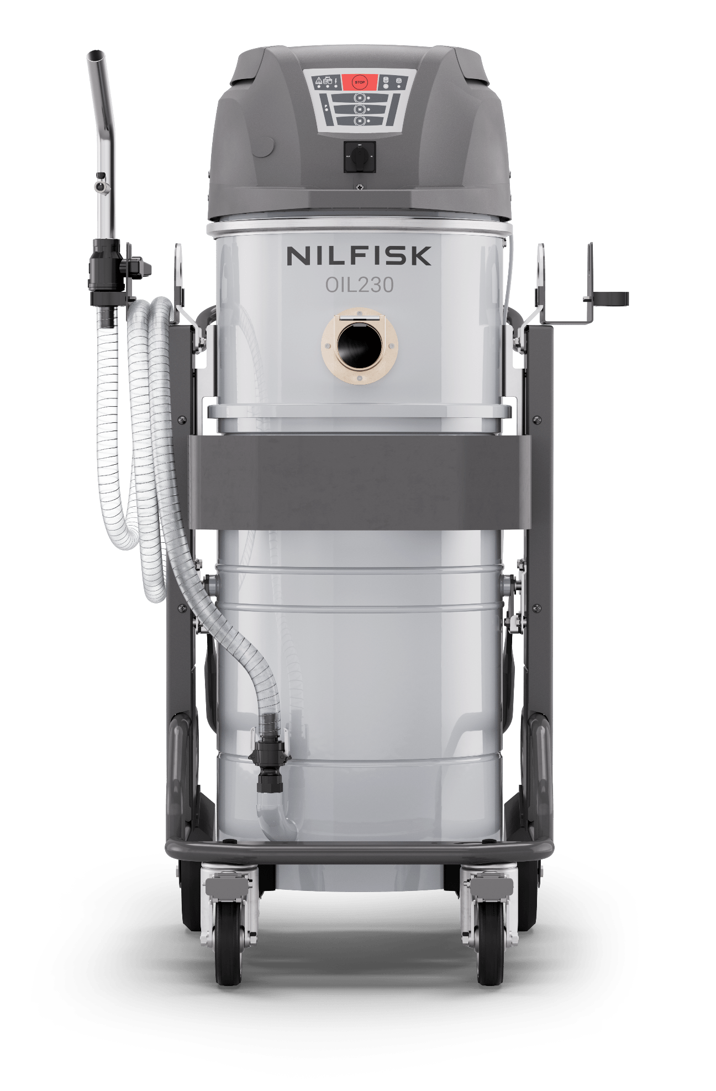
OIL230: Key features summary
Single switch for pump and vacuum
Faster and easier operation with one control
Compact footprint with high performance
Easy to load, transport, and store in standard vans – without compromising performance
Integrated discharge gun and hose holder
Prevents falling and keeps everything tidy during transport
Vacuum hose holder
Neat storage of the hose during machine transport
Sealed 70 mm inlet with O-rings
Ensures tight connection and prevents leakage during operation
Accessories basket with spill containment
Keeps tools organised and catches leaks when hose is disconnected
Single quick release for pump and sensor
Streamlined design for faster disconnection
Removable chips basket at belt height
Allows easy swarf-liquid separation with ergonomic access
Smart design for discharge hose and cables
Quick container extraction, no need to disconnect
External pump below container
Easier maintenance, cleaner setup, no need for priming
Simultaneous vacuum and discharge
Continuous liquid handling with no downtime and built-in electronic stop for safety

Slide 19
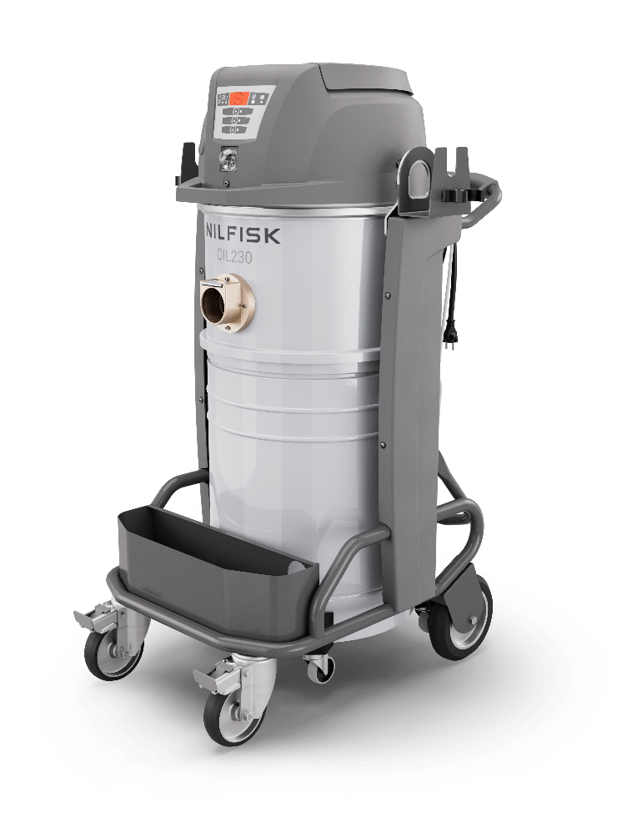
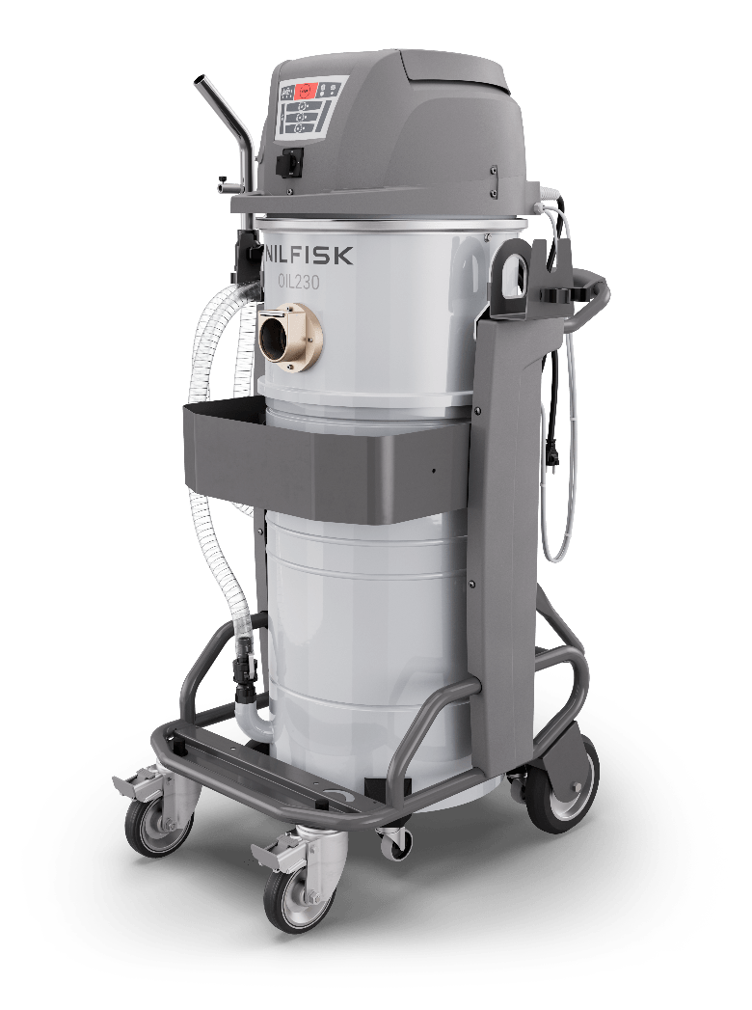
Product definition
Architecture and variant list
Two main variants:
OIL230 – Gravity discharge, simple and effective
OIL230 E – Pump discharge, fast
and powerful
Feature | OIL230 | OIL230 E
Chip basket | • | •
Electronic liquid shut-off | • | •
Discharge pump |  | •
Discharge gun |  | •
Oil mist filter | • | •
Lifting hooks | • | •
Hose hangers | • | •

Slide 20
Variants and options
Configurations tailored to every need
Acronym | Description | Benefits
E | OIL230 with pump driven liquid discharge | Fast, clean emptying at up to 100 l/min. Virtually unlimited liquid handling capacity, ideal for continuous use.
L120 | Optional container with 120 litres total volume (only E version) | Extended runtime and fewer stops for container emptying.
MSS | Mechanical solid stop | Safety back-up: prevents overfilling if the chip basket is not emptied.
CB (*) | Combo versions (*) | Flexible setups combining pump, filter, and safety devices for specific applications.
X | Stainless steel container | Higher durability, corrosion resistance, and longer service life.
IND | Industrial 16 Amps blue plug | Reliable industrial-grade power connection, ensuring safe operation and compliance in heavy-duty environments.
KW2.2 | 2 motors version of the OIL230 | Reduced power absorption, ideal for installations where electrical load cannot be exceeded — such as facilities in Scandinavian countries.
CHP | Version for Switzerland
N1 | Version for North America
* Combo versions are detailed in the Accessories section.

Slide 21
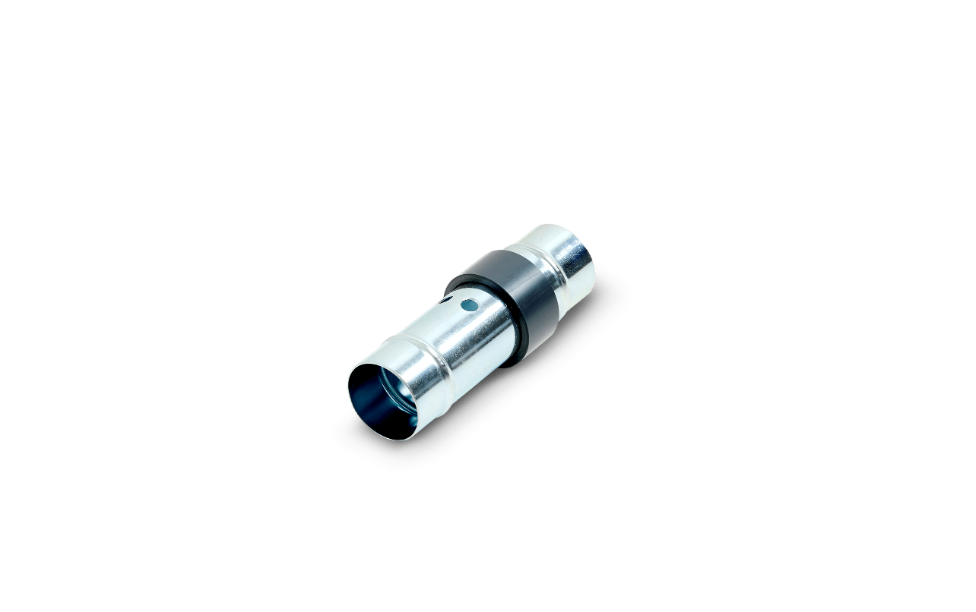
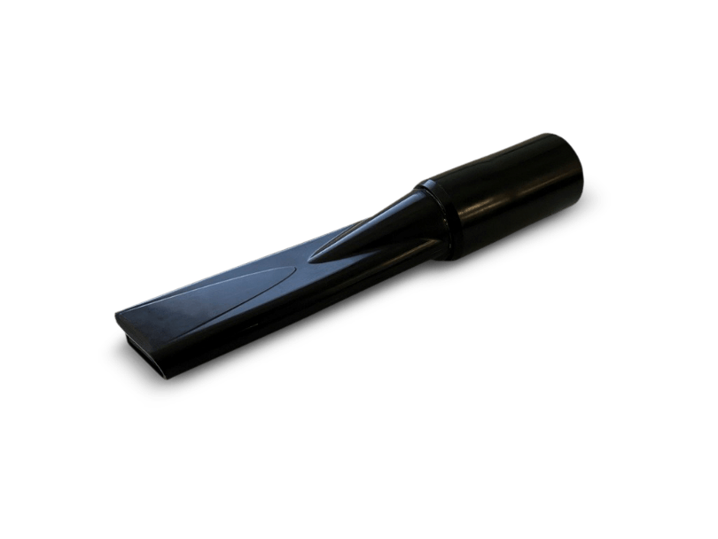
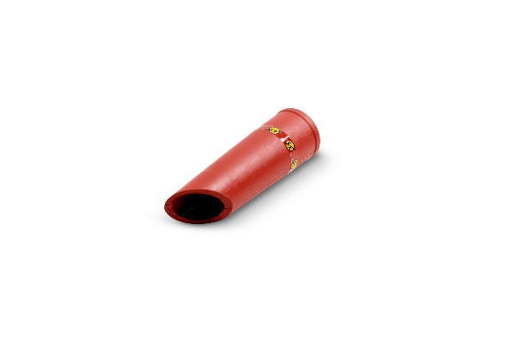
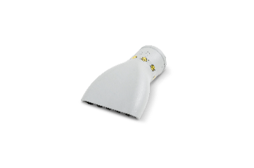
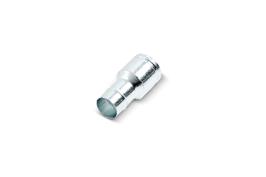
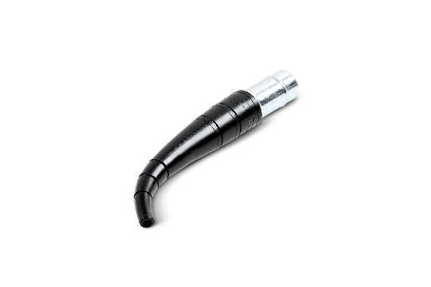
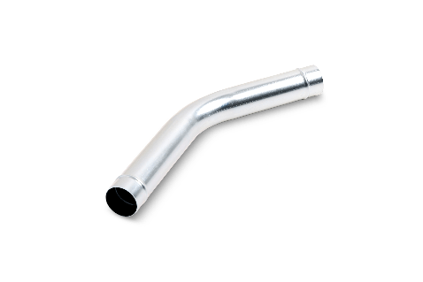
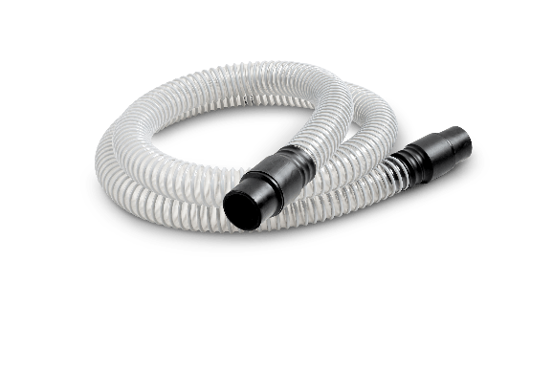
Specific accessories
A complete set to meet every cleaning need
General cleaning kit
P/N: Z7 24156
Durable 50 mm nozzles for high-volume suction and precise cleaning of crevices and flat surfaces. The 3m polyurethane hose offers the ideal balance between durability – resisting sharp chips and oil – and flexibility for comfortable handling.
Flow regulator
P/N: 4072200890
Ideal for collecting large volumes of liquid, especially when the nozzle is submerged. Improves control and efficiency during heavy liquid recovery.
Flexible flat nozzle
P/N: 4072100240
Lightweight and flexible, designed for tight spaces inside CNC machines. The 45° angled tip delivers effective cleaning both horizontally and vertically.

Slide 22
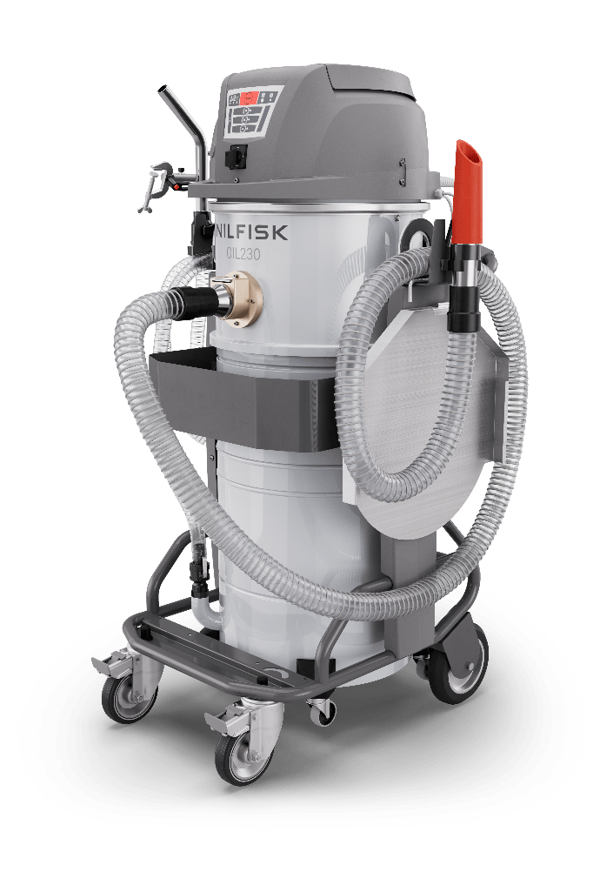
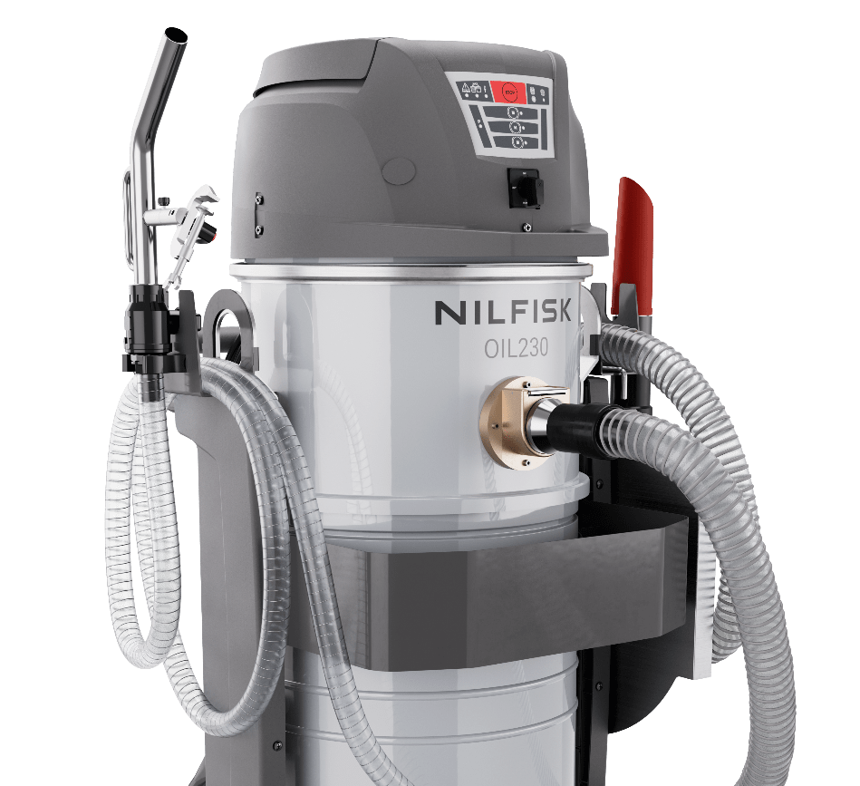

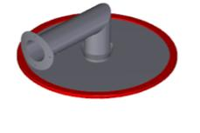
Specific accessories
A complete set to meet every cleaning need
Discharge gun with clamp
P/N: 4089101346
Easily mounts on the machine. Once set, the gun stays secured toward the discharge tank – no supervision needed during emptying.
Drip tray
P/N: 4081801764
Placed under the filter chamber when removing the container, it prevents even a single drop of oil from reaching the floor.
MSS: Mechanical solid stop
P/N: 4089101350 (galvanized)
P/N: 4089101351 (stainless steel)
Failsafe protection against chip basket overfilling – delivering maximum safety and peace of mind in daily use.

Slide 23
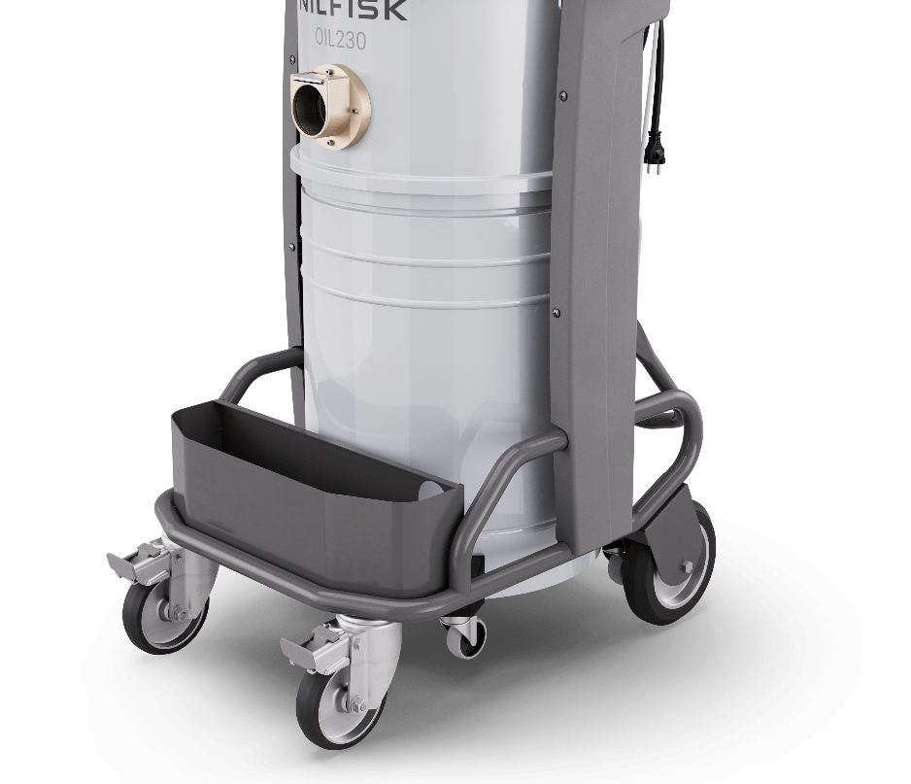
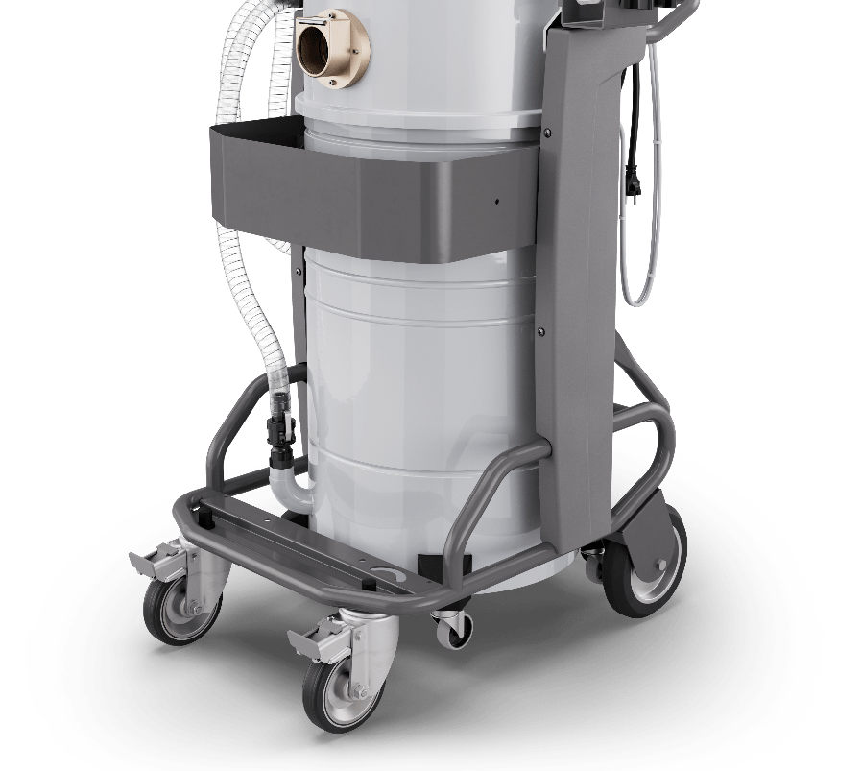

Specific accessories
A complete set to meet every cleaning need
Mud filter 100µm
P/N: Z8 17825
Captures even the finest metal sludge inside the chip basket, ensuring cleaner oil before it is returned to the machine.
Accessory basket OIL230
P/N: 4089101315
On-board basket designed for machines without pump. Keeps accessories organised and always within reach, while maintaining the machine compact and tidy.
Accessory basket OIL230 E
P/N: 4089101344
Tailored for pump-equipped models. Provides dedicated accessory storage without interfering with the pump system, ensuring a neat and ergonomic setup.

Slide 24
Combo versions
Ready-to-use kits for typical applications
Each combo includes the machine plus essential accessories – making the OIL230 immediately ready for common cleaning and recovery tasks.
Stock code | Description | Base version | CB5013 | CB5014
Z7 24156 | Kit AC.D50 equipments cleaning | OIL230 / OIL230 E | • | •
4072100240 | Flexible flat lance D50 conductive | OIL230 / OIL230 E | • | •
4072200890 | Connection joint reg. D50 fe complete | OIL230 / OIL230 E | • | •
4089101346 | Clamp for discharge gun | OIL230 / OIL230 E | • | •
4081801764 | Anti-drip tray M.OIL230 | OIL230 / OIL230 E |  | •
4089101315 | Accessory basket R.7016 matt M.OIL230 | OIL230 |  | •
4089101344 | Accessory basket R.7016 matt M.OIL230 E | OIL230 E |  | •

Slide 25
Accessories
Selected for demanding oil & chips applications
A curated list of the most relevant and widely used accessories – optimized for heavy-duty environments with oil, sharp chips, and abrasive debris.
Stock code | Accessory | Acc group
4072400195 | Antioil kit of acc D50 mach+floor | Accessory kit
Z7 24156 | Kit AC.D50 equipments cleaning | Accessory kit
Z7 22122 | Handgrip D50 chrome plt. complete | Extension tube
Z7 22122 | Handgrip D50 chrome plt. complete | Extension tube
Z8 17825 | Bag filter mud D460 100micr kit eco-oil | Filter
4072100240 | Flexible flat lance | Nozzle
Z7 22141 | Conic end D50/20 complete | Nozzle
Z7 21010 | Conic tube D50 rubber | Nozzle
Z7 21075 | Curved flat lance D50 fe | Nozzle
Z7 21026 | Flat lance D50 zinc plt. | Nozzle
Z7 22021 | Flat lance D50/40 zinc plt. | Nozzle
Z7 21030 | Grey nbr nozzle D50 120 mm | Nozzle
Z7 22167 | Liq.Sucker D50 mm500 fe complete | Nozzle
Z7 22027 | Liquids sucker D50 mm400 fe complete | Nozzle
Z7 22034 | Scraping sucker D50 fe | Nozzle
4089101315 | Accessory basket R.7016 matt M.OIL230 | Option
4089101344 | Accessory basket R.7016 matt m.OIL230 E | Option
Stock code | Accessory | Acc group
4081801764 | Anti-drip tray M.OIL230 | Option
4089101350 | Mechanical chips stop device kit | Option
4089101351 | Mechanical chips stop device kit (inox) | Option
4089101346 | Clamp for discharge gun | Option
4072200890 | Complete tube connector D50+reg | Vacuum hose and connection
Z7 22062 | Air hose D50 MT3+sleeves | Vacuum hose and connection
Z7 22363 | Air hose D50 MT5+sleeves | Vacuum hose and connection
Z7 21012 | Bent connection D50 fe | Vacuum hose and connection
Z7 21003 | Connection tube D50 fe | Vacuum hose and connection
Z7 22298 | Polyurethane hose D50 3 m +sleeves | Vacuum hose and connection
Z7 22366 | Polyurethane hose D50 5 m +sleeves | Vacuum hose and connection
Z7 22001 | Reducer iron D70/50 | Vacuum hose and connection
Z7 22162 | Reducer regulation D70/50 complete | Vacuum hose and connection
Z7 24003 | Rubber hose D50 3 m+integrated sleeves | Vacuum hose and connection
Z7 24179 | Rubber hose D50 5 m+integrated sleeves | Vacuum hose and connection
Z7 20002 | Sleeve D50 rubber | Vacuum hose and connection
40000219 | Sleeve D50antistat.rubber component atex | Vacuum hose and connection

