Slide 1

SC550 Cuustomer Introduction

Slide 2
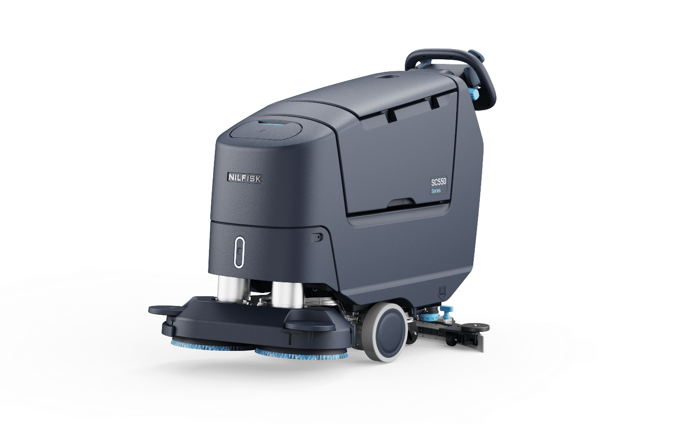
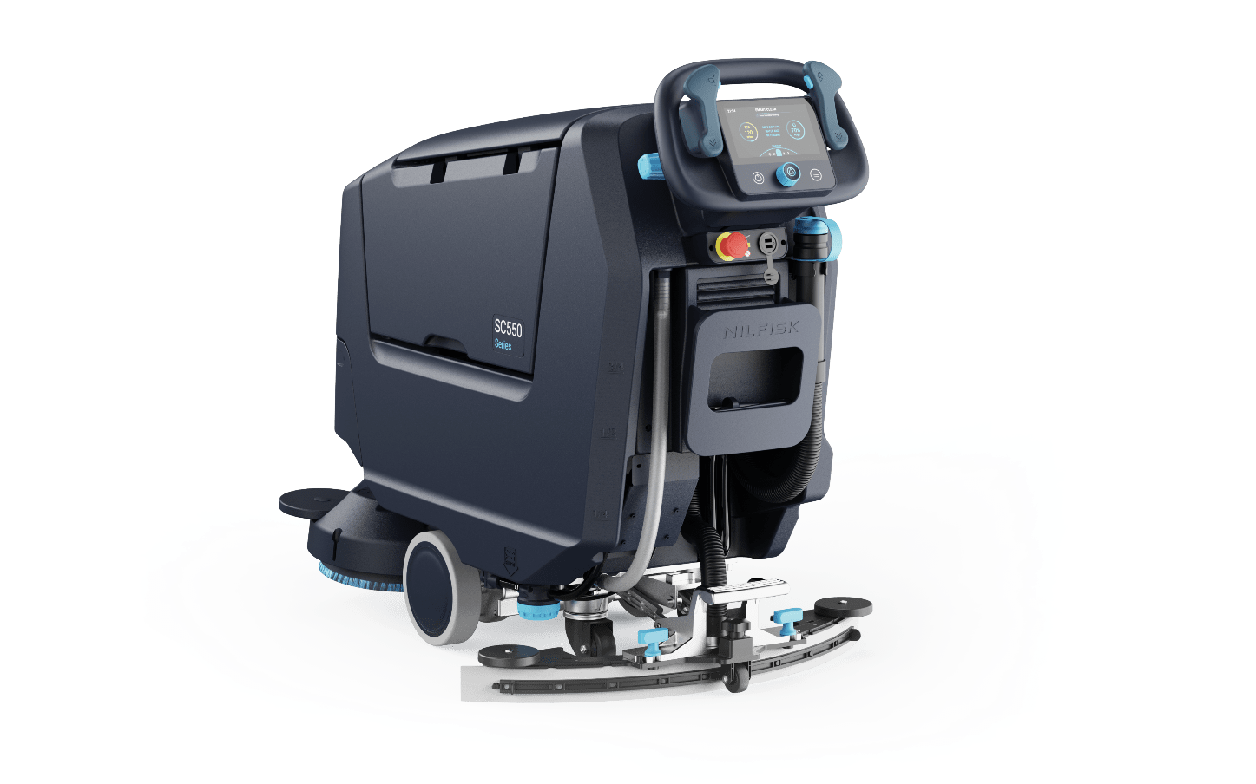
Translating insights into great experience outcomes
Following physical, digital and user experience design strategies

Slide 3
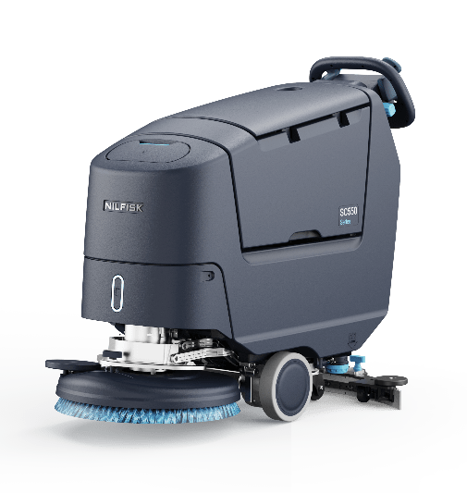
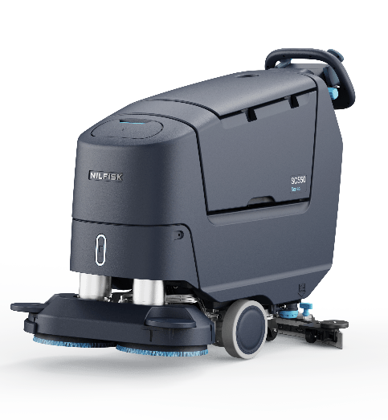
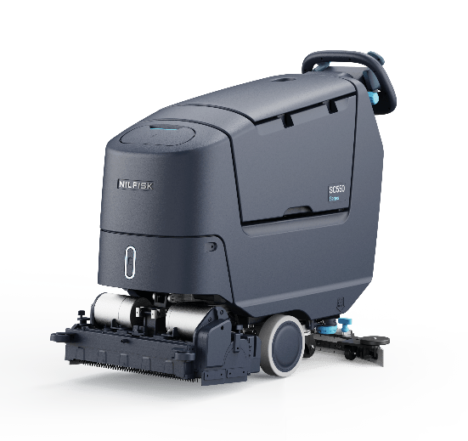
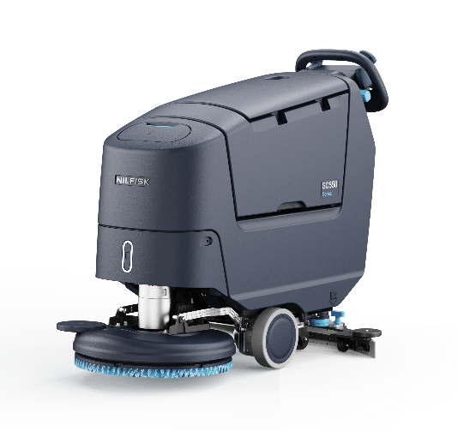
Four deck configurations
SC550 customer introduction
Removable front lower panel supports service and configuration
Deck 1
Single Disc
Deck 2
Dual Disc
Deck 3
Cylindrical
Deck 4
Rev

Slide 4
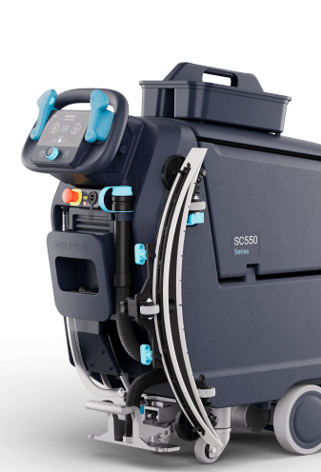
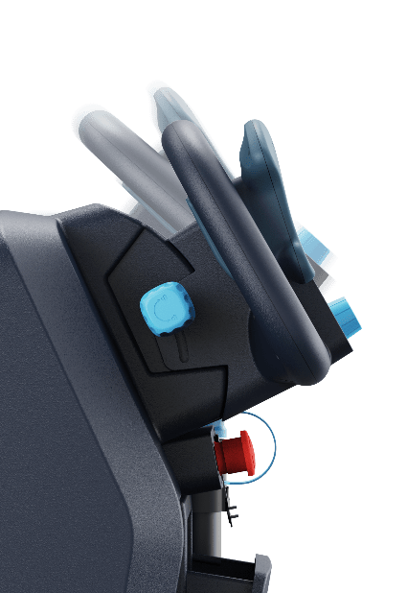
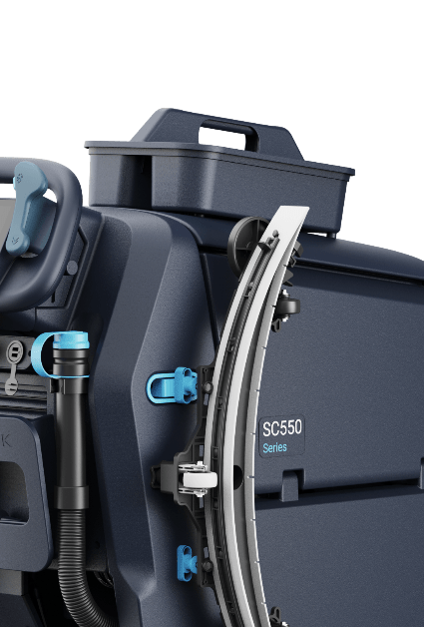
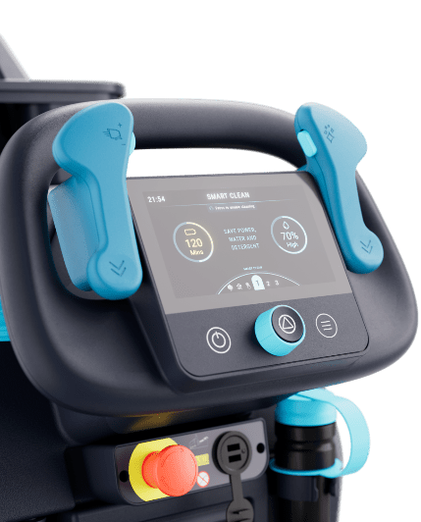
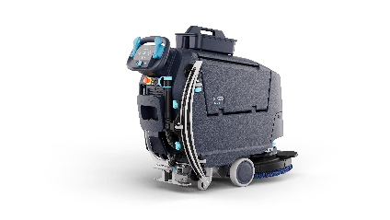

Translating insights into great experience outcomes
SC550 customer introduction
Coloured, informative, antimicrobial touch points
Improved ergonomics for optimum comfort & fit
Optimised user interface for different skill levels
User-centred features

Slide 5
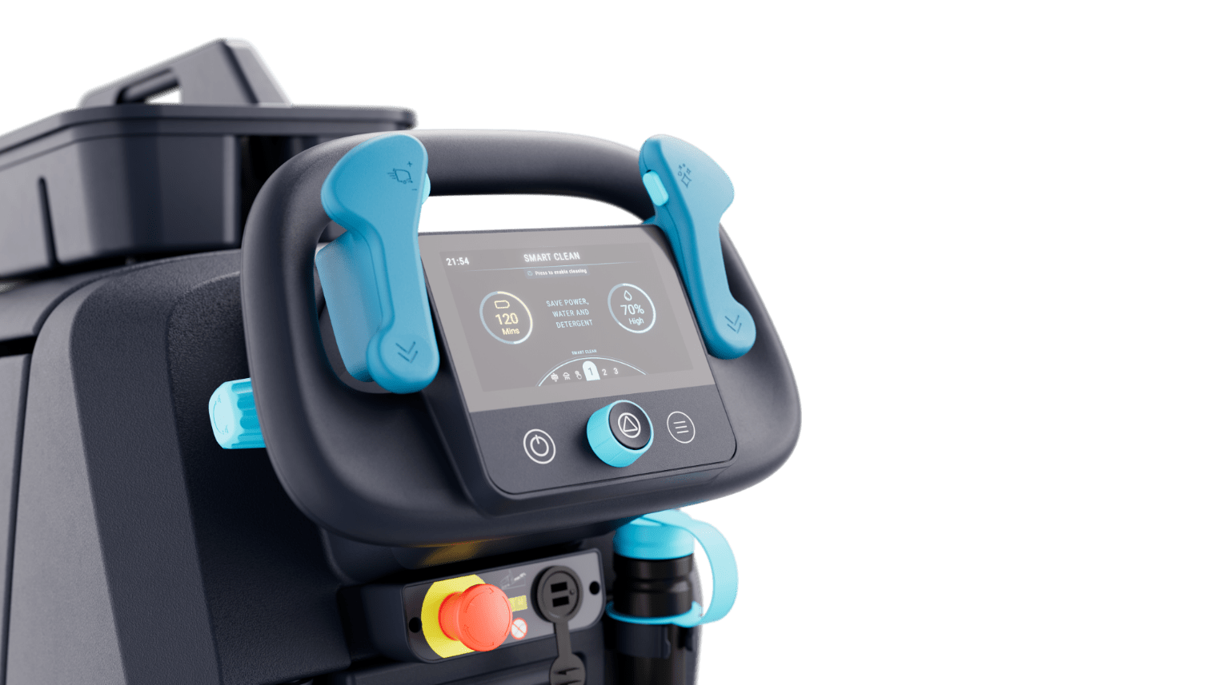
Different user access levels
SC550 customer introduction
Pin login to adapt UI
Language
Relevant presets
Relevant settings
Skill level

Slide 6
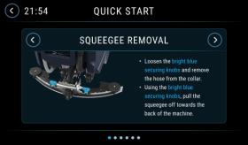
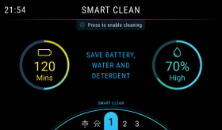
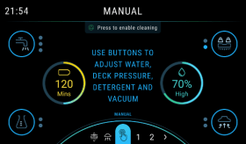
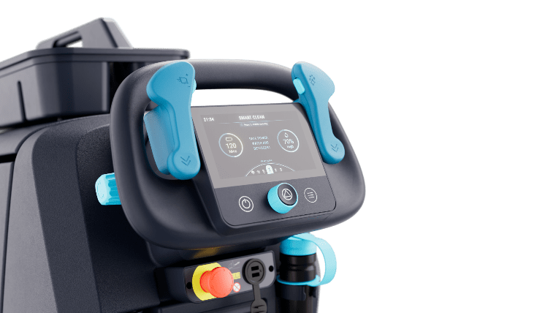
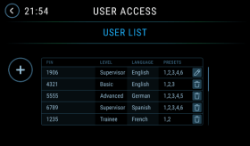
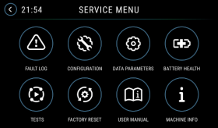
Different user access levels
SC550 customer introduction
TRAINEE OPERATOR
Pin entry 1
BASIC OPERATOR
Pin entry 2
ADVANCED OPERATOR
Pin entry 3
Guidance through machine usage.
Access to Basic presets.
Access to Advanced presets.
SUPERVISOR
Pin entry 4
SERVICE
Pin entry 5
Access to user setup, all machine settings.
Access to service menu, configuration, tests etc.

Slide 7

Sustainability
SC550 customer introduction
Designed to accommodate recycled materials
Up to 30% recycled plastic content in 2025.
Energy efficient motor
.
Smart presets reduce operator error
Ensuring simplicity for basic operators and empowering them with the right settings for the job.
Water efficient pump system and presets

Slide 8
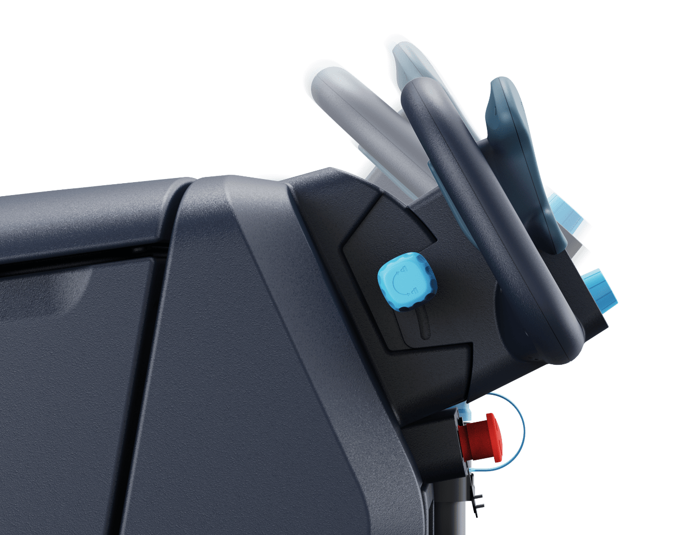
Steering adjustment feature
SC550 customer introduction
Improved ergonomics
Adjustable steering to angle screen and handle to correct height for a wide range of users.

Slide 9
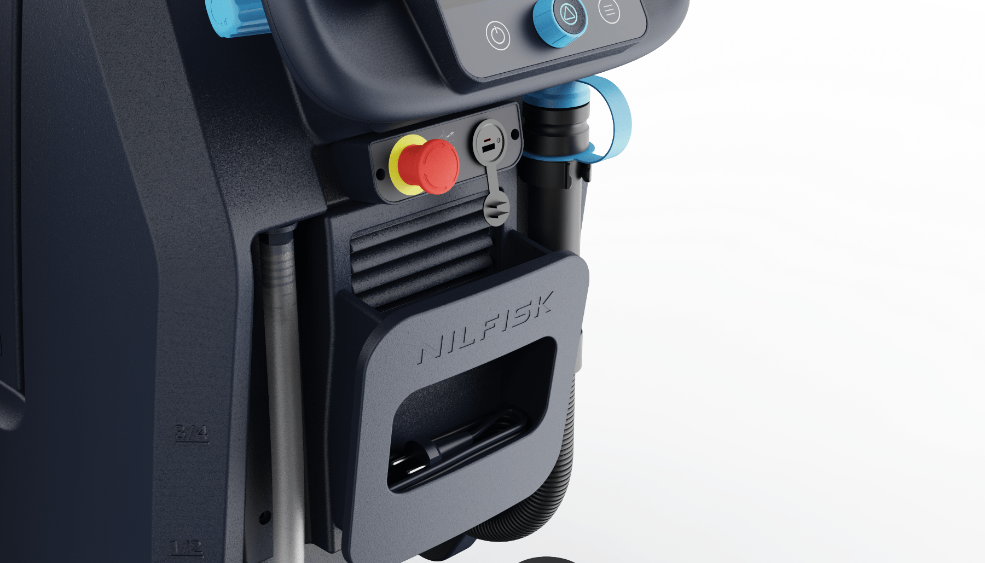
User centered features
SC550 customer introduction
Optimised e-stop
Positioned so it is easy to access but avoids accidental pressing.
Personal device charging and storage
USB and USB-C charging with convenient storage area.

Slide 10
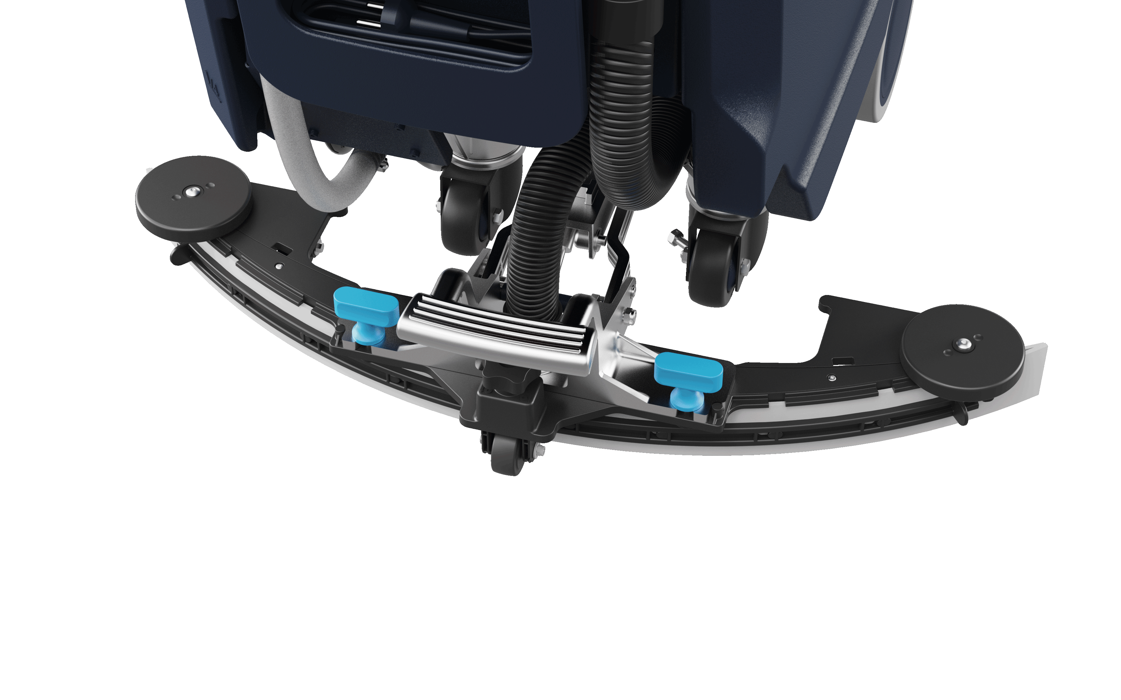
User centred features
SC550 customer introduction
Durable & Lightweight easy use squeegee
Made from durable plastic tested in the field. Easy removal twist and pull touchpoints.

Slide 11
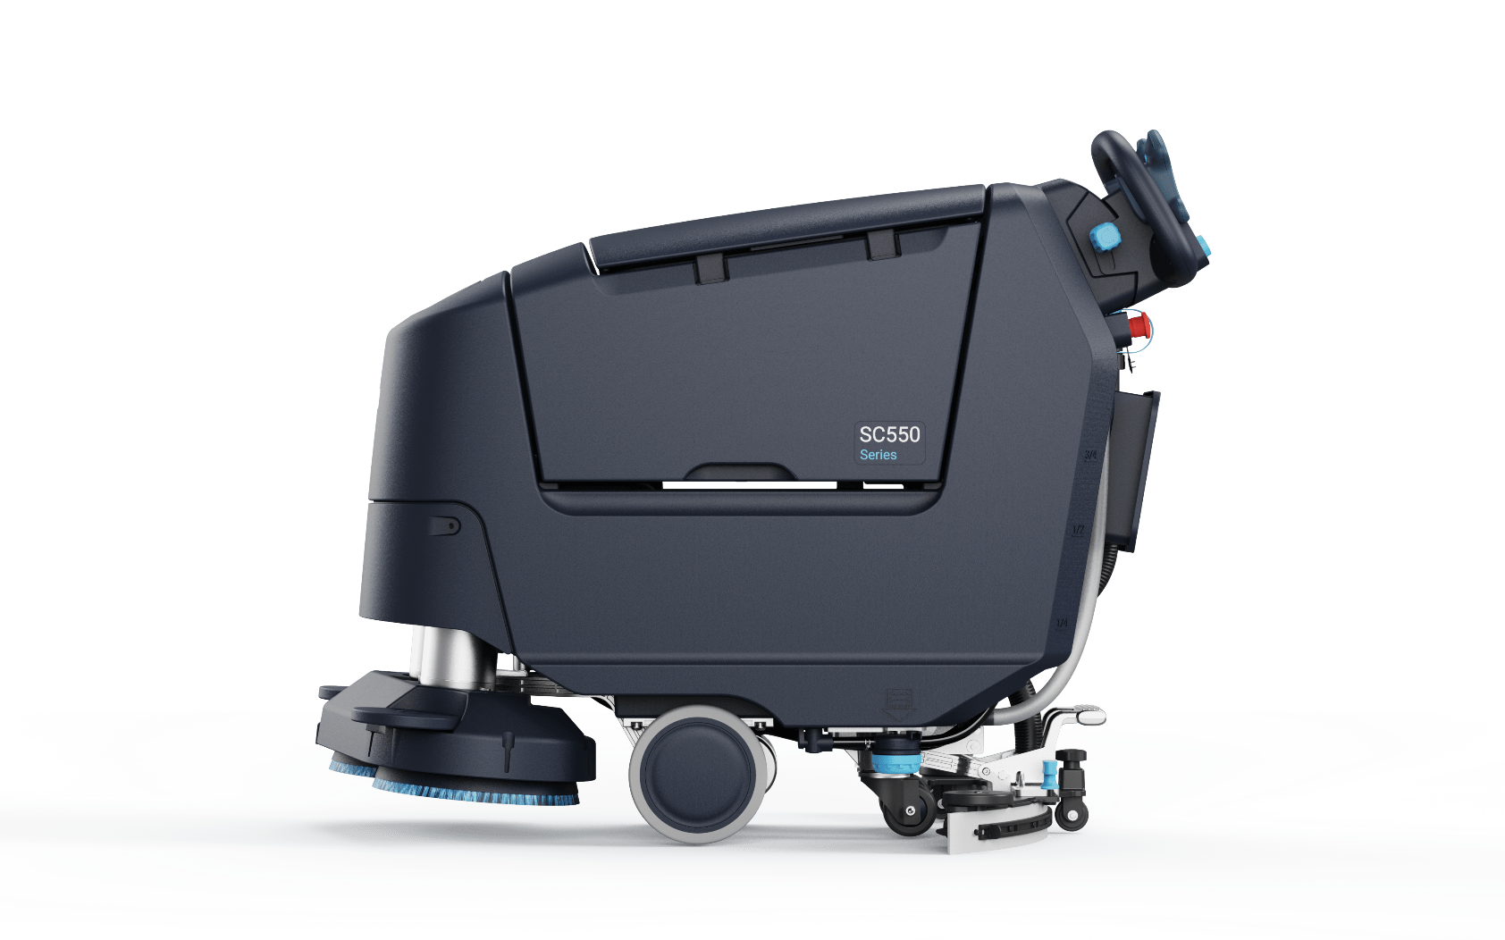
User centered features
SC550 customer introduction
Automatic e-brake
Removes need to place parking brake.

Slide 12
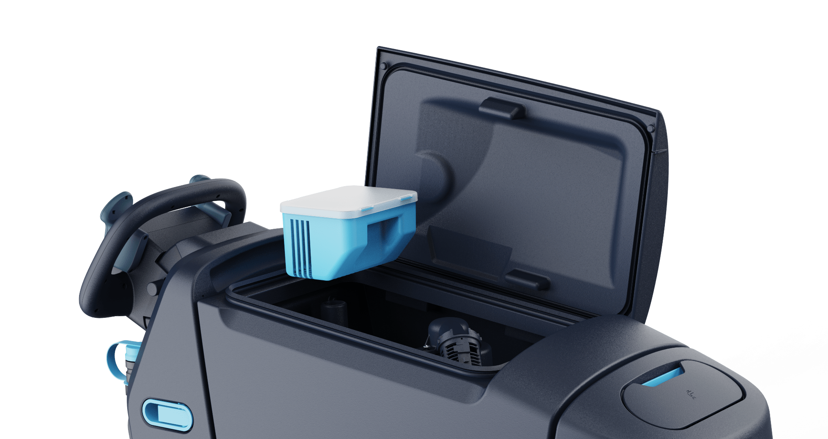


User centred features
SC550 customer introduction
Easy end of shift
Lid stays open for drying, easily removable antimicrobial debris tray.

Slide 13
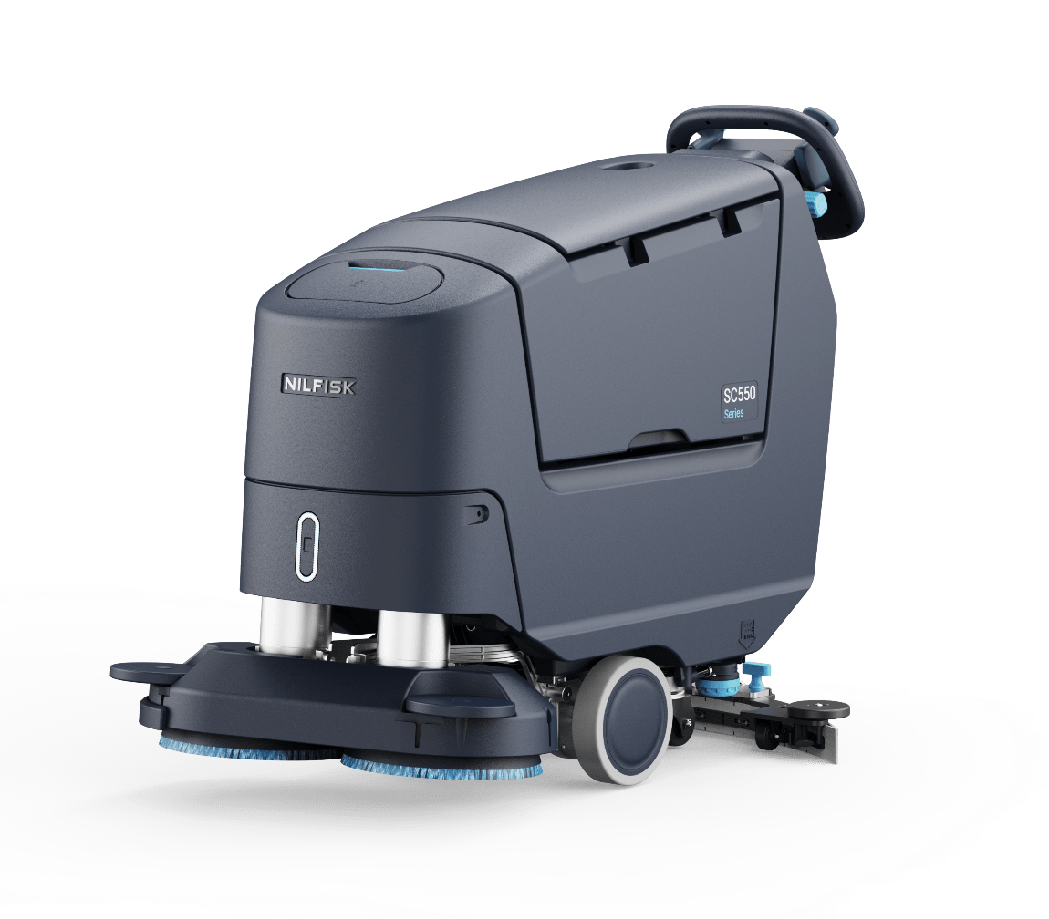
Serviceability
SC550 customer introduction
Robustness
Designed to withstand constant usage, with easily replaceable parts which are subject to intensive wear like hinges and clips.
Easy to service
Simple to absorb error logs, ease of access to serviceable parts.
Guidance through errors.
Service manual on machine.

Slide 14
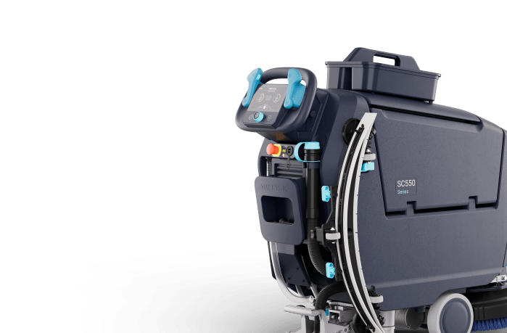
User centred features
SC550 customer introduction
Accessory caddy
With allocated space for water bottle.
Clip out squeegee drying hook
Orientated to clip back in out the way to prevent damage.

Slide 15
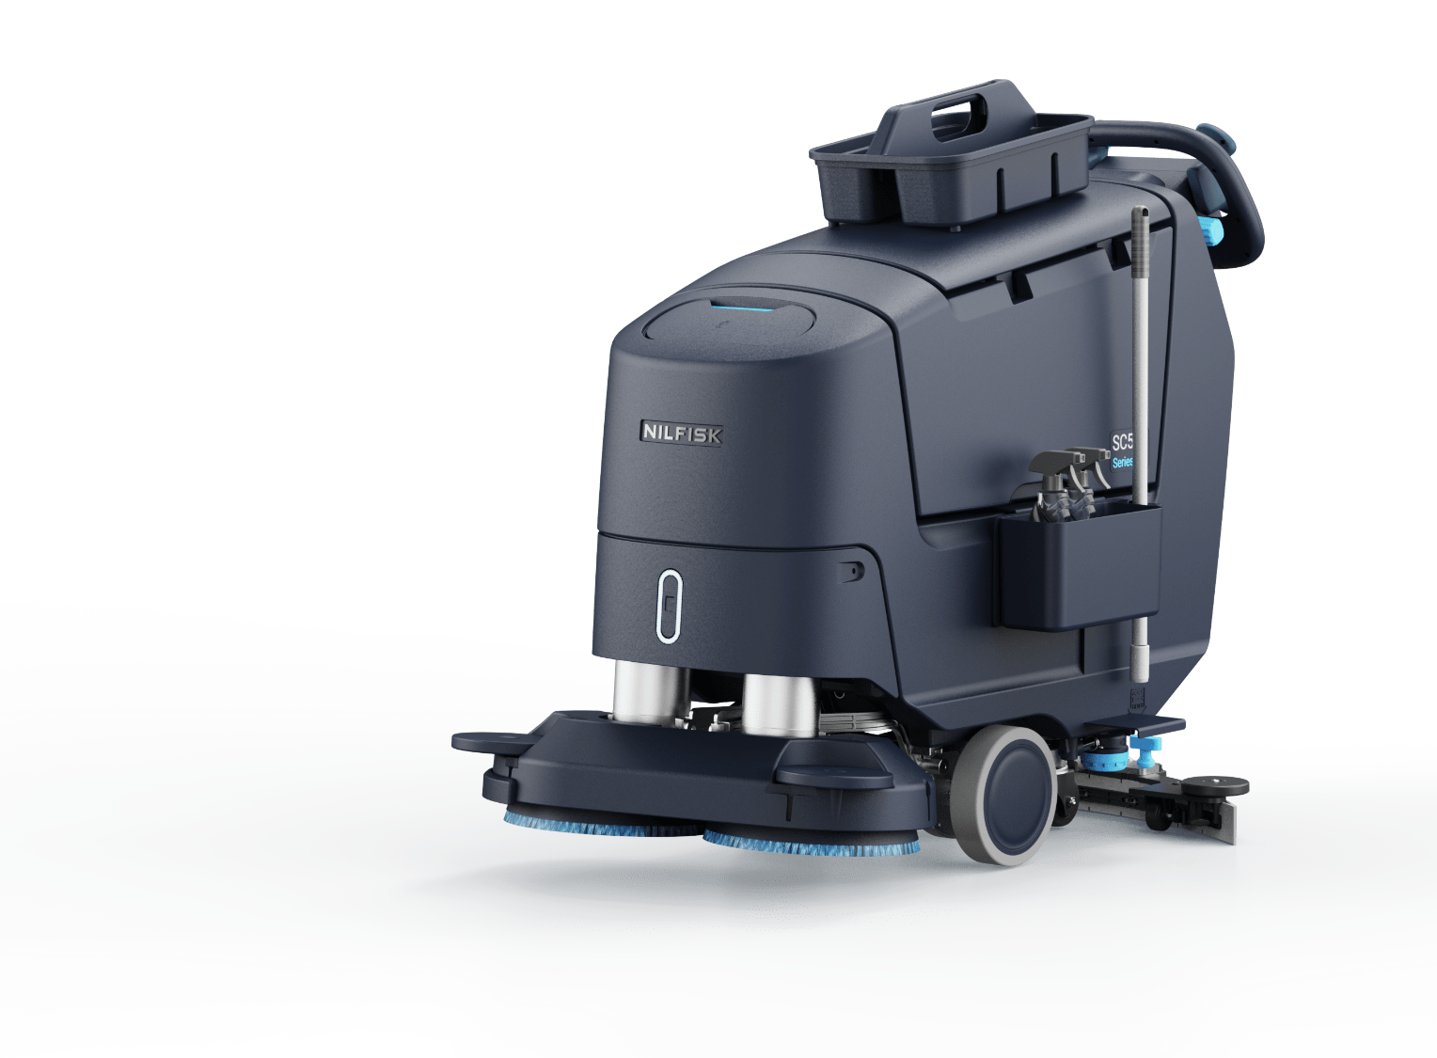
User centred features
SC550 Final Design
Compatible add on
Store everything you need on the machine – reduce trips to the cleaning cupboard, increase productivity.

Slide 16
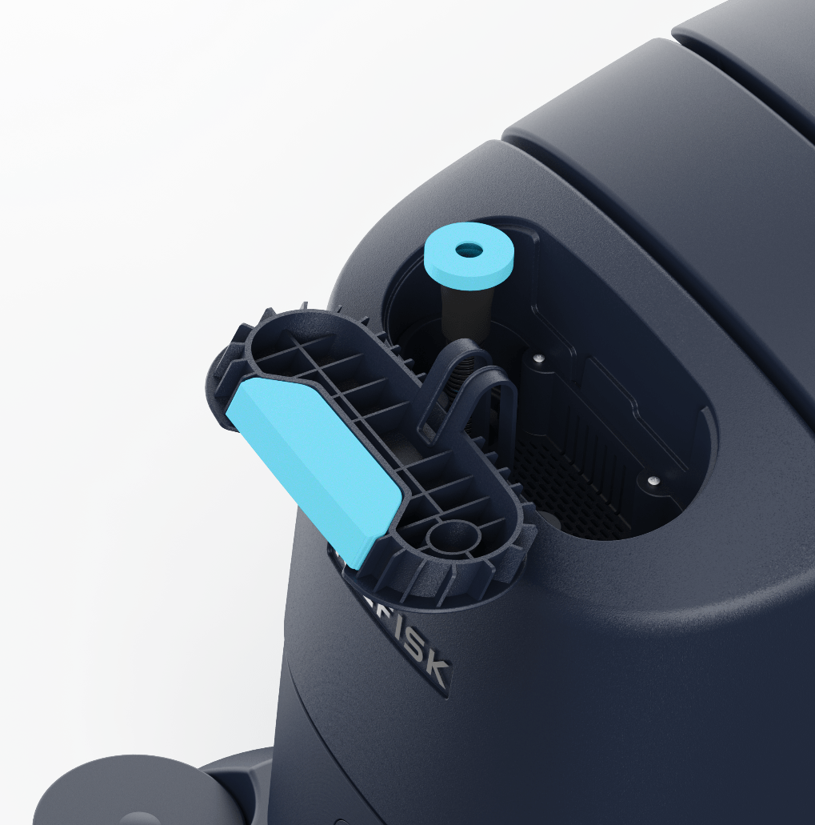
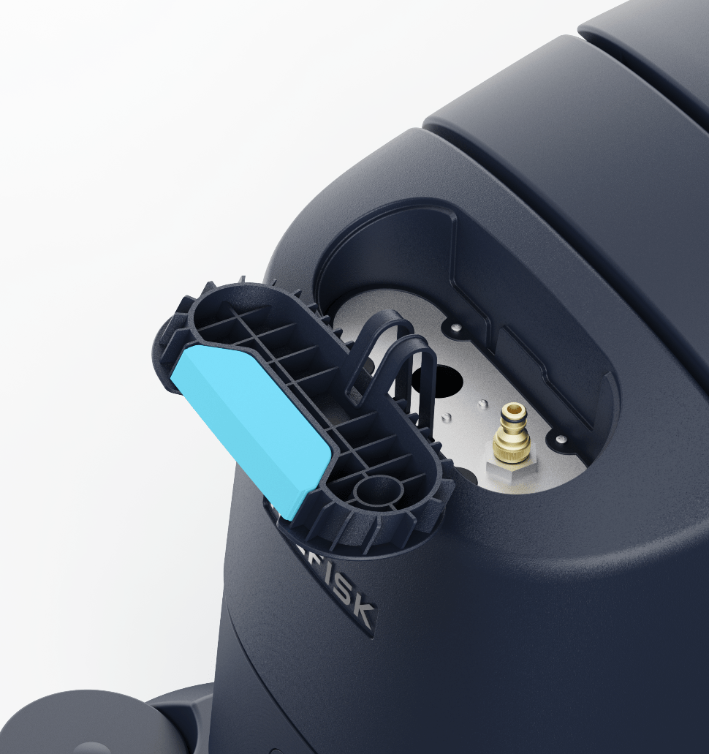
User centred features
SC550 Final Design
Front fill extension hose.
Auto fill hose attachment.

Slide 17

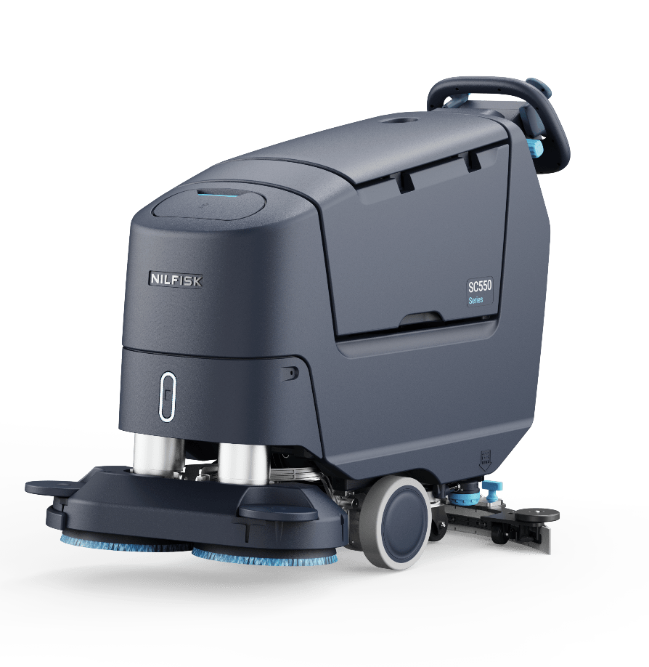
Informative touch points
Antimicrobial for operator safety & highlighted areas to interact with.

Slide 18
Optimised user interface
SC550
7” high quality screen.
Keypad entry to recognise users and avoid loss of fob or key.
Supervisor programmable presets.
Designed for different user skill levels.
Intuitive dial and tactile membrane.
Antimicrobial membrane for user safety.
Hidden until in use on screen controls for simplified use across different variants.
One handed speed limiter control.
Tactile cleaning boost button.

Slide 19
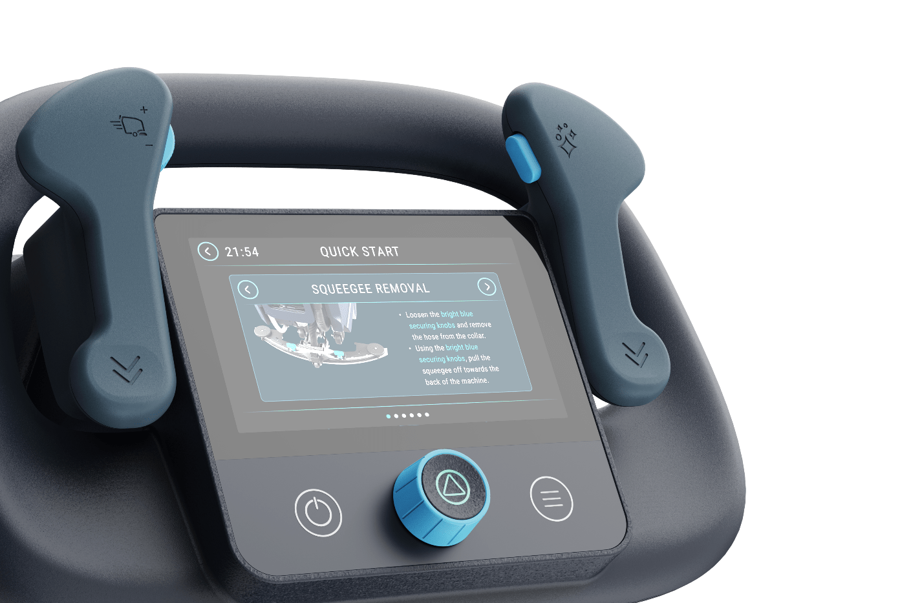
On board help
SC550
On board help
Step by step help guides. QR code to scan and watch video content.

Slide 20

Front light feature
SC550 Final Design
A safety feature to show the presents of the machine in a space (it does not need to function as a ‘headlight’)
A representation of the brand, as it is a shape which is part of the brand DNA.
A way to see status of the machine (battery level, tank fill level, safety lighting)
A way to differentiate between mid-market and premium variants
Allow for components of future technologies.

Slide 21





Front light feature - Advanced
SC550 Final Design
General use
Charging
Filling level
Machine error
maintenance needed
21
PLAY VIDEOS ABOVE

Slide 22

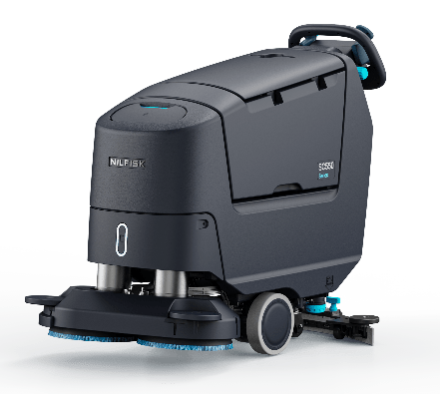
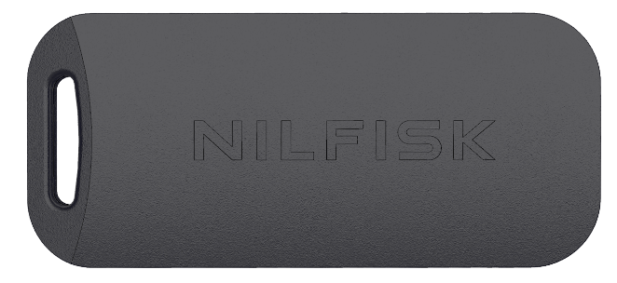

Access control – NFC key entry
Optional extra
Quick keyless access
No need to keep key on machine. Compact comfortable form to be kept in pocket.

Slide 23


