Slide 1
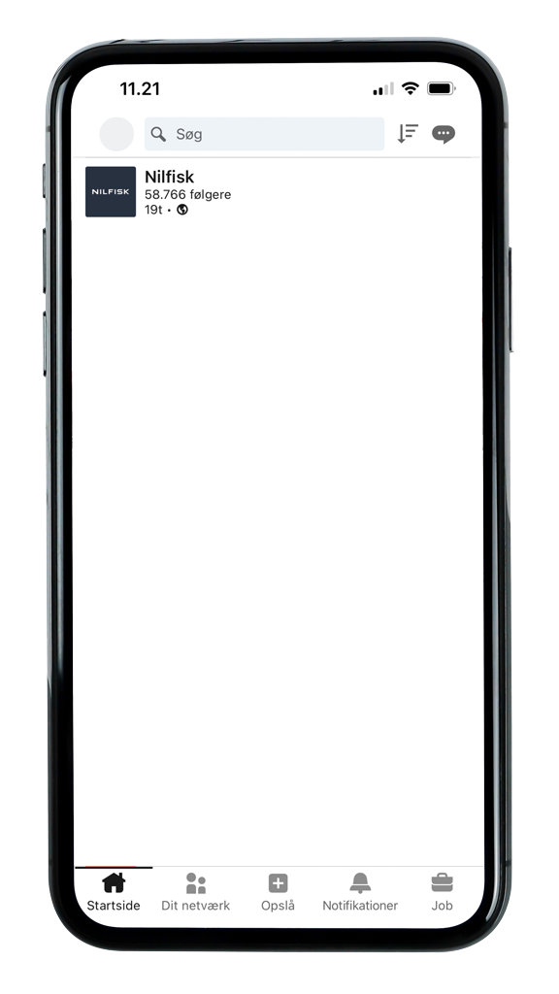
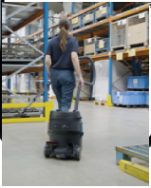
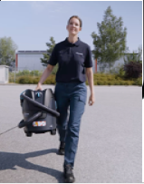
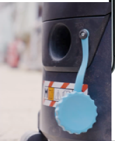
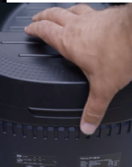
Dealer Package / 8 x Organic SoMe - LinkedIn
Format: 1080 x 1350
🔋 A new formula for freedom Introducing the Nilfisk AERO Battery Vacuum range — built for fast, efficient cleaning and powered to last. 💪
✅ Wet or dry ✅ Quick or tough ✅ No cords. No limits. Just nonstop performance.
Ready to clean without compromise? 👉 Contact us to learn more.
⚡ Free to move. Power to finish
Meet the all-new Nilfisk AERO Battery Vacuum range – engineered for speed, strength, and simplicity. 👌
From wet to dry, quick to tough – tackle any mess, anywhere with powerful cordless performance. No hassle. Just clean.
👉 Contact us to learn how the AERO Battery can power your cleaning.
🔋 No plug, just play
The new Nilfisk AERO Battery Vacuum range is built for seamless, all-battery-powered operation — delivering reliable, uninterrupted performance, wet or dry. ✨
With easy maintenance and Bluetooth support, you can boost productivity and cut downtime.
👉 Contact us to power up your cleaning.
⚡ Lose the cord. Keep the power
The new Nilfisk AERO Battery Vacuum range gives you the freedom to clean anywhere and tackle any task with powerful, battery-powered performance.
💨 Strong suction clears dust and debris — wet or dry — in no time. ✅ Push Clean technology keeps performance consistent and downtime low.
👉 Contact us to discover cordless cleaning that keeps up.
https://nilfisk.23video.com/secret/117527475/f17687f54d1aaf4d15a5832ed3ba487e
https://nilfisk.23video.com/secret/117527485/925850ae64672c21cf57ccb385c618d1
https://nilfisk.23video.com/secret/117527496/3e872f30636e15bbe44e2fdf07443520
https://nilfisk.23video.com/secret/117527495/283261038433a2cc091db37896292738

Slide 2
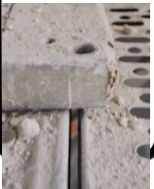
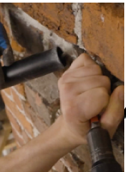
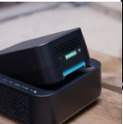
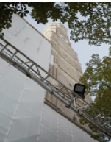
Dealer Package / 8 x Organic SoMe - LinkedIn
Format: 1080 x 1350
🫡 A yes-can-do attitude Meet the all-battery Nilfisk AERO Vacuum — built tough to power through any challenge. Test its durability, runtime, and performance anytime. It won’t back down. ⚡️
CTA / 👉 Take your cleaning to the next level — get in touch
👂 Inspired by you, built for performance All-battery Nilfisk AERO Vacuums are light, powerful, and cord-free for safer, easier cleaning. Top airflow, pro-grade filtration, and low noise keep you efficient and focused.
CTA / 👉 Ready to experience cordless cleaning without compromise?
Contact us today.
💪 Power. Toughness. Freedom. Nilfisk AERO Battery Vacuums deliver fast, efficient cleaning—wet or dry—with long-lasting battery power. Lightweight yet tough, they're built for comfort, durability, and all-day performance.
CTA / 👉 Experience the power of cordless cleaning — contact us today.
🔥 Unplugged. Unstoppable. Looking for durability that delivers? Meet the new Nilfisk AERO Battery Vacuum — 100% battery-powered, built for tough environments.
💨 High-performance suction 🛠️ Rugged, low-maintenance design 🔋 Proven endurance in real-world testing
CTA / Contact us to take your cleaning to the next level
https://nilfisk.23video.com/secret/117527486/09081653800f0d437daade263723fccd
https://nilfisk.23video.com/secret/117527509/0f6e73d60be6469df270e3a8c9dc5337
https://nilfisk.23video.com/secret/117527507/00174a752a2c6e6254e31275ddafe943
https://nilfisk.23video.com/secret/117527508/4478361b9a33daa6705afe559d48f8bf

