Slide 1

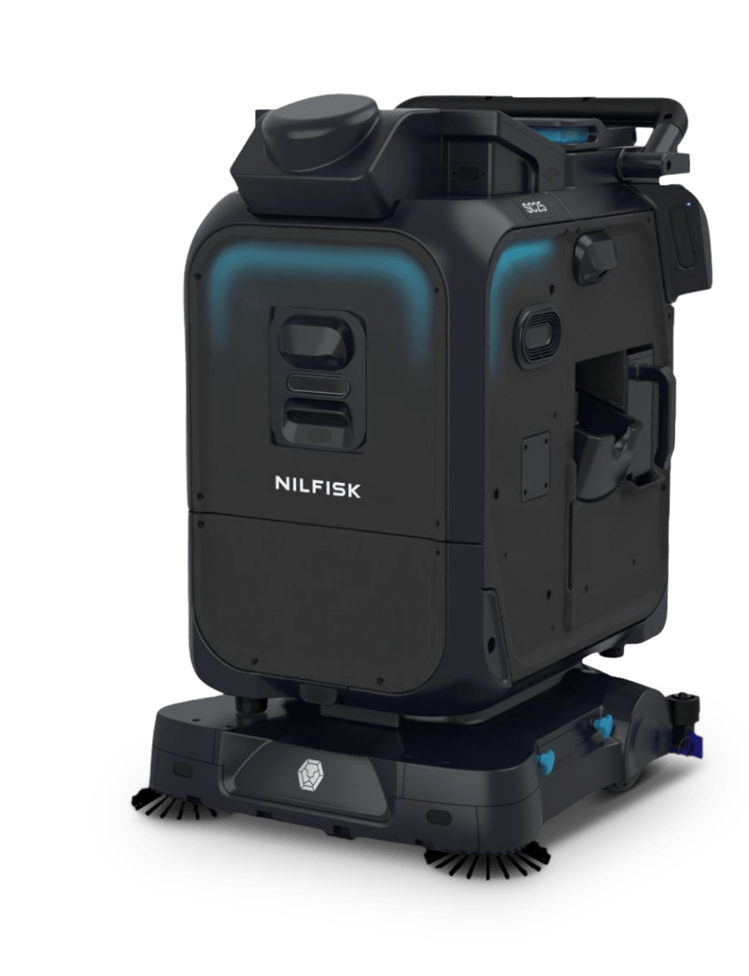
Introducing
SC25

Slide 2
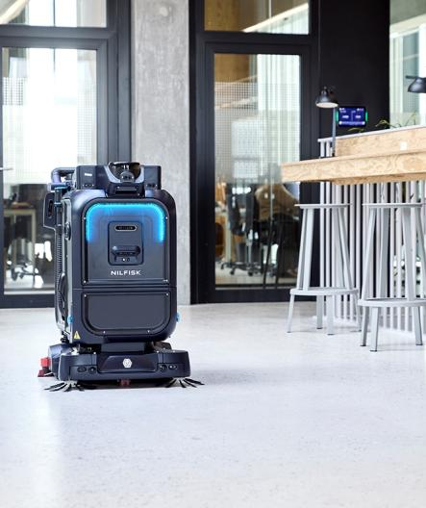
Agenda
1
Introducing SC25
2
Target Customers and applications
3
Key features and benefits
4
Head to Head – Nilfisk vs Lionsbot
5
ROI for the SC25
6
Proof of Clean / Data management
7
Next steps

Slide 3
1
Why SC25?
Smart, compact cleaning.
Reliable, resourceful cleaning at the push of a button.

Slide 4
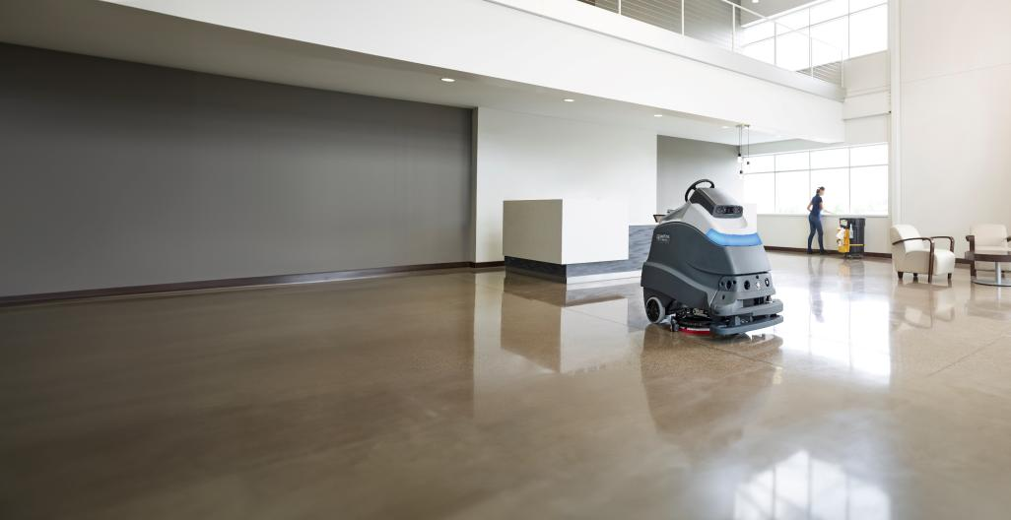
The future of clean: Robotics

Slide 5
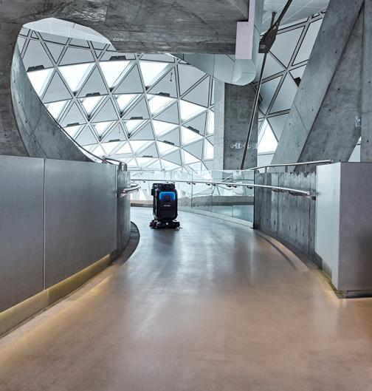





Maintaining high standards of cleanliness: daily obstacles
Labor shortages
Tight scheduling
Costs
Presentation and hygiene standards
Inconsistency

Slide 6
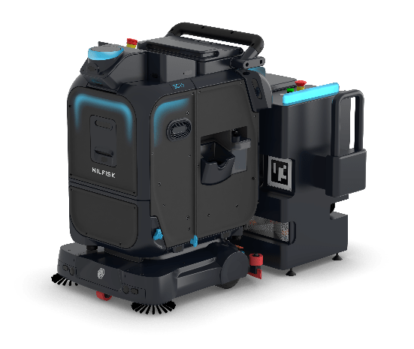
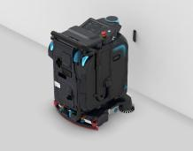
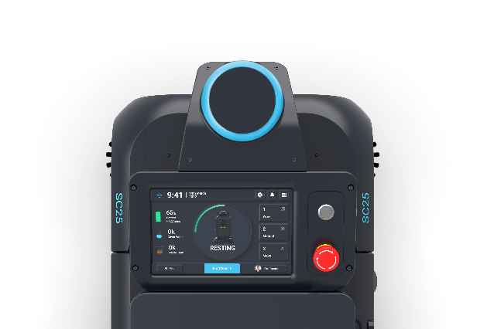
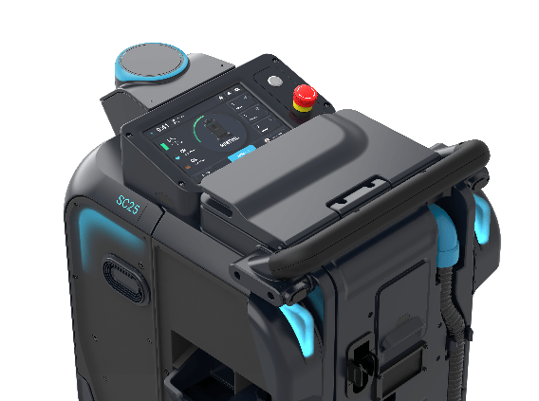
SC25: The solution to your everyday constraints
1. Consistency and reliability
Consistency and precise performance every time helping to increase hygiene and the presentation of your environments
2. People and safety
Cleaning at the highest safety standards with state-of-the-art autonomous technology
3. Maximise your productivity
A productive colleague for the daily cleaning. Reorganise your labour on what matters the most helping you to save on costs
4. Unparalleled ease
of use
Multiple intuitive operation modes for all the cleaning needs at the highest safety standards

Slide 7
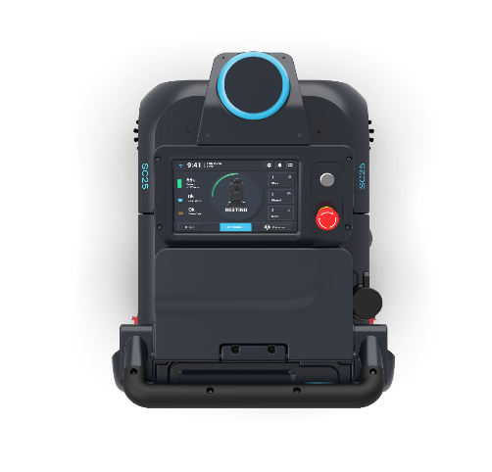
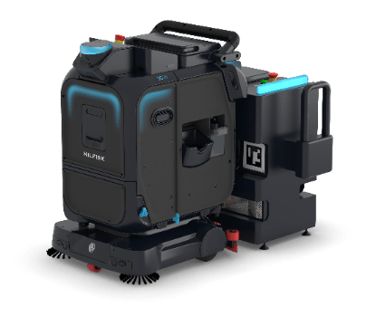

1. Consistency and reliability
Nilfisk cleaning performance
Outstanding scrubbing and drying performance with a standard polypropylene cylindrical brush for light sweeping technology which picks up even the small debris
Detergent dosing system, which tackles even the dirtier areas and elevates the machines’ cleaning performance
Autonomous technology
State of the art autonomous technology guaranteeing close to 100% coverage of the cleaning plan with the same performance every day
Proof of cleaning through the cleaning reports via mobile and web app
Compact design
Get high productivity by filling and covering even tighter areas in less time with a zero-degree turn ability

Slide 8
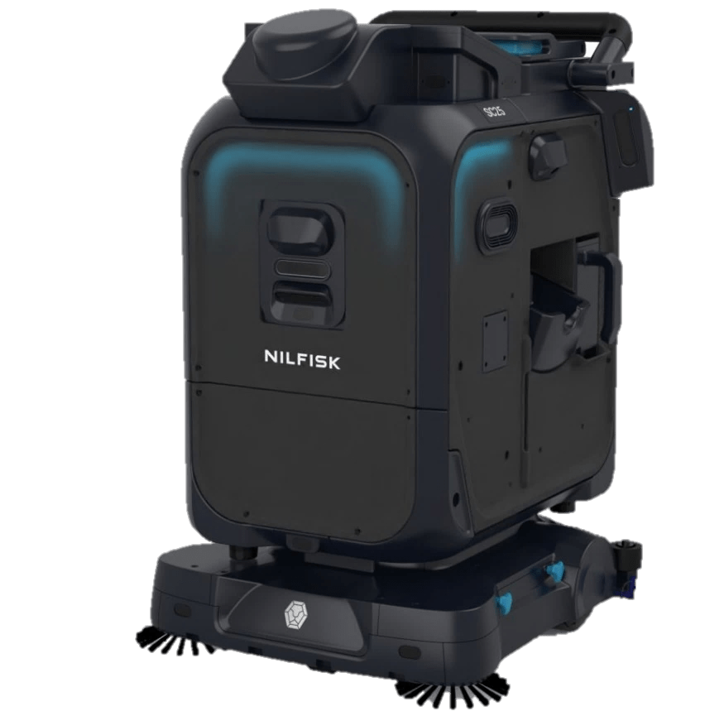
2. People and safety
One of the only 3rd party certified safe autonomous cleaning machine on the market
Nilfisk SC25 bears the cETLus mark and has been 3rd party certified against the CSA/ANSI C22.2 No. 336-17 robotic safety standard by Intertek
Only independent and recognised test laboratories can certify products against industry standards
Intelligent programming allows the machine to carefully operate around people during open hours

Slide 9
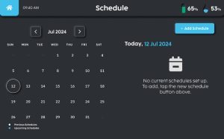
3. Maximised efficiency and productivity
Cleaning schedules
Schedule cleaning plans on the machine’s UI to enable an automatic start of the cleaning operations
Optional docking station
The docking station is charging, dumping dirty water and refilling with fresh water automatically, in order to fully automatise the cleaning operations
Compact design
Get high productivity by filling and covering even tighter areas in less time with a zero-degree turnability

Slide 10
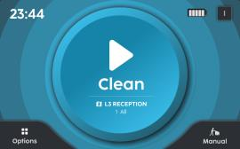

4. Unparalleled ease of use
Battery
More menu
Fast start – intuitive interface gets you up and running quickly and ensures even first-time users become proficient in minimal time
Large 10-inch touch screen displays easy-to-understand controls and step-by-step guidance
Simple icon-based user interface
Get instructions and improvement tips with on-screen tutorial videos
Just press play and clean all your spaces
Options: More operational features for robot
Manual: Used for manual cleaning

Slide 11
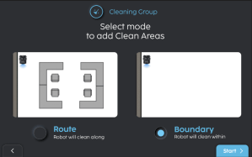
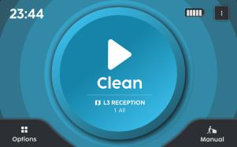
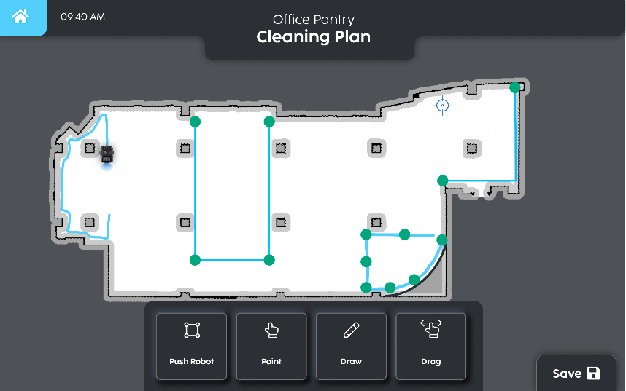
Ease of use and versatility
Cleaning plan modes
Autonomous cleaning modes
Route (CopyCat)
With a single manual ride, the machine precisely learns exactly how you want to clean
CopyCat is designed to clean the way you clean
Boundary (Fill in)
The operator drives once around the perimeter of the area to be cleaned, and the SC25 cleans every inch
in the middle
Drive the perimeter of the area you want to clean, any shape you need
Manual cleaning mode
The operator uses the machine like any other walk behind scrubber-drier for ad-hoc jobs
Remote mode (only for Nilfisk specialists)
Map editor
Create a map of a location via a laptop in few simple clicks via the proprietary map editor
Adjustment to the map made remotely

Slide 12
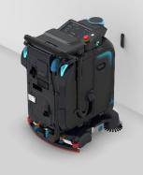


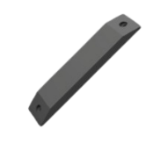
Ease of use and versatility
Magic mode – 3 simple steps to the robotic cleaning
Step 1
Place the machine in front of the magic tag at 20-30 cm and scan it
(7-10 inches)
Magic tag – attached to a vertical surface, serves as a home point and stores several cleaning plans
Step 2
If the map has multiple cleaning plans
(sections), user can click on the edit
icon and choose the desired section
Step 3
Just press “Clean”

Slide 13
2
Primary application and use

Slide 14
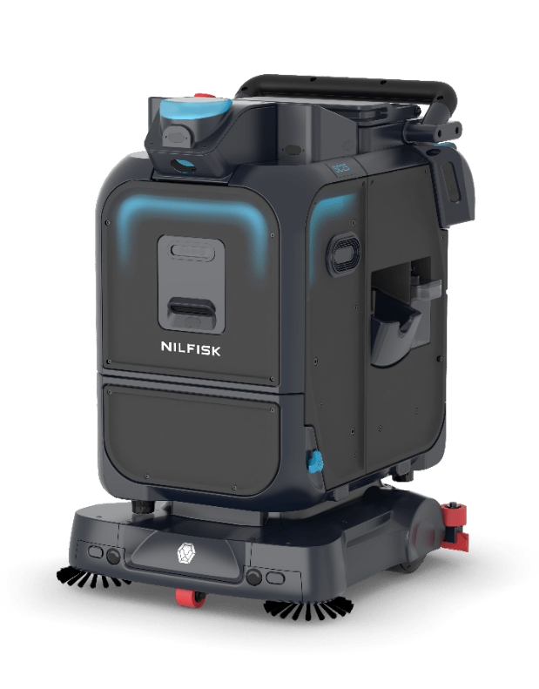


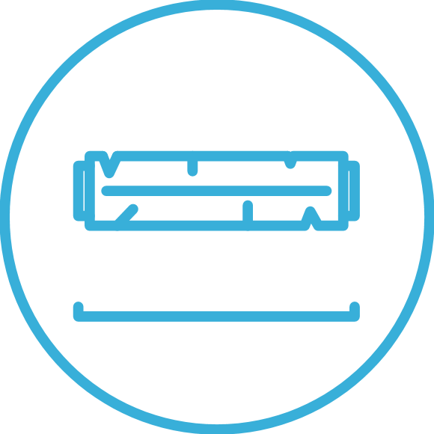

Primary application & use
SC25
Nilfisk is introducing a small autonomous scrubber – SC25:
Up to 3 h
running time
22L Solution /25L Recovery
tank capacity
36.6 cm
cylindrical
Li-ion
battery
Main customer segments:
Primary: Retail, Healthcare, Offices
Secondary: Education
Main Jobs to be done/Applications:
  Cleaning of facilities around 500 – 2000 sqm
  Daily cleaning up to 3h a day
  Small supermarkets, office spaces, clinics, mid sized schools…
  Various hard floors: tiles, concrete, stone, plastic, epoxy, etc..
  Type of dirt: general dirt, grease, spills of liquids, etc..

Slide 15




Target applications
SC25 scrubber primary applications
 | Retail (Primary target) | Offices | Education | Healthcare
Type | Small/medium supermarkets Small/Medium sized retail shops | Mid sized hard floored offices spaces | Small to mid sized schools Kindergartens | Clinics Medium sized hospitals
Size | From 600 (6500) to 1500 (16000) m² (ft²) | Up to 3000 (32000) m² (ft²) | Up to 5000 (54000) m² (ft²) | Up to 5000 (54000) m² (ft²)
Cleaning areas | Shop floor – meat/fish and vegetable areas Aisles Mid open areas in entrance (no cashiers) Back of the store | Hard floored desk areas Hallways Receptions halls | Hallways Canteens Meeting rooms | Hallways Reception/Lobbies Canteens Basements
JTBD | Scrubbing hard floors Light sweeping (small debris, dust) Edge cleaning | Scrubbing hard floors Light sweeping (small debris, dust) Edge cleaning | Scrubbing hard floors Light sweeping (small debris, dust) Edge cleaning | Scrubbing hard floors Light sweeping (small debris, dust) Edge cleaning

Slide 16
3
Key features and benefits

Slide 17
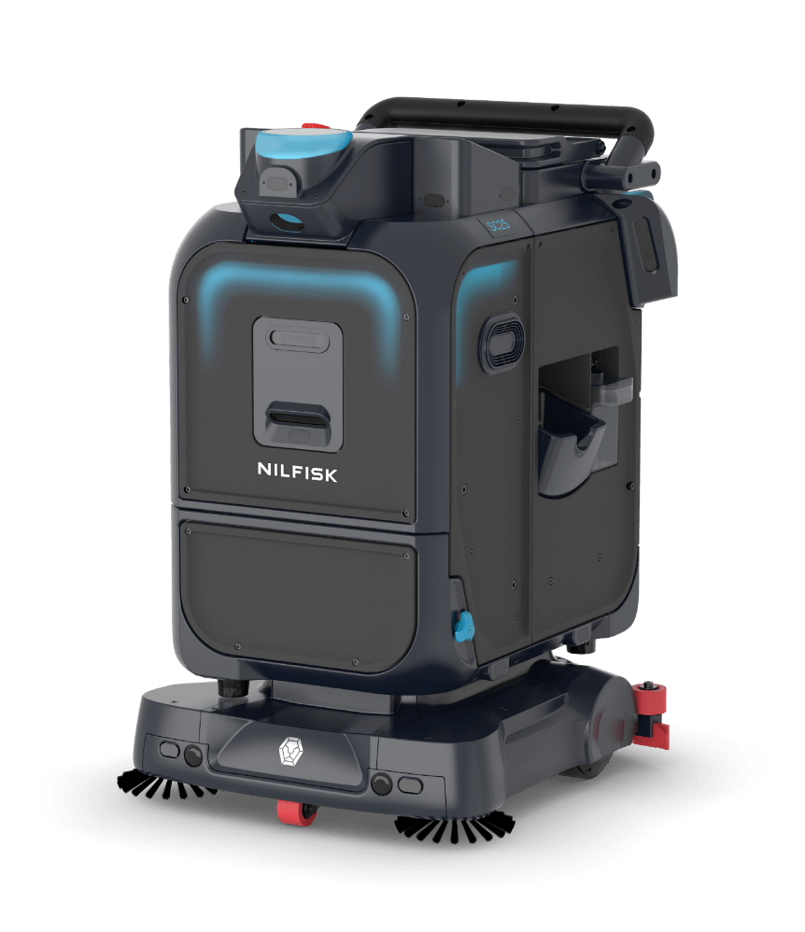


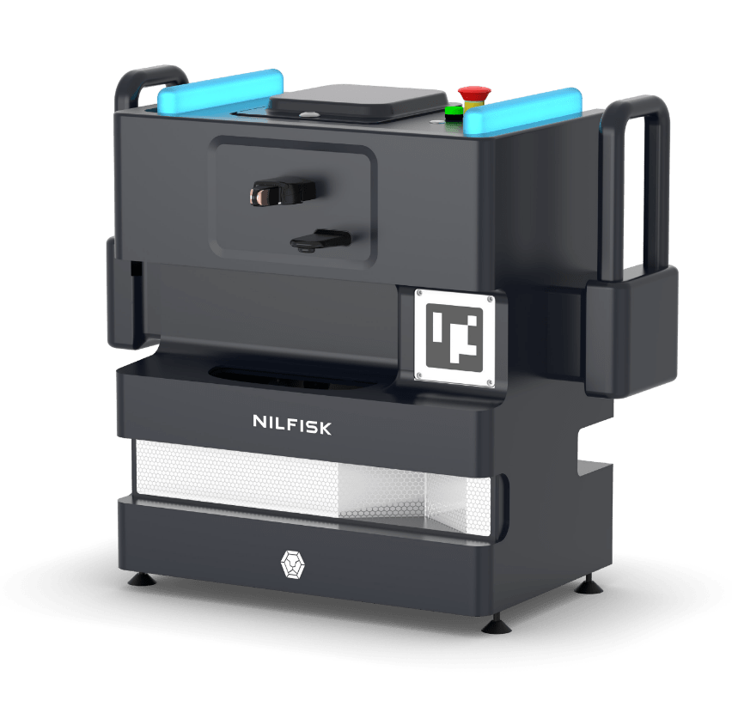




SC25
Product summary SC25
Key Specs*
22 L
solution tank
Up to 3 h
running time
Docking station
1.5 – 3 h
Cleaning time
911 mm
Up to 1500 m²
per charge
Up to 8 kg
brush pressure
654 mm
(w side brushes)
722 mm
Up to 3 h
Max charging time
* Specs to be confirmed, rendering of the final design.

Slide 18

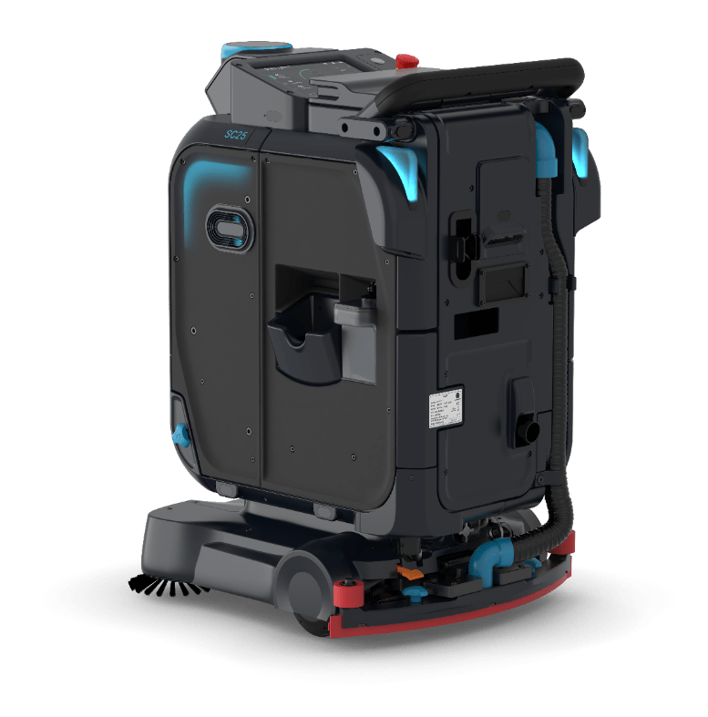
SC25
Main components
Touch screen
Side water inlet
Chemical tank
Front cameras* and drop offs for obstacle avoidance
Diagonal 2D lidars placement – 360° field of view
15 premium grade ultrasonic of 0.9 m range
Side cameras for coverage during turns
Optional 3D lidar housing
8
1
6
7
6
4
3
6
2
5
6
5
6
6
6
* One extra depth camera present in the front - not available in the picture

Slide 19
Key features & benefits
More on SC25 features
Intuitive design & simple operations
Intuitive touchscreen User Interface with pin code operation, simple and fast autonomous mode operation with only 3 steps and all main cleaning functions controlled from operator’s position
Everything at a fingertip all operations can also be controlled via app, web or a remote command center
Comfortable driving position easy to use for spot manual cleaning operations
Productive and efficient
Zero-degree turn improve productivity and navigation even in the tightest areas
Brush motor RPM control reduces energy consumption in lighter cleaning applications and increase productivity and runtime
Adjustable solution-flow levels where solution level is synced with the speed of the machine giving a constant flow per m²
Reliable and easy to maintain
IEC certification compliant, meet the latest safety regulatory standard for North American and Europe
Designed to be easy. The intuitive coloured
touch points allow for fast daily maintenance of
the product
Optional docking station to improve productivity, which is available for hands free refilling and emptying water operations

Slide 20
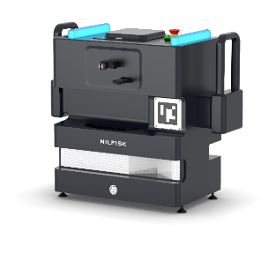



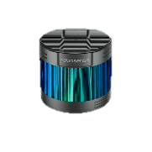

Accessories
SC25 accessory options
Docking station
Refilling/emptying
Charging
3D lidar
Mandatory equipment for navigating in dynamic/complex environments (e.g. Retail) and large open areas (>25 m wide)
Optional brushes
Nylon-Carbide (For heavy scrubbing e.g. factories, warehouse)
Soft bristles (For delicate floors e.g. marble, wood)
Microfiber (For polishing smooth surfaces)

Slide 21
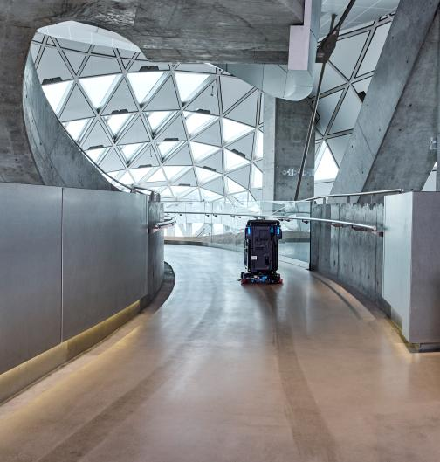
SC25
Key competitive advantages
IEC certification – complying to the latest regulation for robotic in EU/North America
Nilfisk service organisation
Nilfisk portfolio offering, bundling SC25 with multiple solutions
Higher productivity due to the zero degree turn ability – faster during U turns
Nilfisk touch on the cleaning performance
Modular design – easier accessibility

Slide 22
4
Head to head with Lionsbot R3

Slide 23
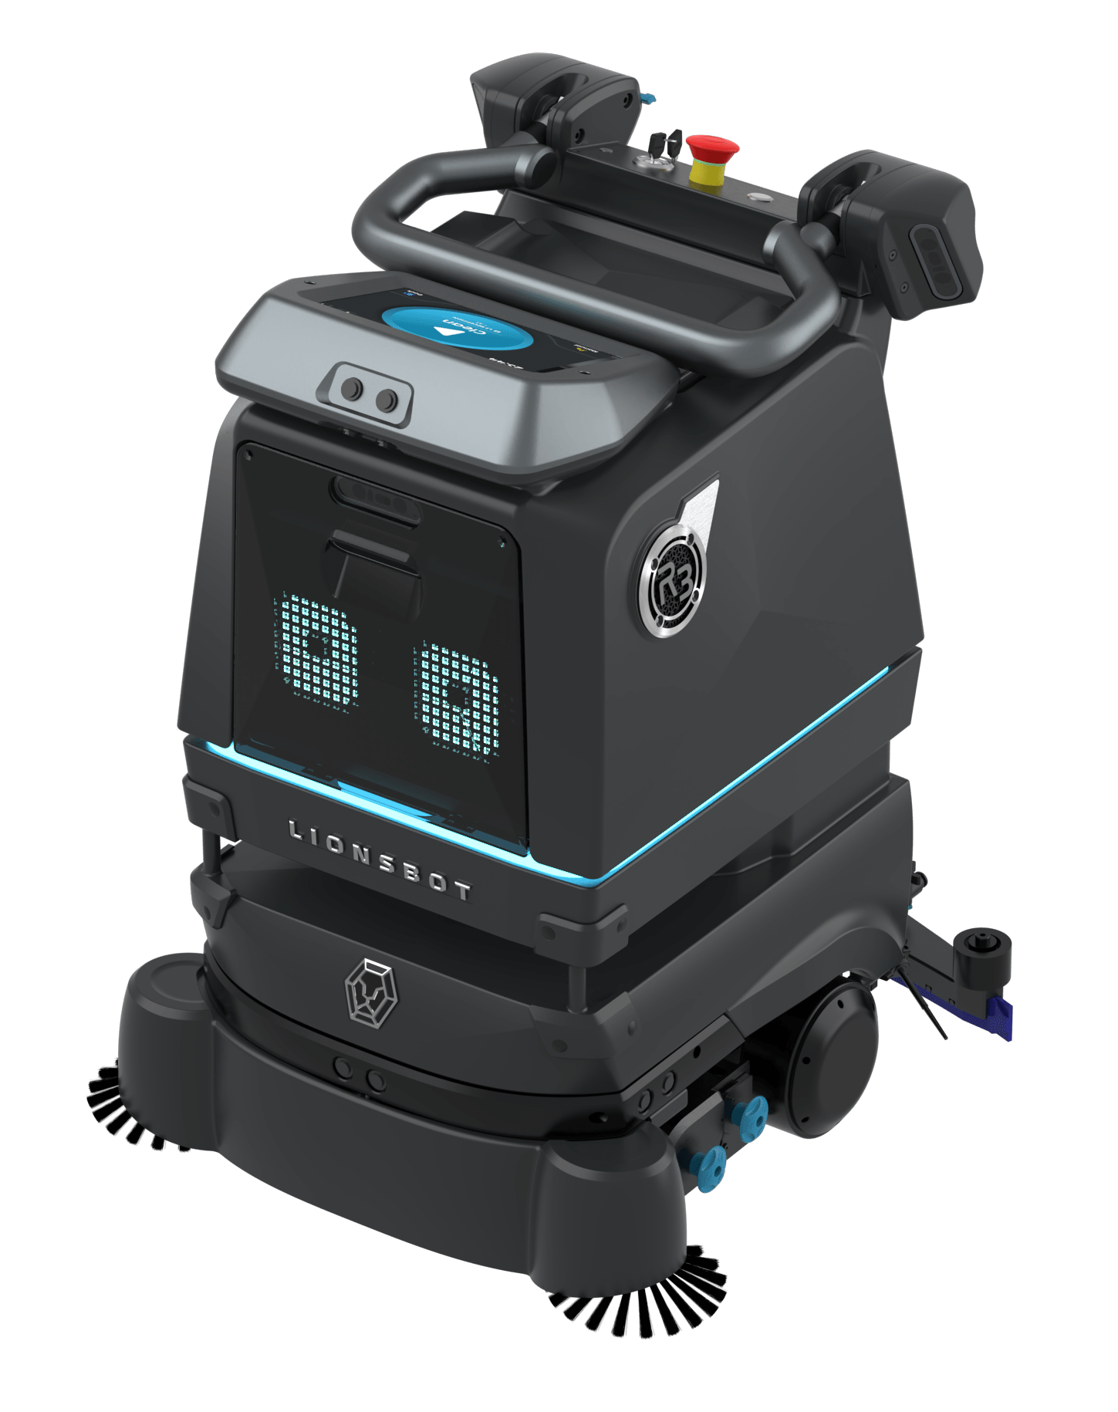

R3 vs SC25
Main differences
Items |  | R3 PRO | SC25
Solution tank | L | 21 | 22
Dimensions | mm | 600 x 540 x 810 | 722 x 654 x 911
Operating level | Db(a) | 70 | 64
Detergent tank |  |  | 
Solution flow |  |  | Optimised with better solution distribution and new std solution levels
Lidar coverage |  | 25 m (radius) 270° field of view | 25 m (radius), 360° field of view (diagonally placed)
Turning radius |  |  | improved with zero-degree turn ability for tighter areas
Manual override breaks |  |  – only electromagnetic breaks |  – manual additionally
IEC robotics std. |  |  | 
Design |  |  | Improved serviceability with modular design and future-proof feature enhancements Fixed handle with improved grip and design at optimal height Battery compartment at front Positioning of freshwater inlet Further improved sensors positioning in respect to certifications and for better autonomous navigation
Cleaning deck |  |  | Improved deck system – for better pick up and scrubbing performances
Brush RPM | Brush RPM | Std between 200-400 | Up to 1200

Slide 24
5
ROI

Slide 25
Improve your ROI
SC25 – Example of TCO 5y
TCO 5Y | Traditional | SC25 | Difference
Machine cost | 4,500.00 € | 30,000.00 € | (25,000.00) €
Manual labour* | 41,632.32 € | 6,244.85 € | 35,387.47 €
Service | 10,000.00 € | 15,000.00 € | (5,000.00) €
Tot | 56,132.32 € | 51,244.85 €
Savings |  |  | 4,887.47 €
Extra values SC25
Cleaning consistency
Employee freed up for almost 1 h of business-related matters
Floor cleaning maintenance quality improved
Cascading and less resources needed for stores' cleaning tasks
*Estimated an avg 25€/h (fully loaded)

Slide 26
6
Proof of clean / Data management

Slide 27
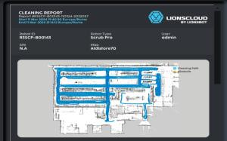

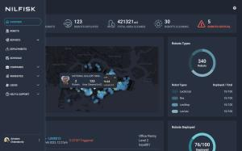
Reporting validates cleanliness and provides data so you can make actionable decisions
Cleaning reports
Cleaning job reports
Includes detailed statistics of how the robot performed for a cleaning plan
Robot monthly report
Summary of how the robot performed during the entire month
Mobile app
All the data available on a user-friendly mobile app
Web app
Possibility to monitor individual robot remotely
Generating reports of cleaning activity
Guided flow to deploy a robot for cleaning
Contractor or end customers

Slide 28
7
Next steps

Slide 29
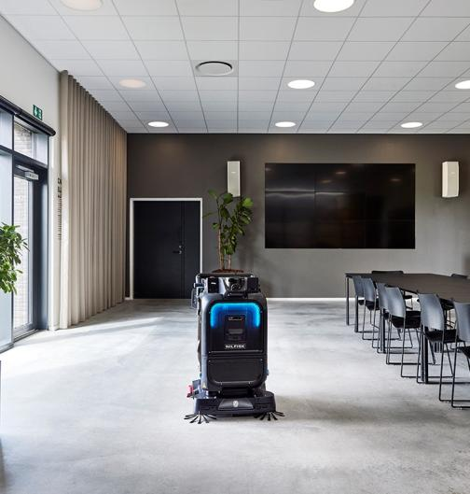




Next step
Contact us
Schedule a site survey
Virtual presentation
Demonstration

Slide 30


